Slide 1


US Foreign Account Tax Compliance Act
FATCA – Like it or not, it’s here….
ICAC
Caribbean Accountants Conference
Lawrence Lewis
June 23, 2012

Slide 2
Today’s Agenda
Background
Draft regulations
Implementation considerations
Questions

Slide 3
Background

Slide 4

What is FATCA?
Whilst FATCA is technically voluntary, FS institutions who ignore it will find themselves frozen out of the global FS market.
Non compliance is generally ‘not’ an option as this could result in significant commercial, reputational and financial damage.
IRS concern
US persons escape their US tax obligations by holding assets through non-US structures and products
IRS response
Non-US financial institutions designated Foreign Financial Institutions, or “FFIs” The default position is that FFIs will suffer 30% withholding on all income & sales proceeds from US sourced income Alternatively, FFIs can enter an agreement with the IRS and become “participating FFIs”
Implications of non-compliance
Financial, commercial and reputational risks May be forced to comply even where no US sourced payments exist as many third parties are likely to require you to be FATCA compliant for practical business reasons
US owner
Bank account
Trust
IFA / wealth manager
Platform
Broker
Fund
Insurance product
Foreign Financial Institutions
Custodian
Income & sales proceeds
US assets

Slide 5
FATCA Overview
In Summary
    On February 8, 2012, the U.S. Treasury and IRS released the proposed regulations for the Foreign Account Tax Compliance Act (FATCA)
    Goal is to ensure U.S. persons with financial assets outside the U.S. are paying U.S. tax
    U.S. Financial Institutions will have to withhold 30% on U.S. sourced payments to foreign institutions/entities that do not comply – includes gross proceeds
Who Needs to Comply?
U.S. Withholding Agents
U.S. entity that has control, receipt, custody disposal or payment of any withholdable payment
Foreign Financial Institutions (FFIs)
Non-U.S. entity that accepts deposits, holds financial assets for the account of others as a substantial part of its business, or engages primarily in the business of investing or trading securities, commodities, partnerships or any interests in such positions.
Non Financial Foreign Entities (NFFEs)
Includes any foreign entity that is not a FFI or is not one of the following specifically EXCEPTED entities:
    Any publicly traded corporation and its corporate affiliates (more than 50% of vote and value)
    Any entity organized under the laws of a possession of the U.S.
    Any foreign government, or any wholly owned agency of
    Any international organization or any wholly owned agency or instrumentality of such
    Any foreign central bank (unless acting as intermediary for clients)
    Any other class of persons identified by the Secretary as posing a low risk of tax evasion
U.S. Individuals
U.S. Citizens, U.S. residents (e.g., Green card holder) and nonresident aliens who meet the substantial presence test

Slide 6
How have we gotten here?
2010 |  | 2011 |  | 2012 | 2013 |  | 2014
HIRE Act passed | Notice 2010-60 | Notice 2011-34 | Notice 2011-53 |  | FATCA effective date | FFI Agreement | FFI withholding phase-in begins
March 18, 2010
FATCA provisions passed into law under HIRE Act.
May 9, 2011*
Additional and amended guidance on documentation of pre-existing accounts, pass-thru payments and reporting requirements.
Date certification by FFI Responsible Officer relates back to.
Released 4-8-2011
August 8, 2011*
Transitional relief for FATCA withholding on payments to FFIs.
Released 7-14-2011
January 1, 2013
Effective date of FATCA legislation.
January 1, 2014
FATCA withholding on payments to FFIs and NFFEs begins on Withholdable Payments of FDAP.
July 1, 2013
FFI Agreements executed prior to 6-30-2013 will have a 7-1-2013 effective date and will be ensured to have the assigned FFI number published in time to prevent FATCA FFI withholding on 1-1-2014 (unless otherwise elected).
September 13, 2010*
IRS initial guidance describing the requirements to become a participating FFI, including documentation due diligence procedures and reporting requirements.
Released 8-27-2010
February 8, 2012
Proposed FATCA regulations. Draft FFI Agreement and certain other matters outstanding.
January 1, 2015 and beyond
FATCA withholding on payments to FFIs and NFFEs: Withholdable Payments of FDAP and gross proceeds.
Pass-thru Payments will become subject to FATCA withholding.
Summer 2012
Expected – Final FATCA regulations.
Early 2013
Expected – FFI Agreements ready to be executed in early 2013.
* Indicates date of official publication in the Internal Revenue Bulletin.
Notes:
FDAP items include dividends, interest, royalties, etc
Fixed, Determinable, Annual, or Periodical (FDAP) income is all income, except:
Gains derived from the sale of real or personal property (including market discount and option premiums, but not including original issue discount)
Items of income excluded from gross income, without regard to the U.S. or foreign status of the owner of the income, such as tax-exempt municipal bond interest and qualified scholarship income
Income is fixed when it is paid in amounts known ahead of time. Income is determinable whenever there is a basis for figuring the amount to be paid. Income can be periodic if it is paid from time to time. It does not have to be paid annually or at regular intervals. Income can be determinable or periodic, even if the length of time during which the payments are made is increased or decreased.

Slide 7
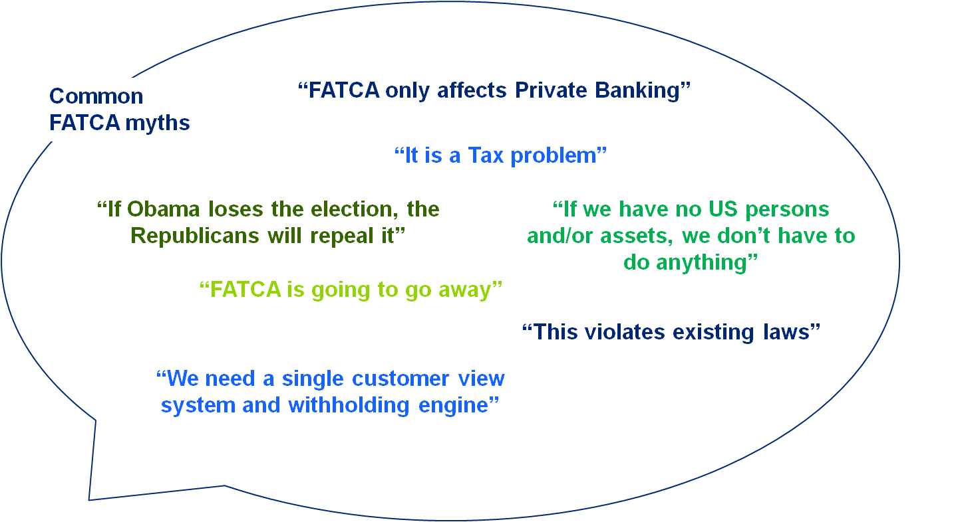
Can We Believe Everything We Hear?

Slide 8
Draft regulations

Slide 9
Overview of changes in the draft regulations
Preexisting account population requiring due diligence limited from prior notice guidance:
  Preexisting individual account document review limited to accounts with over US$1M balances
  Document search on high net worth accounts more defined (e.g., current customer master file documents as opposed to “all available documents”).
  Preexisting entity accounts having balances under $250K are exempt from review
  Due diligence on preexisting accounts for FFIs
Accounts on boarded after the FFI agreement subject to current onboarding procedures used under AML/KYC except to the extent U.S. indicia are identified.
  If U.S. indicia are determined as a part of the AML/KYC review, additional documentation must be collected
  Certain entity accounts exempt from documenting substantial U.S. owners
  Client onboarding for FFIs
  Withholding
Short-term OID and ordinary course of business payments are excluded
Grandfathering is extended
Withholding phased in gradually between 2014 and 2017

Slide 10
Overview of changes in the draft regulations (continued)
Similar to withholding, reporting will be phased in gradually between 2014 and 2017
Other highlights
  Reporting of payments made to non-participating FFIs and recalcitrant accounts
  Reporting does not need to be performed in U.S. currency
  Starting 2015, reporting is generally required to be filed on March 31
  Reporting
  Expanded deemed-compliant categories
  Registered: Must certify it meets requirements every 3 years to IRS and inform of any changes
  Certified: Certifies it meets requirements on Form W-8 to withholding agents
  Deemed Compliant Foreign Entities
Other considerations of the proposed regulations concern:
  Definition of financial accounts for FFIs
  Affiliated group two-year transition for FFIs
  Compliance verification for FFIs
  Miscellaneous

Slide 11
Proposed regulations extended deadlines, while maintaining significant 2013 milestones that require immediate mobilization
FATCA Compliance Action Items | 2012 | 2013 | 2014 | 2015 | 2016 | 2017
Grandfathered obligations cutoff
U.S. withholding agents begin new customer onboarding & remediation
Submit FATCA application to IRS
FFIs begin new customer onboarding
FFIs begin remediation for existing customers meeting FATCA criteria
Begin income withholding
Begin account and balance reporting
Begin gross proceeds withholding
Application due for FFI affiliated group requirement compliance
Begin income reporting
Begin foreign passthru payments withholding
Begin gross proceeds reporting
Mar 18
Jan 1
Jan 1
Jun30
Jul 1
Jul 1
Jan 1
Sep 30
Jan 1
Jul 1
Jan 1
Sep 1
Mar 31
Jan 1
Jan 1
Sep 1
Mar 31
Program Management
Onboarding
Withholding
Reporting
Old date
New date
Unchanged
Notes:
Begin grandfathered obligations:
the proposed regulations would extend several “grandfathering” periods, would expand the universe of entities that are not subject to the regime or are subject to materially reduced burdens, and would streamline the compliance process for “participating” foreign financial institutions in a variety of ways.
Submit FATCA application to IRS:(Pg. 1 of Questions answered Deck)
Despite these concessions businesses should not sit back: given that foreign financial institutions (FFIs) will want to submit their FATCA application to the IRS by 30 June 2013
Begin new customer onboarding:
when the new onboarding process has to go live and any new customer after that date goes thru the new process (with the additional info obtained upfront)
Begin remediation for existing customers meeting FATCA criteria: (pov remediation)
For individual accounts with a value of more than $1 million, participating FFIs must complete required due diligence procedures within one year of their respective FFI agreements’ effective date. For all other accounts, participating FFIs must complete procedures within two years of their respective FFI agreements’ effective date.
Must be complete due diligence on existing accounts within 1 year of the FATCA agreement
Begin income withholding:January 1, 2014: Withholding begins on U.S.-sourced income payments for FDAP payments, including U.S.-sourced interest, dividends, original issue discount, rents, and royalties.
Begin account and balance reporting: (pg 2 POV Reporting)
The filing deadline for reporting on calendar year 2013 is September 30, 2014.
Begin gross proceeds withholding:(FATCA POV-Withholding doc Pg. 2)
January 1, 2015: Withholding expands to include gross proceeds from the sale of property that generates U.S.-sourced interest or dividends as well as income payments.
Deadline for FFI affiliated group requirement compliance: (Pg. 5 of Questions answered Deck)
How are the affiliated group rules impacted?
Each FFI in an expanded affiliated group must agree to be a participating FFI or be deemed compliant.
Due to some country’s jurisdictional law prohibiting compliance with FATCA, a two-year transition period has been created, until 1 January 2016 to fully implement this requirement.
During this period, an FFI affiliate in a jurisdiction that prohibits withholding or reporting as these rules require will not prevent other FFIs in the same group from entering into FFI agreements, as long as the other FFIs agree to perform due diligence to identify U.S. accounts and meet other requirements.
What is the format of the agreement?
The Treasury Department and the IRS intend to publish a draft model FFI agreement in Q1 2012.
A final model FFI agreement is scheduled to be published in the autumn of 2012.
When do I apply and how?
The IRS have proposed that participating FFIs or deemed-compliant FFIs can register online with the IRS before 30 June 2013 to avoid withholding from 1 January 2014.
However, a joint statement released from the US, France, Germany, Italy, Spain and the UK indicates that an approach is potentially envisaged whereby FFIs report to their domestic authorities and governments then share that information with the IRS.
Begin income reporting:(pg 2 POV Reporting)
Starting in 2015 for calendar year 2014, participating FFIs will be required to file reports by March 31.
In 2016, participating FFIs must report U.S. sourced income associated with their U.S. accounts (beginning with calendar year 2015).
In 2017, participating FFIs must report gross proceeds from U.S.-sourced income (starting with calendar year 2016). This will require tracking such information beginning in 2016.
Begin Foreign passthru payments withholding:(FATCA POV-Withholding doc Pg. 2)
January 1, 2017: This is the earliest compliance date to apply withholding on passthru payments (pending further guidance). However, participating FFIs will still have to report on aggregate payments made to non-participating FFIs for calendar years 2015 and 2016.
Begin gross proceeds reporting:(pg 2 POV Reporting)
Starting in 2015 for calendar year 2014, participating FFIs will be required to file reports by March 31.
In 2016, participating FFIs must report U.S. sourced income associated with their U.S. accounts (beginning with calendar year 2015).
In 2017, participating FFIs must report gross proceeds from U.S.-sourced income (starting with calendar year 2016). This will require tracking such information beginning in 2016.

Slide 12
Intergovernmental Approach
This is an ALTERNATIVE to the reporting regime
US Treasury Department released as a joint statement concurrently with draft regulations
Involves France, Germany, Italy, Spain and United Kingdom (FATCA partners)
Reporting is done to the FATCA partner authorities, not to the IRS
Every relevant FATCA partner FFI is required to participate and register with the IRS but will not have to sign an FFI agreement
There is no withholding on FATCA partner FFIs
Allow a reciprocal reporting arrangement of FATCA partner residents with accounts in US

Slide 13
Implementation considerations

Slide 14
FATCA Impacts
Speed to market matters
Opportunity to either gain market share from or lose market share to competitors Rigorous communication and communication strategy will be required for existing clients
Tax provisions will require interpretation
Foreign entities will need to be classified at a much more granular level, besides just FFIs or NFFEs The process for identifying and documenting a foreign entity’s status is still unclear, and there is potential exposure if the determination is incorrect
Operational processes will need to be augmented
Customer Facing: New Account Processing, Account Transfers, Client Reporting Statements, Privacy and AML / KYC Asset Servicing: Corporate Actions Processing, Tax Reporting, Security Master, and Payments inventory & withholding Regulatory Reporting: New annual IRS/U.S. Treasury Reporting
FATCA
Business
Operations
Technology
Compliance
Tax
Compliance will have to be addressed across countries
Compliance with FATCA’s due diligence, verification and annual reporting may result in conflicts with local privacy laws With presence in many countries, institutions need to launch an orchestrated compliance monitoring effort to meet the deadline
Technology investments will need to be made
Potential new systems to continuously track FFI agreements, as well as FFI and NFFE ownership data Existing systems and processes are likely to struggle with the additional data elements, withholding calculations and reporting changes

Slide 15
FATCA Implementation Framework
Identify high impact areas, combine “like” entities to simplify analysis and craft compliance strategy
Design a compliance blueprint that extends existing capabilities and leverages ongoing KYC/AML initiatives
Actively govern the implementation to minimize costs, impact to business operations and risks to customers
1. Assessment
2. Solution Development
3. Implementation
4. Tax Interpretation
FATCA Scoping
  Roadmap Development
  Target Operating Model
  Implementation Planning
  Process Change Implementation
  On-going Compliance
    Gap Analysis
  Business Requirements
  Systems Change Implementation
Compliance Strategy
  Systems Architecture Development
  Existing Customer Remediation
5. Governance, Communications and Program Management
Involve tax experts from assessment through implementation to support the application of FATCA requirements to business operations
Balance central oversight and coordination with local execution of FATCA projects

Slide 16
FATCA challenges faced by organizations
Proper and efficient scoping and legal entity classification
Assessment
Streamline system / process / data gap assessment
Project planning / business strategy
Interpretation of FATCA regulations
Awareness of local laws conflicting with FATCA
Solution development
Customer data aggregation and analytics
Classification of existing clients as per FATCA taxonomy
Communication and remediation of existing account
Implementation
IT strategy and implementation of system and process changes
Implementation
Managing projects which span multiple jurisdictions

Slide 17
Questions

Slide 18
This presentation contains general information only and Deloitte is not, by means of this presentation, rendering accounting, business, financial, investment, legal, tax, or other professional advice or services. This presentation is not a substitute for such professional advice or services, nor should it be used as a basis for any decision or action that may affect your business. Before making any decision or taking any action that may affect your business, you should consult a qualified professional advisor. Deloitte shall not be responsible for any loss sustained by any person who relies on this presentation.

Slide 19
About Deloitte
Deloitte refers to one or more of Deloitte Touche Tohmatsu Limited, a UK private company limited by guarantee, and its network of member firms, each of which is a legally separate and independent entity. Please see www.deloitte.com/about for a detailed description of the legal structure of Deloitte Touche Tohmatsu Limited and its member firms. Certain services may not be available to attest clients under the rules and regulations of public accounting.

