Slide 1
IAMGOLD/Rosebel Gold Mines N.V.
32nd ICAC Conference 2014
Remon van de Paal
Controller Rosebel Gold Mines N.V.
June 6th, 2014
Notes:
Welcome to Suriname, welcome to the ICAC Congres.
I;m Remon van de Paal and in this presentation will give you an insight in our Company, Rosebel Gold mines, and in particular, what someone with a CPA background, does in a mining company.
I studied BE at University Maastricht and after completion, started with Deloitte.
After completing post grad RA, I left audit and joint NYRSTAR (Zinifex at the time), a zinc mining and refining company, with a zinc refinery in the Netherlands
In 2008, I moved to Australia and in 2010 to Peru.
Last year I joint IAMGOLD.
In this presentation I want to give you an insight how I use my background as an auditor on an almost daily basis in my role as controller for RGM

Slide 2
IAMGOLD presentation ICAC Conference 2014
What is a mine?
About IAMGOLD
About Rosebel Gold Mines N.V.
What does a CPA in Mining do?

Slide 3
Cautionary Statement on Forward-Looking Information
All information included in this presentation, including any information as to the Company’s future financial or operating performance, and other statements that express management’s expectations or estimates of future performance, other than statements of historical fact, constitute forward looking information or forward-looking statements and are based on expectations, estimates and projections as of the date of this presentation. Forward-looking statements contained in this presentation include, without limitation, statements with respect to: the Company’s guidance for production, cash costs, all-in sustaining costs, depreciation expense, effective tax rate, niobium production and operating margin, capital expenditures, operations outlook, cost management initiatives, development and expansion projects, exploration, the future price of gold, the estimation of mineral reserves and mineral resources, the realization of mineral reserve and mineral resource estimates, the timing and amount of estimated future production, costs of production, permitting timelines, currency fluctuations, requirements for additional capital, government regulation of mining operations, environmental risks, unanticipated reclamation expenses, title disputes or claims and limitations on insurance coverage. Forward-looking statements are provided for the purpose of providing information about management’s current expectations and plans relating to the future. Forward-looking statements are generally identifiable by, but are not limited to the, use of the words “may”, “will”, “should”, “continue”, “expect”, “anticipate”, “estimate”, “believe”, “intend”, “plan”, “suggest”, “guidance”, “outlook”, “potential”, “prospects”, “seek”, “targets”, “strategy” or “project” or the negative of these words or other variations on these words or comparable terminology. Forward-looking statements are necessarily based upon a number of estimates and assumptions that, while considered reasonable by management, are inherently subject to significant business, economic and competitive uncertainties and contingencies. The Company cautions the reader that reliance on such forward-looking statements involve risks, uncertainties and other factors that may cause the actual financial results, performance or achievements of IAMGOLD to be materially different from the Company’s estimated future results, performance or achievements expressed or implied by those forward-looking statements, and the forward-looking statements are not guarantees of future performance. These risks, uncertainties and other factors include, but are not limited to, changes in the global prices for gold, niobium, copper, silver or certain other commodities (such as diesel, aluminum and electricity); changes in U.S. dollar and other currency exchange rates, interest rates or gold lease rates; risks arising from holding derivative instruments; the level of liquidity and capital resources; access to capital markets, and financing; mining tax regimes; ability to successfully integrate acquired assets; legislative, political or economic developments in the jurisdictions in which the Company carries on business; operating or technical difficulties in connection with mining or development activities; laws and regulations governing the protection of the environment; employee relations; availability and increasing costs associated with mining inputs and labour; the speculative nature of exploration and development, including the risks of diminishing quantities or grades of reserves; adverse changes in the Company’s credit rating; contests over title to properties, particularly title to undeveloped properties; and the risks involved in the exploration, development and mining business. With respect to development projects, IAMGOLD’s ability to sustain or increase its present levels of gold production is dependent in part on the success of its projects. Risks and unknowns inherent in all projects include the inaccuracy of estimated reserves and resources, metallurgical recoveries, capital and operating costs of such projects, and the future prices for the relevant minerals. Development projects have no operating history upon which to base estimates of future cash flows. The capital expenditures and time required to develop new mines or other projects are considerable, and changes in costs or construction schedules can affect project economics. Actual costs and economic returns may differ materially from IAMGOLD’s estimates or IAMGOLD could fail to obtain the governmental approvals necessary for the operation of a project; in either case, the project may not proceed, either on its original timing or at all.
For a more comprehensive discussion of the risks faced by the Company, and which may cause the actual financial results, performance or achievements of IAMGOLD to be materially different from the company’s estimated future results, performance or achievements expressed or implied by forward-looking information or forward-looking statements, please refer to the Company’s latest Annual Information Form, filed with Canadian securities regulatory authorities at www.sedar.com, and filed under Form 40-F with the United States Securities Exchange Commission at www.sec.gov/edgar.html. The risks described in the Annual Information Form (filed and viewable on www.sedar.com and www.sec.gov/edgar.html, and available upon request from the Company) are hereby incorporated by reference into this presentation.
The Company disclaims any intention or obligation to update or revise any forward-looking statements whether as a result of new information, future events or otherwise except as required by applicable law.

Slide 4
What is a Mine?

Slide 5
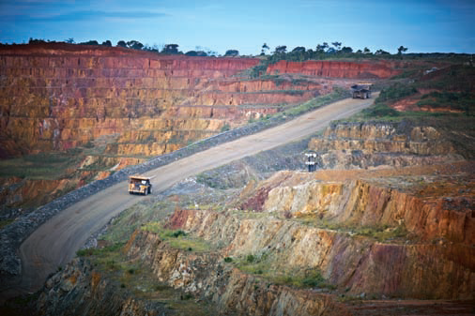
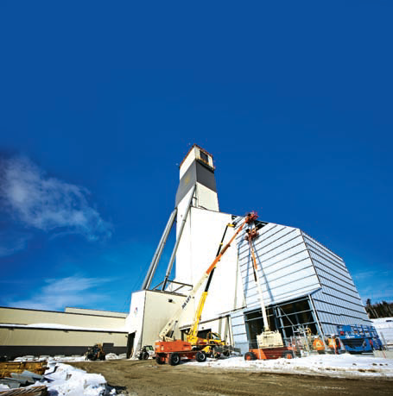
Open pit mine vs. Underground mine
Rosebel Gold Mine - Suriname
Westwood Gold Mine – Canada
Notes:
Open pit mines have metal containing material, which is called ore, at surface or very close to surface
Its easy to access and relative small concentrations of metal already make the orebody economic to process.
Underground mines have the metal containing material deep underground, in some cases over 1000 meter.
It’s hard to access. Shafts and tunnels need to be build, which is expensive and requires very different techniques. Metal concentrations therefore need to be a lot higher in order for the material to be economic
RGM is open pit mine, and this presentation is only about open pit mining

Slide 6

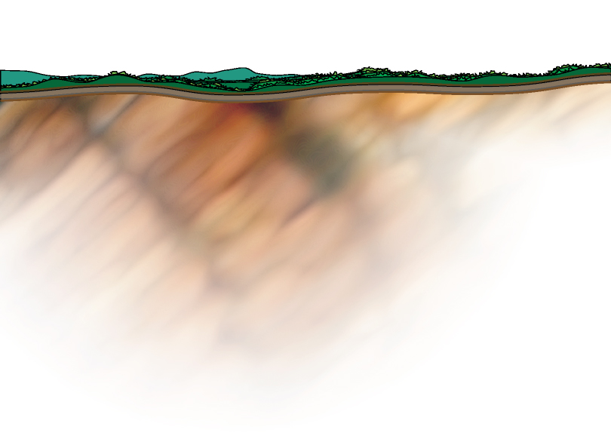





A mine starts with the discovery of an ore body
About 1 in every 3,000 raw discoveries (or anomalies) results in a producing mine
Gold Deposits Discovered
Gold Deposits Discovered
EUREKA!
EXPLORATION DRILLING
Core samples are extracted from various depths and locations for study and testing at the surface by geologists.
Notes:
Geologists look for anomalies in the earth crust which might be signs of a metal resource.
This is a science a requires a lot of understanding of geology.
Once they find a high potential area, they start drilling.
Drill samples are send to lab for assay
Drilling is very expensive and is like putting a needle in a the earth, and based on the sample results try to draw conclusions on overall ore body

Slide 7
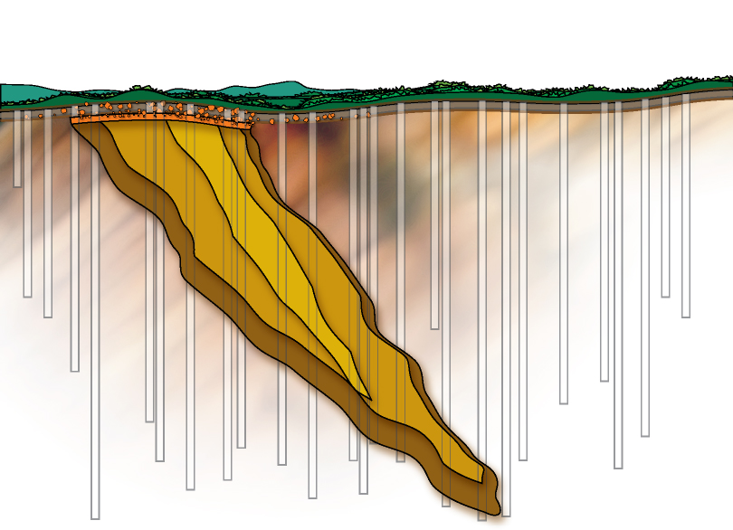
Studies to support decision to construct a mine
Exploring for gold is much like looking at the earth through a straw.
Each study gives a larger and clearer view of the value and extent
of the mineral deposit, and the viability of the project.
SCOPING STUDY
PRE-FEASIBILITY STUDY
FULL FEASIBILITY STUDY
Notes:
Follow the builds on this slide as well. The feasibility is confirmed by more and more information (e.g. more drill holes). More drill holes means more investment – we are still spending money, but not making any yet! In fact, we’re still not sure if we will make money back, but the more information we get the more certainty we have. For example a scoping study might get us 20% confidence that we’re got a viable deposit, a pre-feasibility study might get us to 40% confidence and a feasibility to 80%.

Slide 8
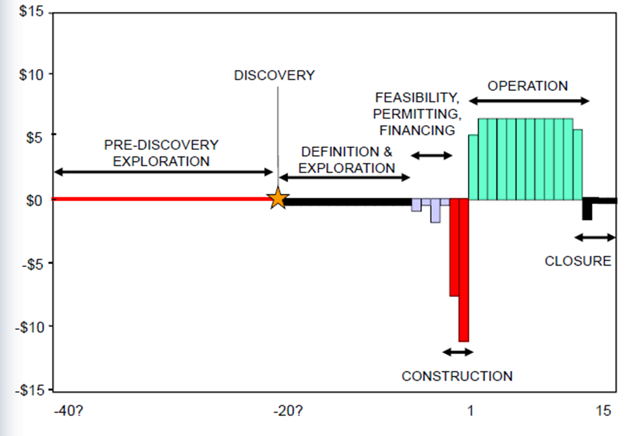
Mine Life Cycle
L.D. Smith - CIM
Notes:
TELL This is a generic example of a life of mine cycle.
If you think about return on investment over the course of the life of mine, you start off making a lot of investments up front, then you have a window of operation in order to not only pay for the operation, but also to pay for the investments you’ve already made. Add to that mine closure, and you’ve also got to earn enough during operation to pay for the years after the mine is closed.
So when a mine is in operation, you’re making money to pay for today, but also to pay for yesterday and for tomorrow!

Slide 9
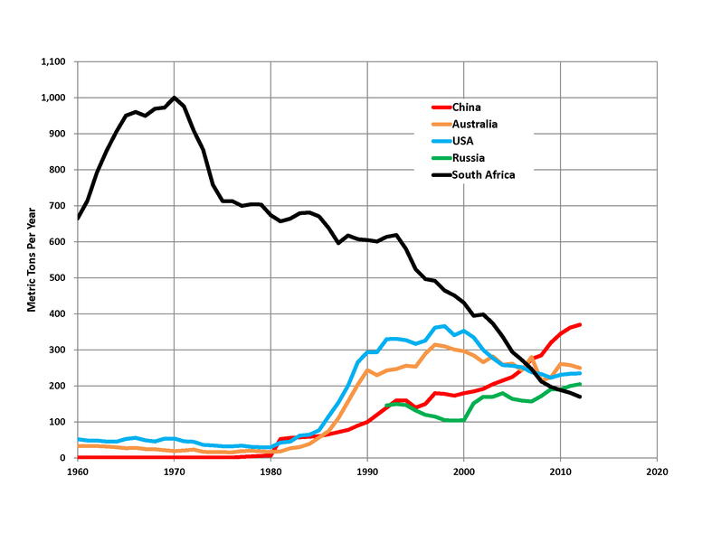
World’s top gold producing countries
9

Slide 10
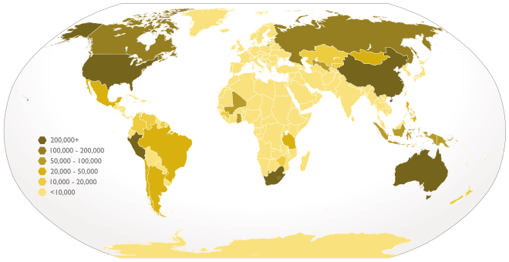
World’s top gold producing countries
New gold discoveries in increasingly remote locations
Notes:
This map of the world shows the gold production on a global level.
Gold is increasingly extracted in more remote and more politically instable countries, like Pery, Mali, Ghana, Burkina, Krigizie, Mongolia

Slide 11
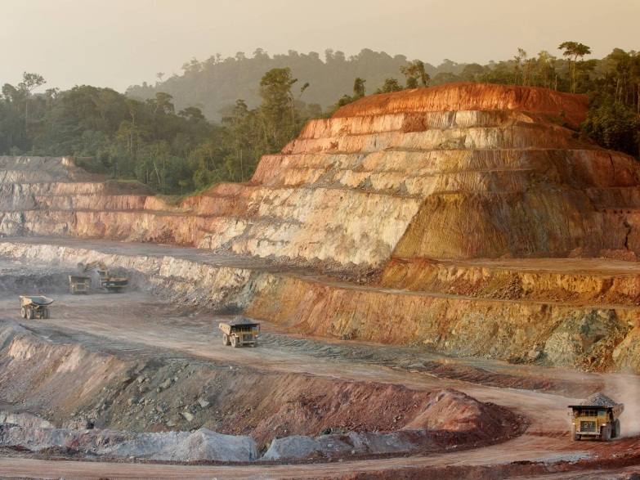
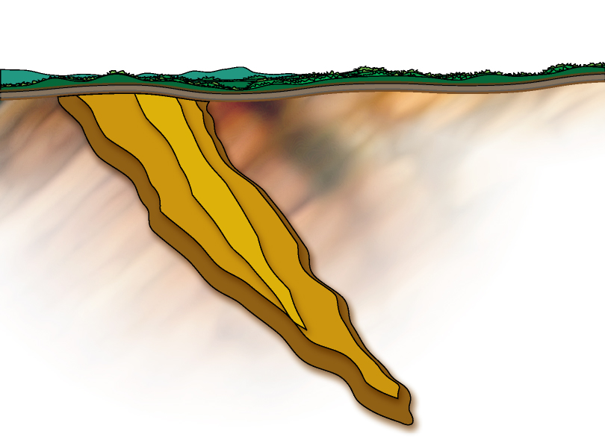
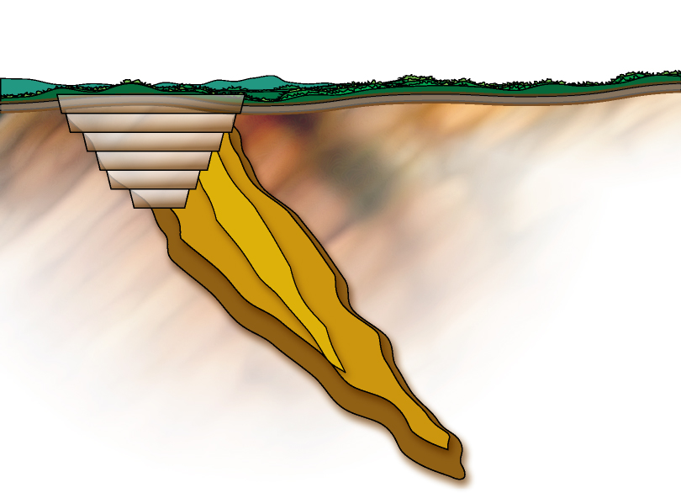
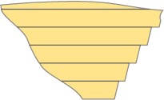
Life of Mine – initial phase
OPEN PIT
STRIP RATIO = 0 NO WASTE
PIT
ORE BODY
STRIP RATIO
0 TONNES WASTE
1 TONNE ORE
$
MINING
COSTS
Empowering People, Extraordinary Performance
Notes:
The cost to mine at 0 stripping ratio is very low because you’re getting ore in every truck load and you don’t need to remove waste.

Slide 12
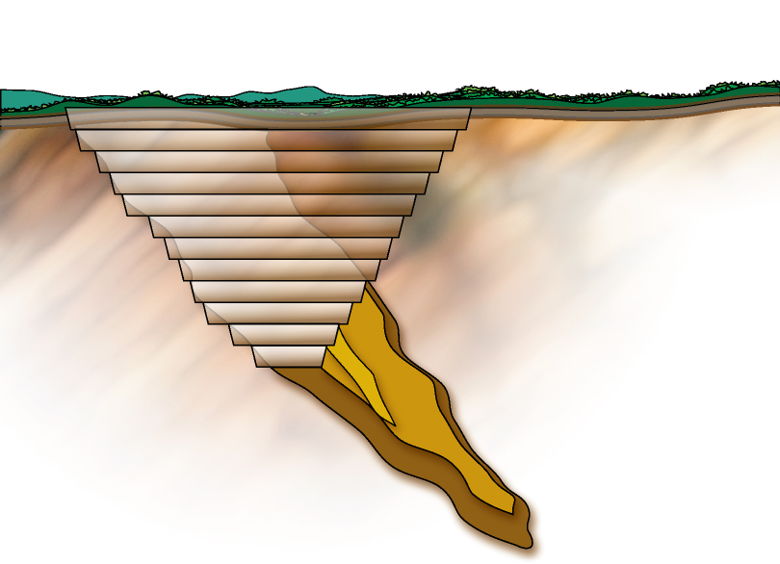
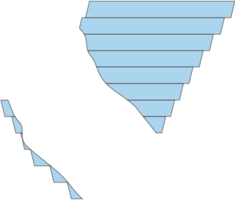
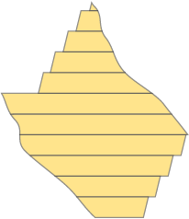
Life of Mine – Strip Ratio increases
Existing PIT
Expanded PIT
1
1
STRIP RATIO
1 TONNE WASTE
1 TONNE ORE
ORE BODY
$
ORE BODY
$
MINING
COSTS
Empowering People, Extraordinary Performance
Notes:
As you need to remove more waste, you add cost. That waste materials still needs to blasted, scooped, hauled and relocated somewhere. All of that uses equipment, time, resources, etc. and it costs the same to remove one tonne of waste as it does to remove one tonne of ore.

Slide 13
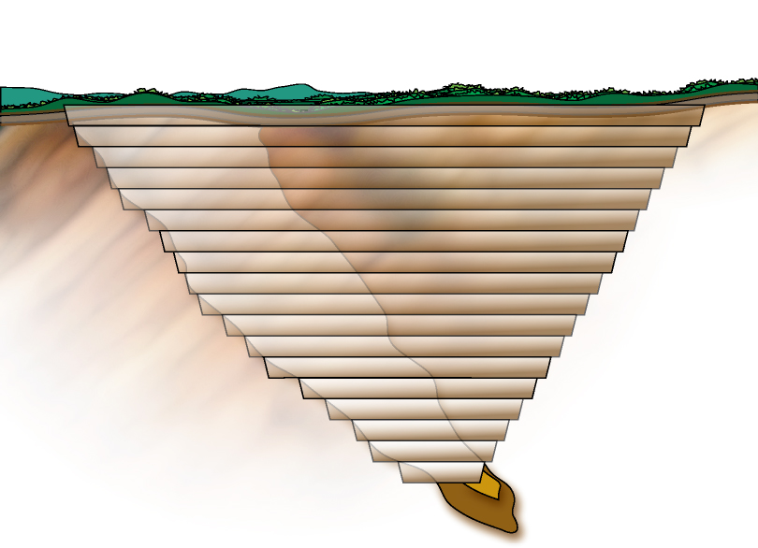
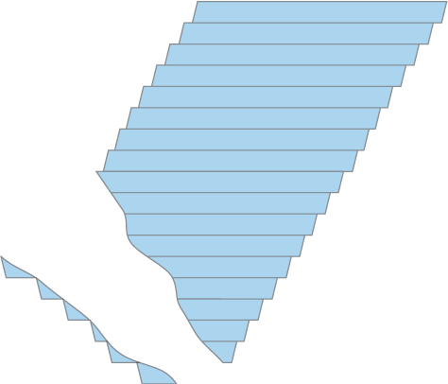
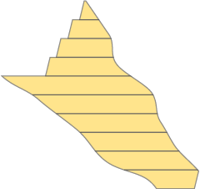
Life of Mine – deeper ore becomes economic
OPEN PIT
STRIP RATIO = 4:1
4
$
$
$
1
STRIP RATIO
4 TONNES WASTE
1 TONNE ORE
$
$
MINING
COSTS
Empowering People, Extraordinary Performance
Notes:
Costs increase even further as we get into a 4:1 stripping ratio. More and more waste material needs to be dealt with, 4 tonnes of waste (4 times the cost) for every 1 tonne of ore.

Slide 14
Pit design
Design of the pit is a science, many variables to be taken into account:
  Ore body
  Metal prices
  Operating Costs
  Deeper ore is harder, which is more expensive to Mill
  Deeper ore requires more waste stripping
  Pits closer to Mill incur lower transport costs
  Equipment
  Ground stability determines steepness of pit-slopes
Ore that might not have been economic previously, can become economic at higher gold prices
And vice versa….

Slide 15
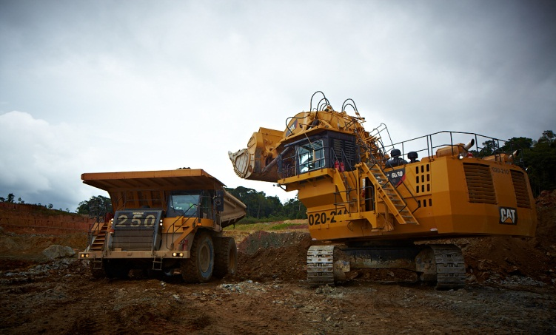
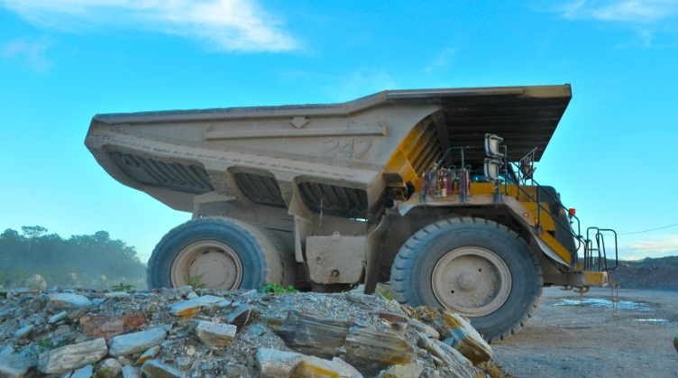
Rosebel Mine
24 hours / day; 365 days / year
> 70 MT per year; 58 MT is waste rock, 12 MT is Ore
Ore contains ~ 1 gram gold / ton (0.0001%)
Results in 365,000 Oz (11 tonnes) = $ 475 M @ $ 1,300 / Oz

Slide 16
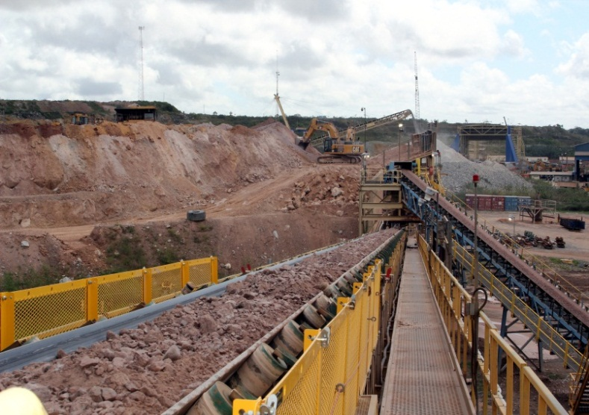
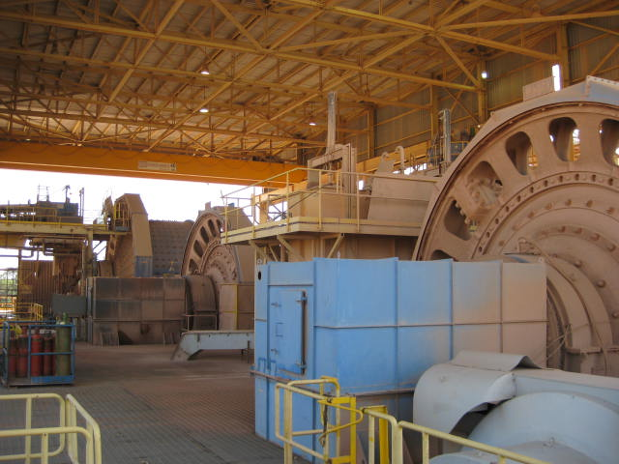
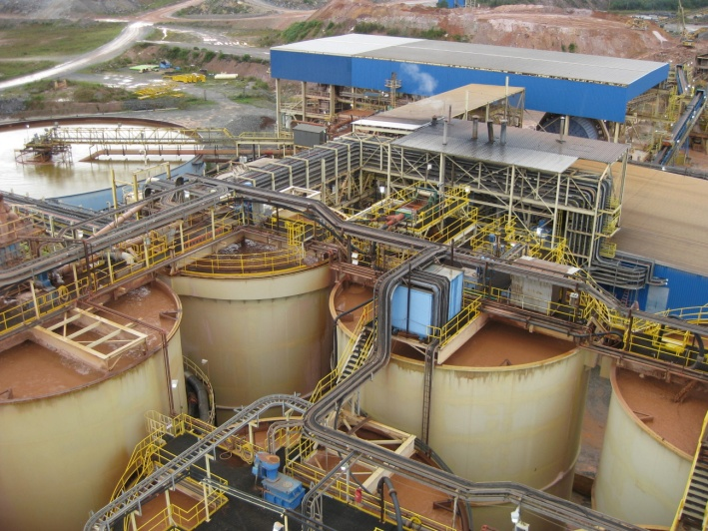
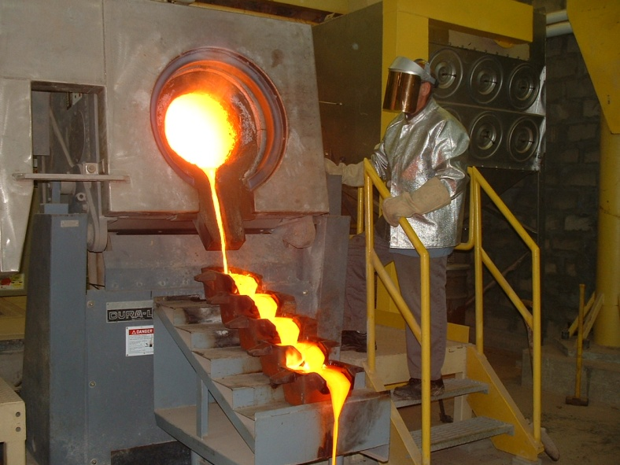
Mill - Process
Processes to recover gold from the ore:
  Crushing;
  Grinding (SAG Mill and 3 Ball Mills);
  Gravity Separation;
  Leaching (CIL Tanks); and
  Gold bullion pour
16

Slide 17
Highly knowledge intensive industry
Geologists to identify Resources & Reserves
Mine Engineers
Construction Engineers
Maintenance Engineers
Metallurgists
(how do you separate 12 tonnes gold from 12 million tonnes of rock, with >95% recovery?)
Safety specialists
Environmental specialists
Maximizing value - Finance
17

Slide 18
Risks associated with operating a mine
Reserves & Resources
Exposure to Gold price
Construction costs of a mine
Exposure to Costs (Labour, Capital Equipment, Diesel, Tires, Explosives, Electricity, Reagents, etc.)
Availability of qualified workforce
Environmental management
Political Risk
Social license to operate (maintaining good relations with local communities)

Slide 19
About IAMGOLD
19

Slide 20
About IAMGOLD
IAMGOLD is a leading mid-tier gold mining company
Gold production of approximately 850,000 ounces annually from 5 mines on 3 continents
Corporate office located in Toronto, Canada
Publicly Listed Company on TSX (IMG) & NYSE (IAG)
Rosebel is IAMGOLD’s flagship mine

Slide 21
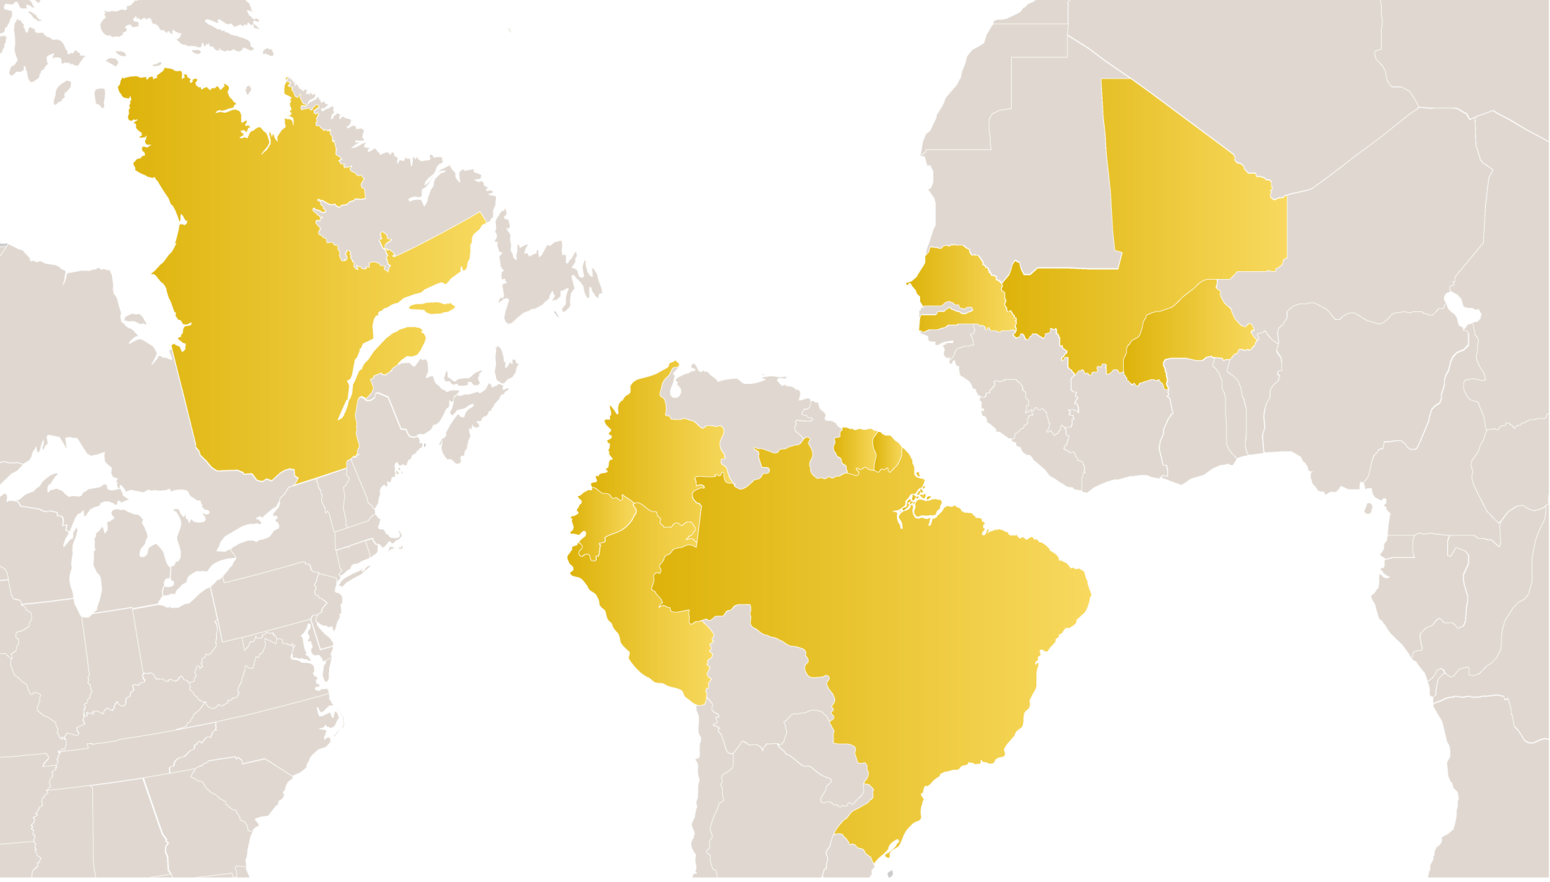

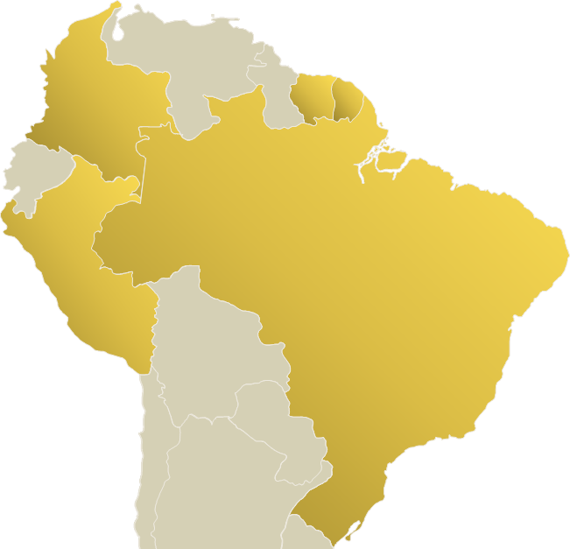
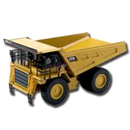
IAMGOLD’s High Quality, Long-Life Assets
YATELA
SADIOLA
ESSAKANE
Senegal
Mali
WESTWOOD
Boto
NIOBEC
Siribaya
Burkina Faso
Val d’Or
Suriname
Colombia
Côté Gold
ROSEBEL
Peru
Brazil
Niobium Mine
GOLD Mines
Development Project
Pitangui
Advanced Exploration
Exploration Office
Five Gold Mines: 2014 Production Guidance 835-900K oz.

Slide 22
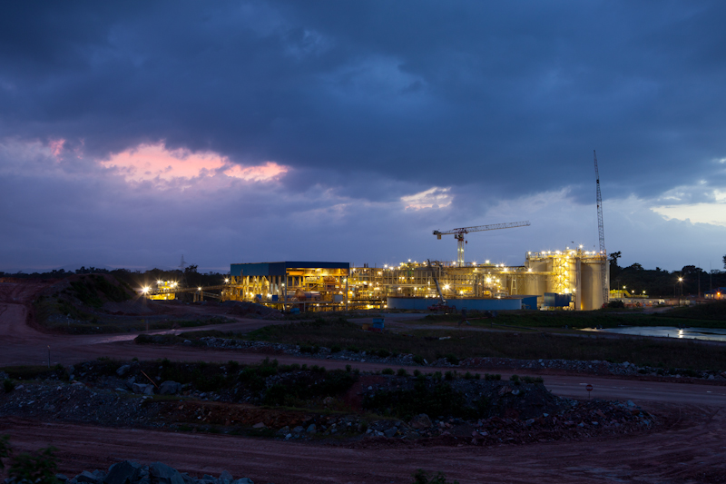
Rosebel Gold Mines N.V.
About Rosebel Gold Mines
22

Slide 23
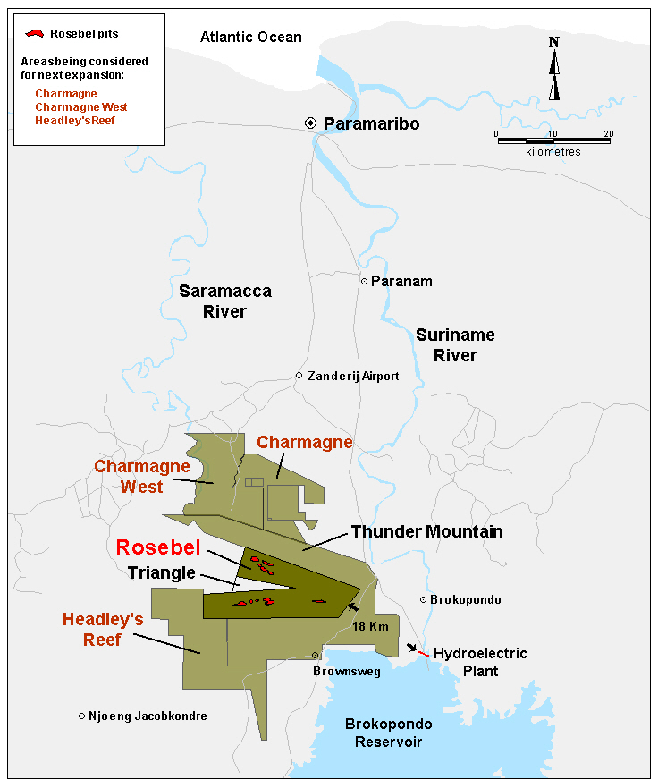
From Start-up to Production: The Facts
LOCATION
District of Brokopondo
CONCESSIONS
+/- 100 km from Paramaribo
+/- 18 km from the Afobakka Hydro Plant
Exploration Concession: 85,400 ha
BUSINESS WISE
Current “largest” foreign investment in Suriname
1st Commercial large scale gold mine in Suriname
Exploitation Concession: 17,000 ha
23

Slide 24
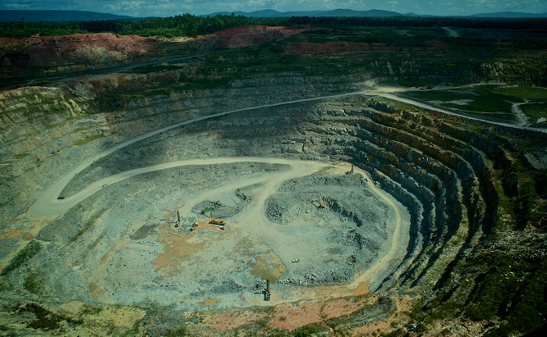
Rosebel: March 2014: 10 years Commercial Production
‘92
Mineral Agreement
‘97
Feasibility Study
ESIA
‘02
Est. RGM N.V.
‘03
Amending Agreement
‘04
Start Commercial Production
‘06
IMG acquires Cambior
‘14
10 years Commercial Production
Pre-production costs ’03 -’04: $147M

Slide 25
10 Years in review - Production, Cash Costs & Reserves

Slide 26
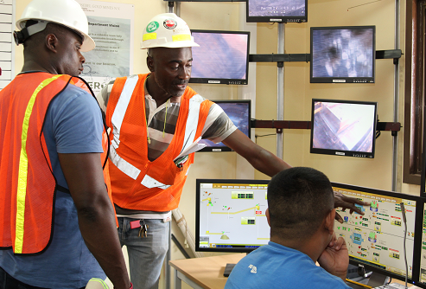
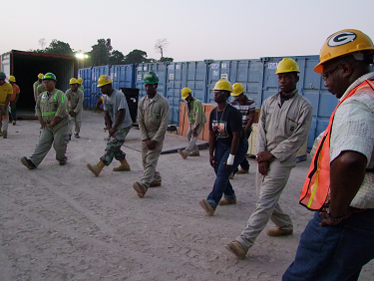
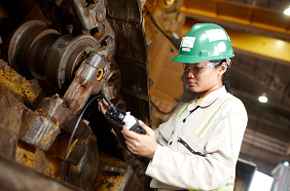
Rosebel’s Workforce
Q1-2014: ~1900
Contractors ~300
Regional Exploration
~60
Construction/Major Drilling
~50
Direct Employment:
- Nationals: ~1400
- Expats: ~60

Slide 27
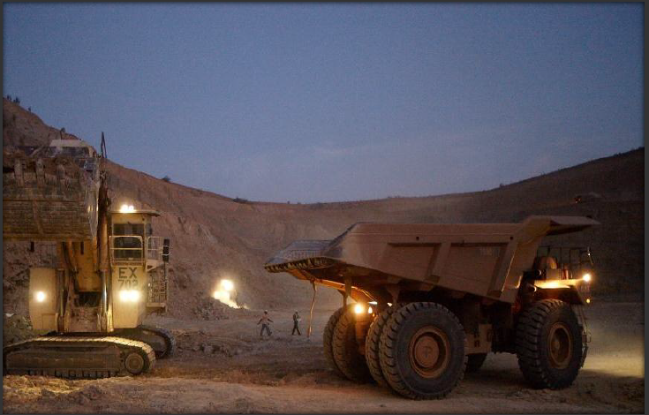
ROSEBEL: Direct Financial Contribution to Government
Taxes
36% Income Tax
Payroll Tax
Government Royalties
2% of Gold Production
0.25% of Gold Production to Foundation
6.5% of revenues in excess of $425/oz
Equity Participation
Free carried participation of 5%
Dividends on 5% of Class A shares
27

Slide 28
Rosebel’s total Economic Value to Suriname
Total Economic Value 2004 – 2013 in excess of $2 billion
28

Slide 29
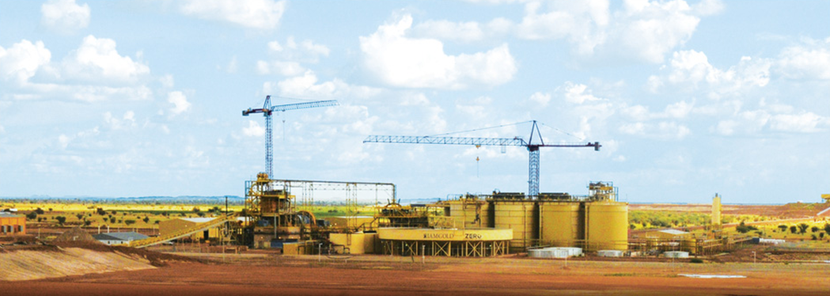
What does a CPA in Mining do?
Essakane Gold Mine - Burkina Faso

Slide 30
What does a CPA in Mining do?
Some of the most successful CEO’s in Mining started as CPA’s
    - Ivan Glasenberg (CEO Glencore-Xstrata)
    - Mick Davis (former CEO Xstrata)
    - Richard Adkerson (CEO Freeport-McMoRan)
30

Slide 31
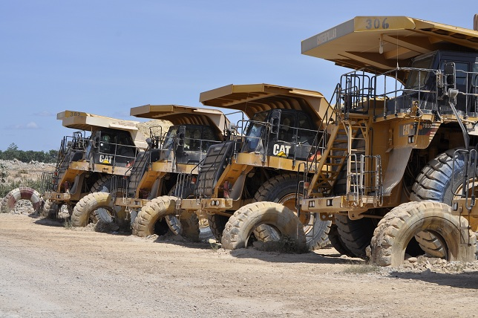
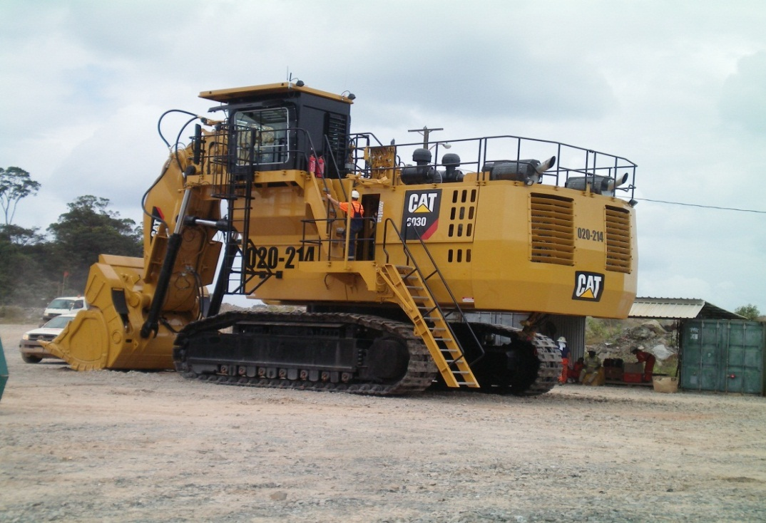
Accounting at a mine site
Componentization of Fixed Assets
Capital Spares & Insurance Spares
Leasing
Notes:
A haul truck costs usd 2m, we have 57 haul trucks
Components need to be tracked, engine, transmission, wheel set, gear box

Slide 32
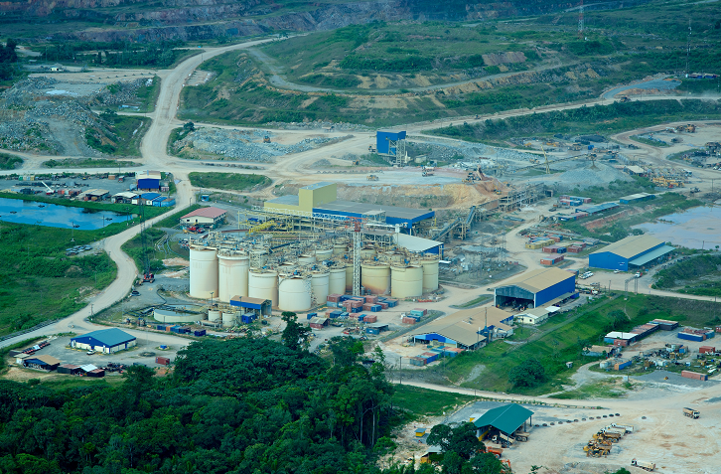
Accounting at a mine site
Capitalized pre-production costs

Slide 33

Accounting at a mine site
Mill, major asset, depreciation over Life of Mine

Slide 34
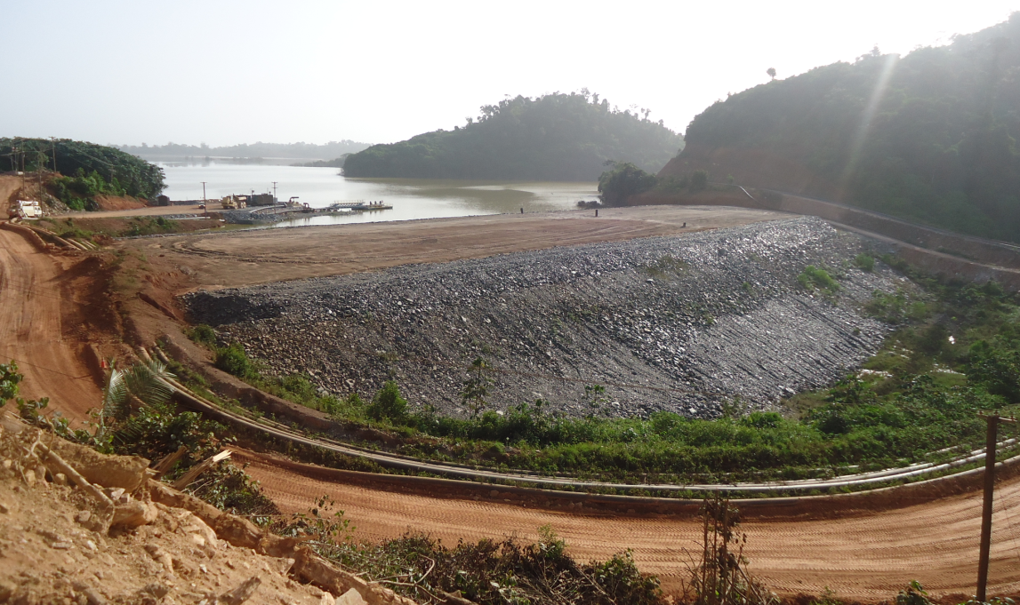
Accounting at a mine site
Tailings dams, write of over capacity of pond

Slide 35
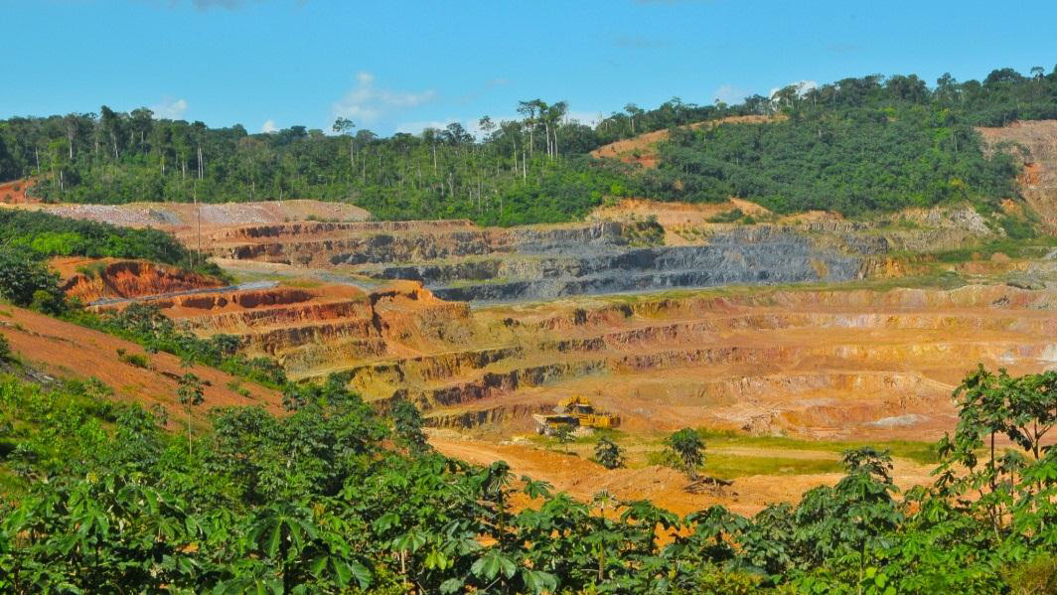
Accounting at a mine site
Asset Retirement Obligation
35

Slide 36
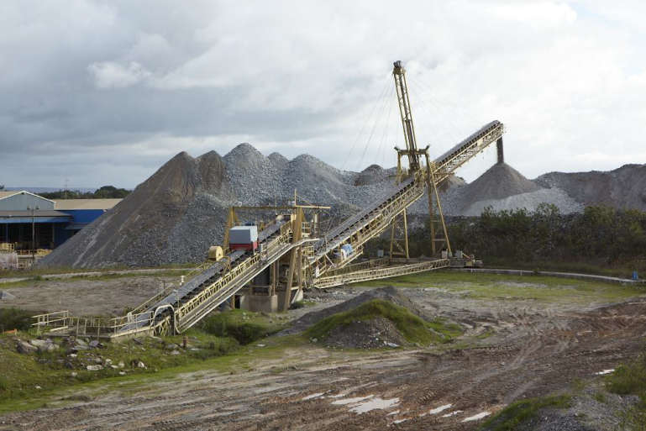
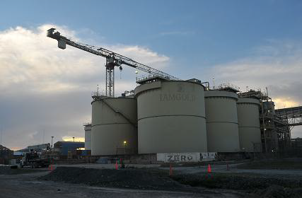
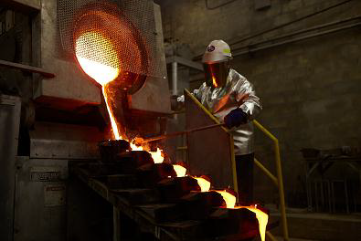
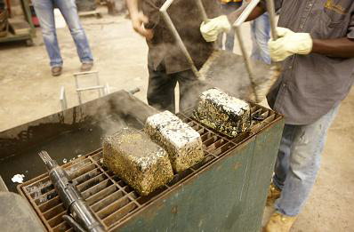
Accounting at a mine site
Inventory valuation
NRV testing on Ore Stockpiles (very different @ $1,200 vs $1,800 / Oz)

Slide 37
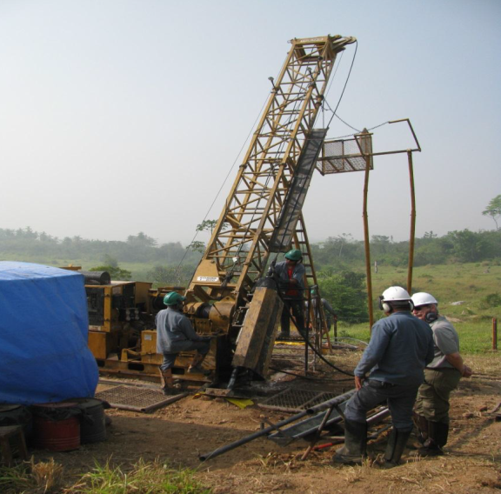
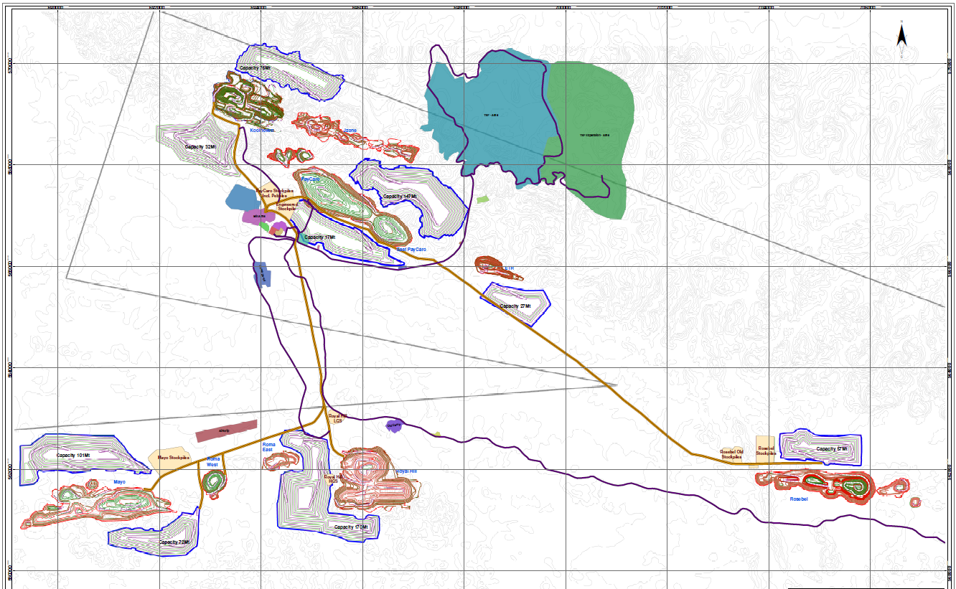
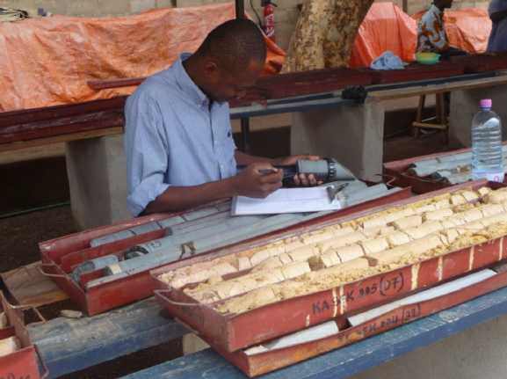
Accounting at a mine site
Exploration expenses: OpEx vs Capital
37

Slide 38
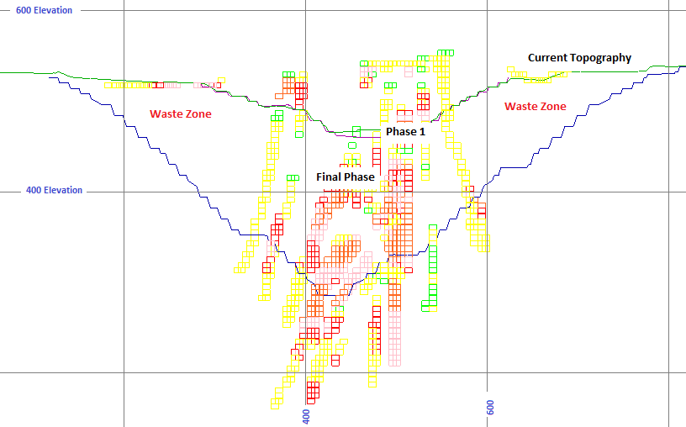
Accounting at a mine site
Reserves & Resources
Capitalized Stripping

Slide 39
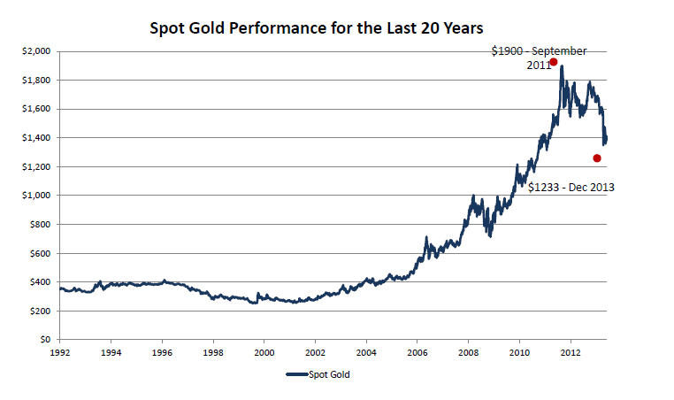
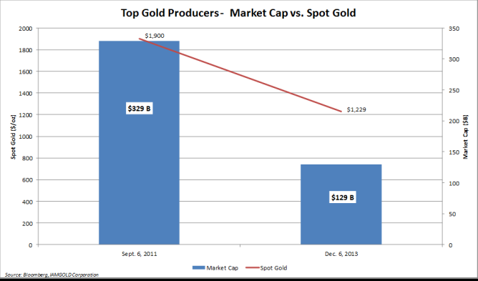
Accounting at a mine site
Since top of $ 1,900 in Sept 2011, Gold decreased by 35%
Market cap of top 10 Gold producers decreased by >60%, or >$ 200 billion
39

Slide 40
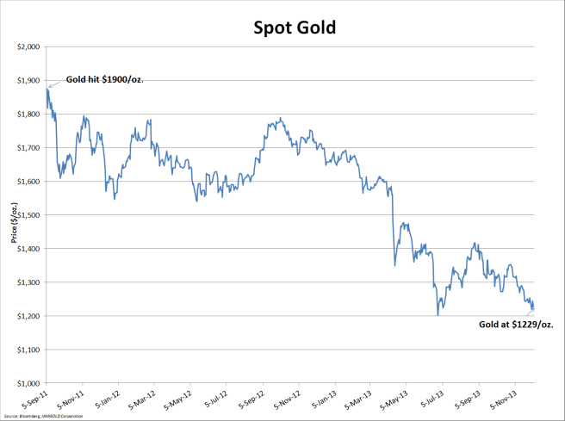
Accounting at a mine site
Impairment testing:
- Gold prices
- Cost escalation
- Reserve estimate
- Construction costs
- Permitting
40

Slide 41
THANK YOU
Remon van de Paal
Controller Rosebel Gold Mines N.V.
June 6, 2014

Slide 42


Some key facts on gold
In the past 12 years total capital spending for ten of the world`s top gold producers, who account for about one-third of global production, increased nearly ten-fold, yet production fell 3% and unit costs grew at a compound annual rate of 11%
Citi Research

Slide 43
Some key facts on gold
Fundamental change to fundamentals for Gold:
- Declining Grade of Reserves (decrease from >2 g/t to just 1g/t)
    (This in itself doubles the operating costs per ounce, where you needed to process 15 tonnes of Ore, you now need to process 31 tonnes of Ore to produce an ounce of Gold (1 ounce = 31.1035g) )
- Despite significant increase in Exploration expenses,
there has been a significant decrease of new discoveries
- Escalation of Construction costs
- Escalation of Operating costs
- Permitting

Slide 44















Mining equipment
Model
770
772
773
775
777
785
789
793
795
797
Tons
40
50
60
70
100
150
200
250
345
400
3-5 pass
3-5 pass
3-5 pass
3-5 pass
3-5 pass
3-5 pass
3-4 pass
Model
6015/6015 FS
6018/6018 FS
6030/6030 FS
6040/6040 FS
6050/6050 FS
6060/6060 FS
6090 FS
Cubic Meter
7.0
10.0
17.0/16.5
22.0
28.0/26.0
34.0
52.0

