Slide 1


Slide 2

Company Overview
Vision
To profoundly impact educational outcomes for all learners, with the goal to align educational interests with labour market needs, through the use of technology
Mission
To make learning fun, compelling and engaging for learners, with the use of technology

Slide 3

Friendly and helpful tutorial videos that cover the entire PEP Math syllabus
Friendly and helpful tutorial videos that cover the entire PEP Math syllabus
Detailed study guides covering the full spectrum of the the Grades 4, 5 and 6 syllabi
Step-by-step solutions for PEP Math questions that students get wrong
EduFocal provides over 23,000 questions and answers to help you prepare for all your exams
2

Slide 4

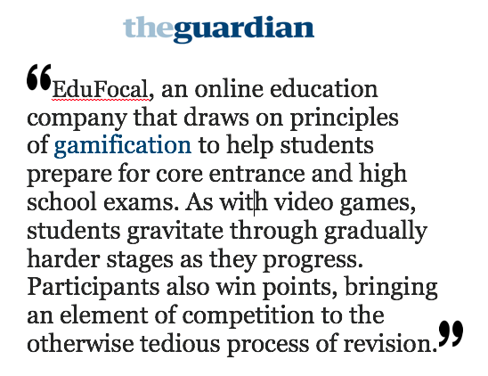
12

Slide 5

From concept to execution
Notes:
Starting Up…
Anticipating the needs of market; developing things that the market isn’t ready for. Talk about payment solution for teachers.

Slide 6

Innovation: Overcoming Hurdles
Notes:
Challenges Faced:
E-Commerce (Both on consumer end, and on setting up end)
Speak to digitization of cash, speak to temporary measures (access cards).
Access to the Internet

Slide 7

Thinking about becoming an Entrepreneur?

Slide 8


Slide 9
Thank You.
Twitter: @gordonswaby
Instagram: @gordonswaby
Email: gordon@gordonswaby.com

