Slide 1



ICAC Conference 2019
Engaging millennials and generation Z – are you ready for the employee and consumer of tomorrow?
Leo Lee – past president, ACCA
June 2019
Notes:
Slide 1
Good morning.
I am Leo Lee, the past president of ACCA.
It’s a great pleasure to be here with you all in Kingston.
Thank you to
Mrs. Pamela Monroe-Ellis - Secretary General CAROSAI
Mrs. Charmain Felter – Chairperson of CAROSAI
And Mr. Deodat Sharma - Auditor General, SAI Guyana for your kind invitation to be here today.
I am honoured to share with you ACCA’s thinking about a growing generation of our population and how we can manage and attract the employee and consumer of tomorrow.
My presentation today is all about how we should plan to engage with Millennials and Generation Z - or Gen Z as it’s known.
CLICK

Slide 2

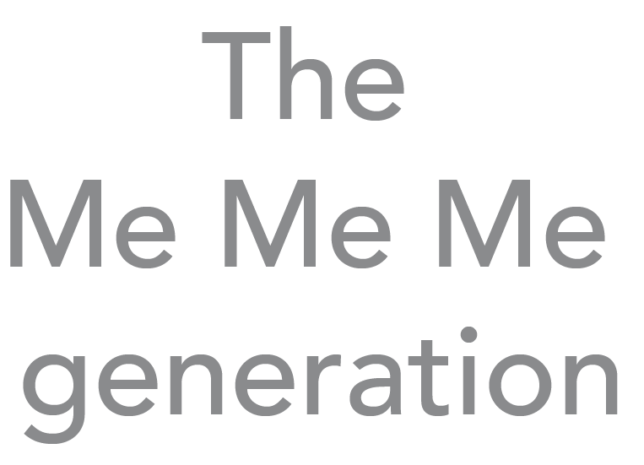

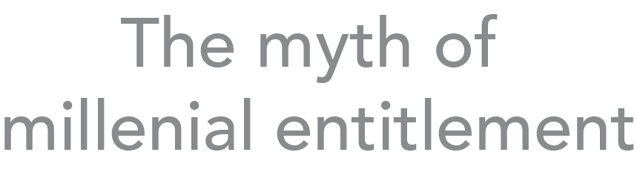
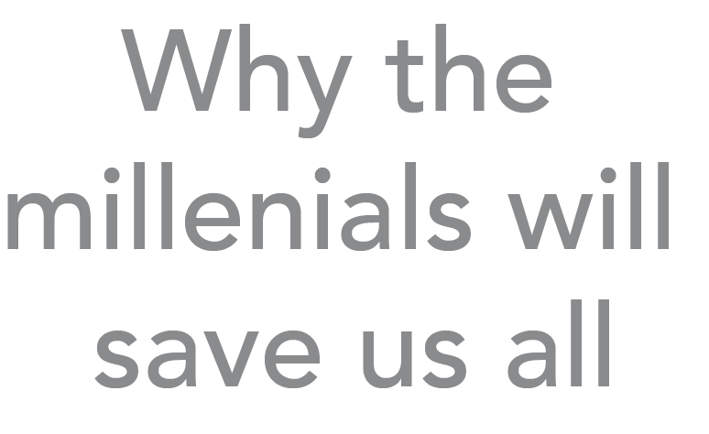

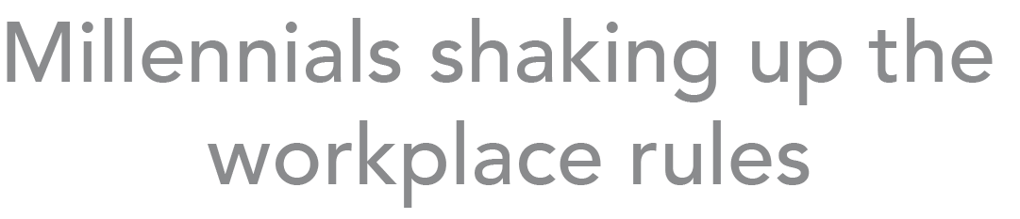

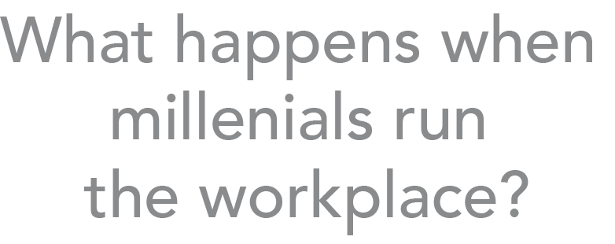



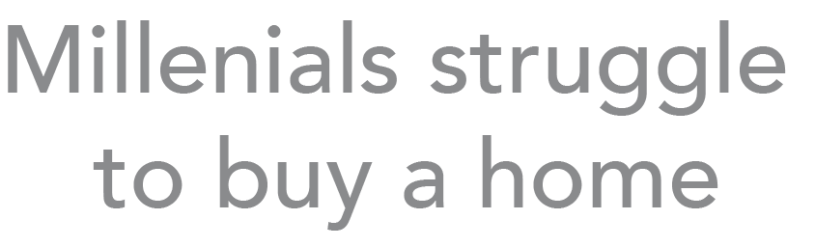



Notes:
Slide 2
You’ve probably seen some of the headlines about these generations. And you probably know the definitions already, but as a reminder, millennials or Generation Y were born from 1981-1996, according to the Pew Research Centre.
Gen Z are people born from the mid-90s until 2015.
And according to the Financial Times, millennials are big news and with good reason as they make up an exclusive club of 1.8billion people.
This is about a quarter of the world’s population. By 2020, millennials are forecast to make up 35 per cent of the global workforce. They reached the same figure in the US two years ago, at the same time becoming the largest generation in the workforce.
CLICK

Slide 3


Millennials vs Gen Z
  Gen Z are people born from mid 90s to 2015
  Gen Z = 32% of the global population
  Millennials = 31.5% of the global population
  Technology differentiates them.
Notes:
Slide 3
Millennials are about to be overtaken by Gen Z.
Gen Z will comprise 32 per cent of the global population of 7.7 billion in 2019, ahead of millennials, who will account for a 31.5 percent share, based on Bloomberg analysis of United Nations data, and using 2000/2001 as the generational split.
To give you some idea of the numbers in the US alone, there are 65 million Gen Z people and by 2020 Gen Z will account for 40 per cent of all consumers.
Are you seeing what I am seeing? This is a huge demographic change to the working world and our economies, and while some might see this as disruptive, I would like to talk about how employers might cope or adjust.
I’m sure you will be asking these questions; Gen Z and Millennials are here - so how will we manage?
Also what is the difference between Millennials and Gen Z?
Perhaps confusingly, both Generation Y and Generation Z can be called "Millennials," with the primary difference between the two being technology, especially the developments in technology that have happened over the years and how they use it.
CLICK

Slide 4

Tech enabled…..
Gen Y = personal computers, cell phones, and video game systems
Millennials / Gen Z – tablets, smartphones and apps
They are more optimistic – but are their expectations unreal?
Notes:
Slide 4
Generation Y grew-up on personal computers, cell phones, and video game systems, while Gen Z has grown up on tablets, smartphones, and apps. Yet, the common ground between both generations is that both have been changing communication and identity.
Millennials grew up with electronics, and in an increasingly online and socially-networked world. They have received the most marketing attention. As the most ethnically diverse generation, they tend to be tolerant of difference. Having been brought up with the mantra "follow your dreams" and often being told they were special, they tend to be confident.
They are often seen as more optimistic about the future than other generations - despite the fact that they are the first generation since the Silent Generation, those born between 1927 and 1946 who were brought up to be seen and not heard. Millennials and Gen Z are expected to be less economically successful than their parents.
There have been reports that the result of Millennials’ optimism means they are entering into adulthood with unrealistic expectations, which sometimes leads to disillusion.
Many early Millennials went through post-secondary education only to find themselves employed in unrelated fields or underemployed. They are found to be changing jobs more frequently than previous generations. Their expectations may have resulted from the very encouraging, involved and almost ever-present group of parents that became known as “helicopter parents” – watching and hovering over their every move.
CLICK

Slide 5

Tech savvy
Gen Z is comfortable with being connected
They are ‘neo-digital’ natives and live a digital life with ease
Gen Z is the first generation which finds the extraordinary technological advances of the last 20th century are just a normal part of life.
Notes:
Slide 5
Gen Z is the generation that never had to deal with the dial-up internet or brick-sized mobile phones.
They have grown up with the knowledge that they can speak to anyone around the world at a moment’s notice, and through assorted social media networks, that’s what they’ve been doing for their entire lives.
For this generation, electronics that were a luxury to their parents and older siblings have always been a must-have for living in the modern world. This facility with technology has sometimes between used to describe the entire generation; they are the ‘neo-digital natives’.
Gen Z is the first generation which finds the extraordinary technological advances of the last part of the 20th century and into this 21st century to be just a normal part of life.
Undoubtedly they will see the same huge changes in technology in their adult lives as baby boomers, Gen X and millennials have done in theirs – but with their early experiences, Gen Z may well be better able to adapt and cope.
CLICK

Slide 6

Stormy times
History shapes their beliefs and what they see of the world – the good and the bad
Financial crisis, recession, international terrorism have all happened in their lifetime
Gen Z therefore have a reputation for frugality and caution in comparison with the generations that came before them. These new adults are responsible savers, not rash spenders.
Notes:
Slide 6
The second key question that separates Gen Z from the others is whether or not they remember the stormy news headlines while they grew up – especially around the financial crisis and its aftermath.
Many were born during or just before the 2007 financial crisis and resulting recession. For the unlucky members of this generation, their earliest memories might well include houses being repossessed, family members losing their jobs, and other signs of massive international financial upheaval.
Contrast this with boomers and earlier millennials, who were both born in times of prosperity and typically didn’t have to face economic downturns and their consequences until they were well into their teens. No wonder that Gen Z has a reputation for frugality and caution in comparison with the generations that came before them. These new adults are responsible savers, not rash spenders.
To be tolerant of differences has always been the default position of Gen Z – while their politics vary and can tend towards the economically conservative, they think that being socially liberal goes without saying. They can be often shocked that anyone could think otherwise. Partly this is motivated by the fact that Gen Z are themselves a very diverse generation; they’re the generation whose parents travelled more widely because of cheap flights and also met people via the internet. As a result, there are now more multi-racial young people and often they hold more than one nationality than those who came before.
CLICK

Slide 7

The digital world
Digital privacy matters - Gen Z has little interest in Facebook
Gen Z help to keep their communications private, but not their customer preferences
Brands matter a great deal….
Notes:
Slide 7
I’d like to move on to the digital world.
As the number of politicians caught out by unwise social media comments, blog posts and Facebook discussions shows, earlier generations have frequently been embarrassed by bad management of their digital privacy – forgetting that on the internet, nothing ever really goes away, and that saying something on social media can be more like shouting it from the town square than whispering it to a friend.
This isn’t such a danger for Gen Z, who’ve grown up with a keen understanding of the line between public and private with online settings, and who guard their privacy carefully as a result. It’s one of the reasons that Gen Z now has little interest in Facebook, preferring social media where they can more easily keep their interactions restricted to their closest friends, or present a carefully edited image when they do post for a wider audience, such as on Instagram.
That’s not to say that Gen Z are privacy-conscious at the expense of all else. They have, after all, grown up in a world where it’s usual for their favourite brands to gather extensive data on them in order to tailor marketing communications to their specific wants.
The difference is that unlike older generations, Gen Z doesn’t view this as an invasion of privacy, but instead an expected marketing technique of any company wanting to provide a good customer experience. It’s not a contradiction; it’s just that Gen Z expect to keep their communications private, but not their customer preferences. In fact, they’ll avoid brands that don’t offer them a sufficiently personalised experience.
CLICK

Slide 8
The digital world
Gen Z are planning for their future careers
Gen Z is more realistic about their dreams than Millennials
The line between child and adulthood has moved a great deal over the past 100 years – the concept of the teenager has moved on
Notes:
Slide 8
Gen Z has grown up in a world that hasn’t always made them feel financially secure, and they’ve taken that on board in their plans for their future careers. While the millennial generation were encouraged to dream big and aim to find fulfilment and wealth in creative and exciting careers, Gen Z is more realistic.
They dream of becoming entrepreneurs, building up their own businesses and never needing to answer to a boss. With all the resources of the internet at their disposal, they know that running your own business can be very hard work, but they’re ready for it because they see it as a route to the financial security that they prioritise. And their goals are optimistic, but not impossible: they don’t plan on becoming billionaires before they’re 30, but they do dream of inventing an app that lets them graduate without debt.
Gen Z have also grown up with the knowledge that they aren’t likely to have it so good, and they’ve made their plans to fit this. That’s not just reflected in their entrepreneurial streak, but also in their inclination to prioritise working towards a well-paid career over chasing a dream.
The line between childhood and adulthood has moved a great deal over the past hundred years. The concept of being a ‘teenager’ is something separate and different from a child or an adult had only just arrived back in the 1950s.
The line between childhood and adulthood is just as unclear for Gen Z as it was for their 1950s predecessors, but in a different way. Gen Z won’t leave education until they’re at least 18 and a large majority of them will go on to university after that. And as Gen Z have grown up in a world that feels unsafe, they’re unlikely to have enjoyed the freedom to roam by themselves that earlier generations took for granted; they’re also much less likely to own a car or know how to drive one. But in the other direction, Gen Z’s growing awareness of the internet and their privacy means that even as very young teenagers, they’re starting to think about what they’re saying and how they’re saying it, and even working towards establishing a personal brand online. The rise of the ‘online influencer’ is especially powerful to Gen Z.
CLICK

Slide 9
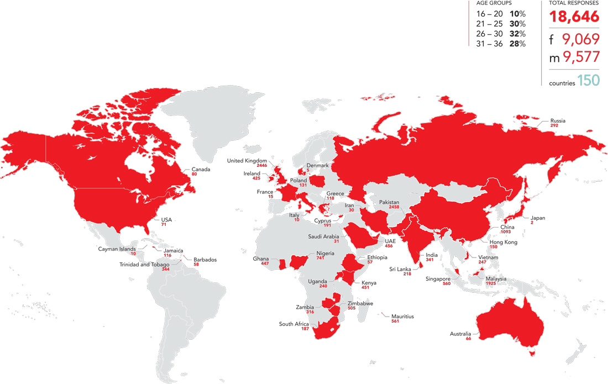
Generation Next – a global response to our survey
(map shows sample country response)
Notes:
Slide 9
Now I’ve set the scene, let me tell you about ACCA’s work on this generation.
ACCA is very interested in these developments and has produced important research about the next generation of finance talent: the skills they will need to succeed, and the ways in which ACCA has recently developed our Qualification to meet these future needs.
In 2017, we published major research into the career aspirations, preferences and skills of what we call Generation Next – the age group of 18 – 36.
For this research, we surveyed more than 2,000 people under 36 and conducted more than 300 workshops across 21 cities –as a result it truly reflects the views and ambitions of Generation Next around the world.
ACCA firmly believes the opportunities for the accountancy profession have never been greater in helping to promote growth and prosperity in the global economy and to attract and retain this generation.
From this survey, the positive news for the accountancy profession is that Generation Next overwhelmingly realise that getting finance experience early on is a good platform for acquiring skills and for their career growth.
CLICK

Slide 10

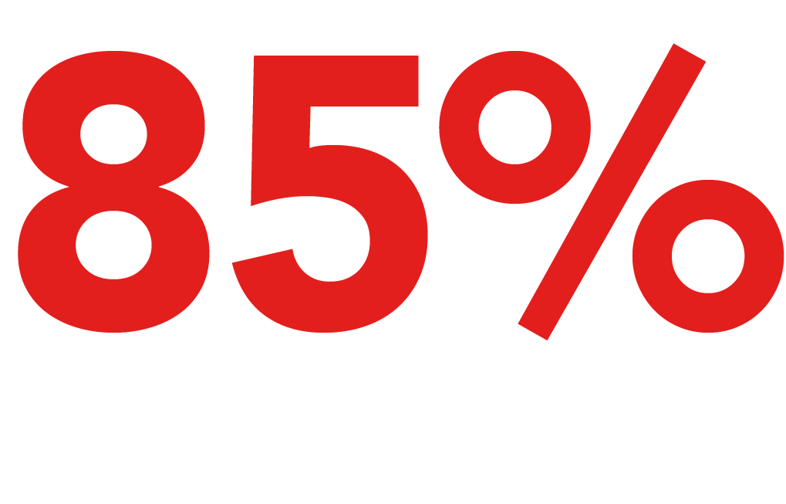
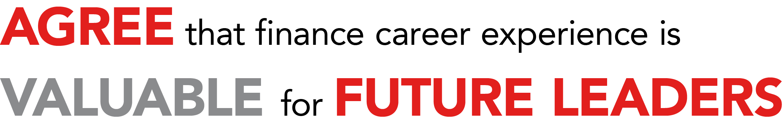



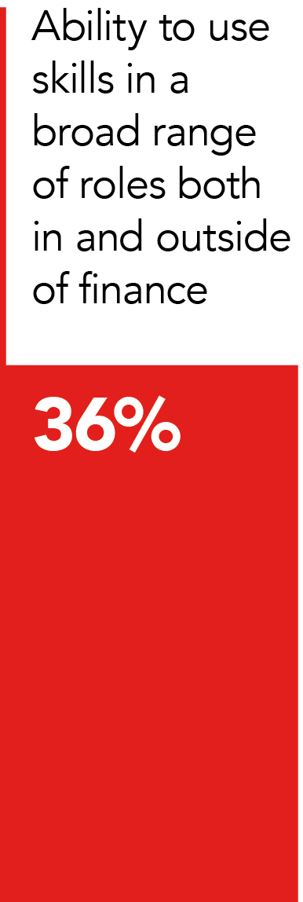


Notes:
Slide 10
The data suggests that young professionals understand the value of finance career experience – with 85% of respondents agreeing that finance experience was valuable for future leaders in organisations - but it also suggests many of them do not see themselves staying in one job, or even sector or industry, for the majority of their careers.
CLICK

Slide 11


This is generation
NOW when it comes to mobility
Notes:
Slide 11
Instead, they are Generation Right Now when it comes to mobility aspiration. Generation Next is at ease with the idea of moving roles and employers quickly as they seek out new career progression opportunities.
They appear confident about changing jobs, and if their current organisation does not see them as ready for promotion, they are willing to move to an organisation willing to hire them for a bigger role. So employers need to think about new ways to retain young talent – and to do that, we need to understand what they are looking for in the workplace.
The research showed that Generation Next is focused on developing their careers and attaining new capabilities. While many do have these ambitions to move quickly, they should also consider that spending time at organisations that provide opportunities to learn new skills, and have clear progression paths, may actually have great benefit early in their careers.
CLICK

Slide 12

WHAT KEEPS YOU WITH AN EMPLOYER
95%
Learning new skills is an important factor in keeping them with an employer
87%
More likely to stay with an employer if they offered a competitive financial package
Notes:
Slide 12
Our data suggests the factors that keep Generation Next remaining with a particular employer are broadly similar to those that attracted them in the first place. The opportunity to learn new skills is the highest-ranked factor – 95% of respondents rated it as an important factor in attracting them to a particular employer, and 89% said it was an important factor in keeping them with an employer. This is followed by career progression opportunities.
Today’s junior finance professionals will look for an employer which takes into account the diversity of skills needed in today’s workplace, and gives them the opportunity to learn.
Employers should make sure that their career paths are transparent and well formed. In our study 87% of respondents indicated that they were more likely to stay with an employer if they offered a competitive financial remuneration package.
Future finance leaders are happy to seize the initiative in the labour market to achieve professional satisfaction. They know that demand for their skills is high and if their employer isn’t delivering, they won’t wait around. The result of that is employers can’t attract, nurture or retain the finance leaders of tomorrow in the same way they did the leaders of today.
So the challenge ahead for employers large and small is make sure they provide the sort of work environment and clear path for progression that the best of the next generation demand.
CLICK

Slide 13

Gender differences
Women more loyal than men to their current employer
Women happier with their pay – 36% compared to 30% of men
Women - 87% - expect to balance their home and work life more than men at 69%
Notes:
Slide 13
While Generation Next employees of both genders sought rapid career progression, female respondents were more likely to show loyalty to their current employer than their male counterparts.
The research shows that women are more likely to be happy with their current remuneration - 36%, compared to 30% of men - and to expect to stay with their current employer in their next role - 42%, compared to 37% of men.
And while men and women were equally likely to seek roles on the basis of the pay package and career progression, the research indicates that women are expecting to balance their job with family life. Women are more likely to accept a role on the basis of work life balance - 87%, compared to 69% of men- and flexible working arrangements.
CLICK

Slide 14

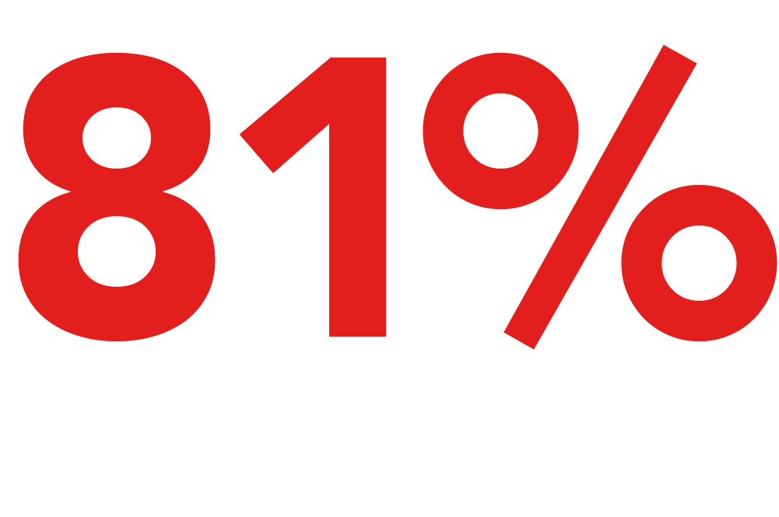
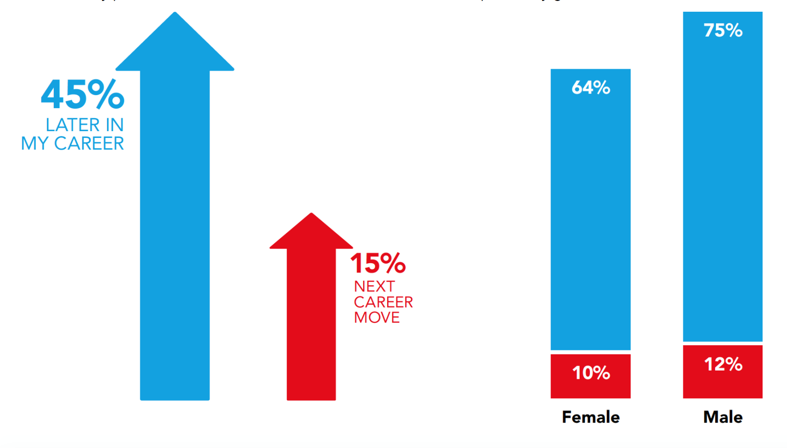
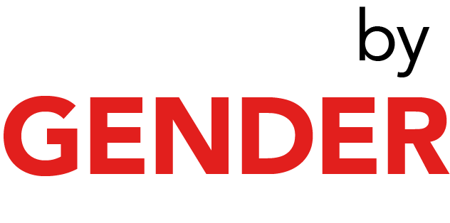
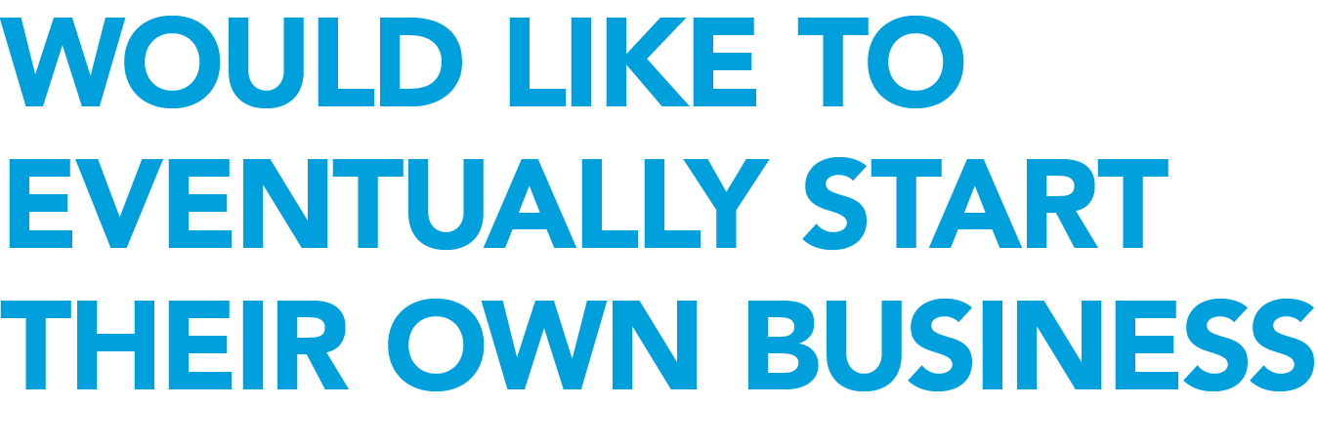
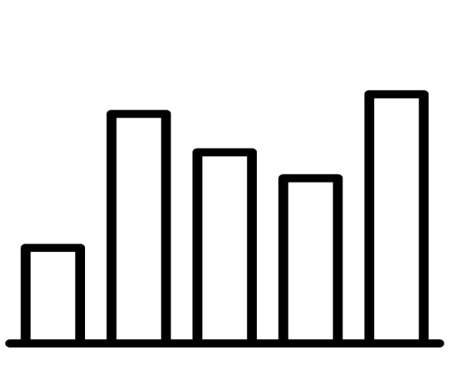
Notes:
Slide 14
While Generation Next is actively seeking skills from the workplace, they may also bring their own traits and skills that can be very useful to employers and organisations if harnessed well.
For example, 81% of respondents to our research said that they would wish to eventually start their own business, demonstrating entrepreneurial aspirations. Employers who encourage their staff to undertake employee-led initiatives can foster ‘intrapreneurs’ – those who do something new, innovative and creative within the confines of the business.
As I mentioned earlier, this generation are digital natives: they have grown up among rapidly developing technologies, and an overwhelming majority are excited – rather than scared – about the possibilities that technology trends like artificial intelligence, automation and machine learning can bring.
This makes Millennials and Gen Z well-placed to drive innovation in a business, if senior management are alert to this possibility and are open to change.
CLICK

Slide 15

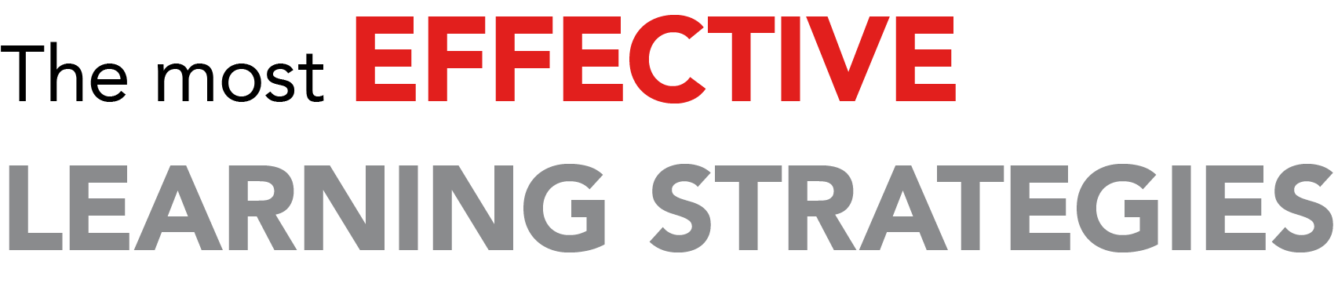
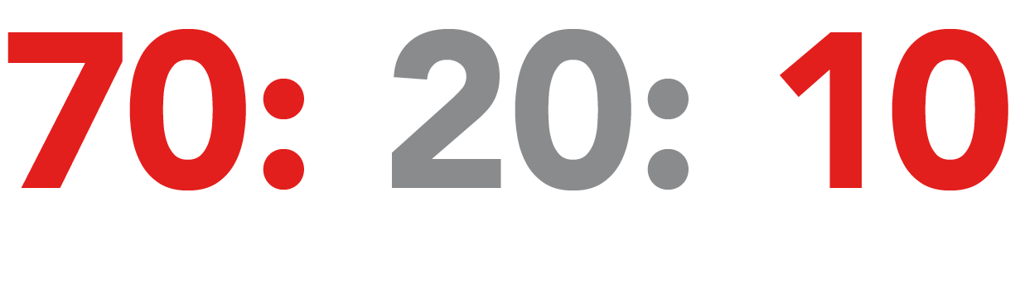
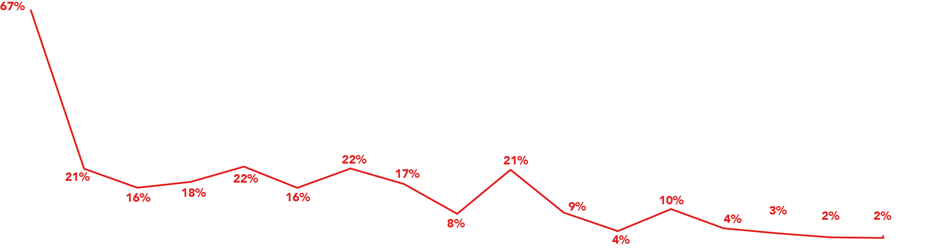
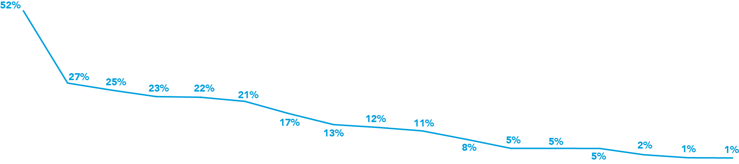
Notes:
Slide 15
Generation Next wants to learn, and according to the data in our research it’s on-the- job learning that is seen as most beneficial in supporting career development. Some of the most valuable skills that you learn throughout your career are those that can be attained in the workplace.
On-the-job learning ranks as the most widely used learning tool, and the one that is deemed most effective. But respondents to our survey also identified mentoring, job rotations and professional qualifications as relatively important too.
For decades the 70:20:10 rule has been a commonly accepted model for learning and development. It holds that individuals gain 70% of their knowledge from job related experiences, 20% from social learning with colleagues, and just 10% through formal learning such as classroom training or on line.
Gen Z may wish to consider proactively seeking ways to learn throughout their career. For example, personalised training interventions such as mentoring can bring a more focused individual approach to helping career development and supporting lifelong learning. Effective mentoring is a really powerful tool, and I would highly recommend that junior staff or recent graduates look for mentors and sponsors both within and outside their organisation to assist with professional development.
Employers can also support their employees by looking at their learning support and ensuring they are offering training which will be valuable - such as mentoring or coaching. They also need to think about developing specific training that allows for knowledge to be shared across the generations in the workforce - to ensure the business does not lose unspoken knowledge.
CLICK

Slide 16


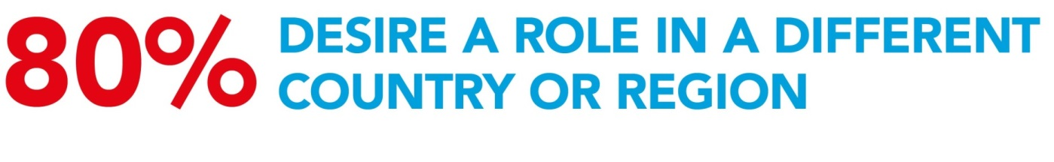
Notes:
Slide 16
Our research also shows that Generation Next respondents expect a global role – 80% say they want a role in a different country or region, and see finance and accountancy as a way to make this happen for them.
CLICK

Slide 17
What do they expect from the workplace?
Career progression and mobility
Employers that care for them and are part of a wellness ecosystem
Gen Z are looking for positive values, relaxed and productive atmosphere, commitment to excellence, open and honest communication, cooperation, support, and empowerment, sense of humour, compassion, respect, and understanding and flexibility.
Notes:
Slide 17
So what do Gen Z and Millennials expect from the workplace? They expect:
Career progression and mobility
Employers that care for them and are part of a wellness ecosystem
Gen Z are looking for positive values, relaxed and productive atmosphere, commitment to excellence, open and honest communication, cooperation, support, and empowerment, sense of humour, compassion, respect, and understanding and flexibility.
In today’s work environment, bringing a more diverse view to the workplace is increasingly relevant. Most businesses are affected by macro-economic global trends. This requires finance professionals to have a broad understanding of the world, and respect for cultural differences plus the benefits that diversity of experience can bring.
A great way to obtain this is to work in global teams, and seek international experience. This exposure to different geographic and cultural environments is also increasingly expected for leadership roles in larger organisations.
CLICK

Slide 18
Digital Darwinism?
Mobile
AI
Robotics
Cloud
Cyber security
Social technologies and others
More automation, more digital –but there is a need for more authenticity at a time of ‘fake news’
Notes:
Slide 18
An ACCA research report titled Digital Darwinism: thriving in the face of technology change has previously identified 10 technology trends with the potential to reshape the business and accountancy landscape in the future.
These include mobile, artificial intelligence and robotics, cloud, cyber-security and social technologies amongst others. With the advent of the digital economy, this Millennials and Generation Z are well placed to drive innovation in the business.
With increasing attention on the application of “robotic” software across the profession, the data suggests this is a generation who broadly expect to see more automation taking place. They expect some displacement of more junior level roles across the profession, but also recognise that technology will enable finance professionals to focus on much higher value added activity.
So it’s time to get ready for Generation Now or Gen Z. How we build our future brands will determine whether we reach this generation successfully.
Brands and businesses need to move fast to be ready to serve Gen Z when this group reaches consumer dominance in the early 2020s.
But employers also need to take the time to understand this group: they have an ultra-short attention span, but are hungry for authentic experiences and content; they are sceptical of financial institutions, yet want to save and be financially independent; they are immersed in social media, but also want to have a positive impact in the real world.
The time to engage Gen Z is now. But only those companies that genuinely grasp gen Z’s particular behaviours, values and priorities are likely to meet with success.
CLICK

Slide 19

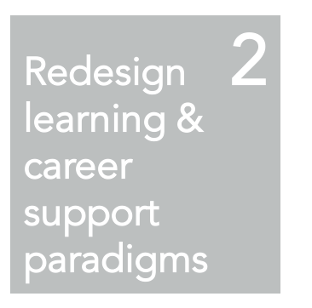
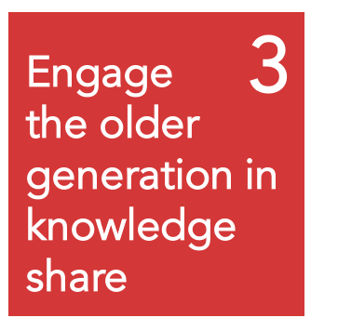
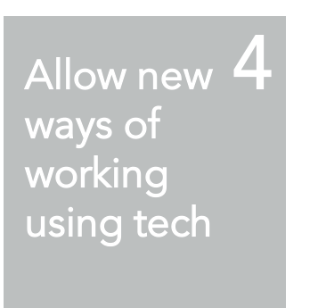
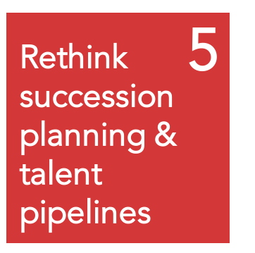
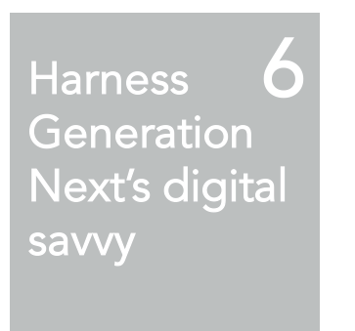
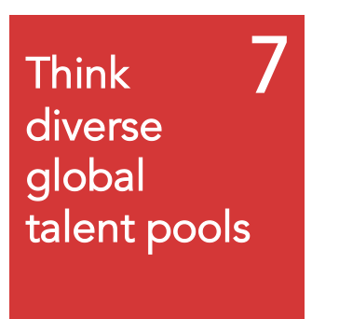
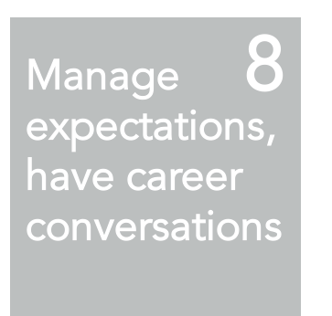
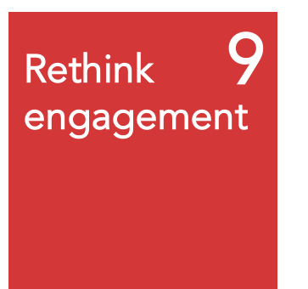
1
Revisit career paths
Notes:
Slide 19
Finally, how do you attract millennials to your business, especially as employers or as a brand?
Here are nine ways from our Gen Z report to do just this. I can’t say which of these is the most important; we need to be able to flex each of these and then apply them where and when necessary. The most important thing is to be authentic in your approach.
Alongside these, to attract Gen Z, companies must emphasise corporate social responsibility (CSR).
This tends to mean a shift in priorities in terms of developing and promoting a CSR strategy.
Recognising that this is very important, companies such as IBM, Google, Johnson & Johnson, and Netflix have already focused proactively on their CSR programmes.
Google, for example, allows its workers to devote up to 20 hours of work time to volunteer efforts each year and awards $50 grants to non-profit organisations for every five hours that a Googler spends volunteering for a particular organisation.
CLICK

Slide 20
How to keep engagement strong
Keep them in the loop with plans and business goals
Ask for their unique inputs and ideas
Involve them in the decision-making process
Coach, don’t manage
Create regular training and development
Assure them that there is room for growth
Provide feedback
Be open and transparent
Notes:
Slide 20
So how do you keep these Generations engaged?
Keep them in the loop. Bring them in on the larger business goals and plans.
Ask for their unique input.
Involve them in the decision-making process
Coach, don't manage
Provide feedback
Create regular training programs.
Assure them that there is room for growth.
Be transparent.
Again, this list is not exhaustive and we need to flex these appropriately.
CLICK

Slide 21
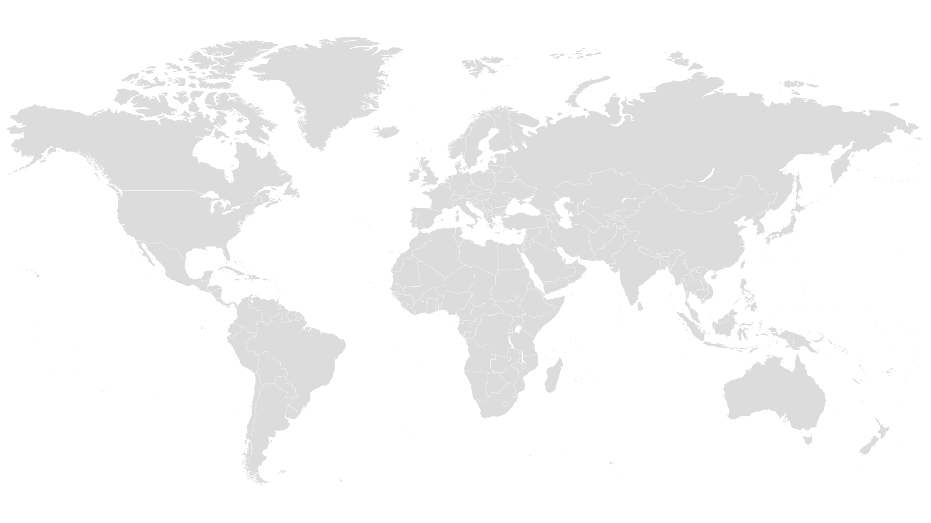
Notes:
Slide 21
This has been an overview of a detailed and fascinating piece of research, but I hope that I have covered how we can attract, retain and develop future talent, as well as some of the benefits that they may bring to the business as a whole.
But it’s not just employers who need to learn and adapt to this new generation: professional bodies, qualifications and learning providers do too. That is why ACCA announced back in October 2016 landmark changes to our qualification. We compiled our conclusions about the future of the world, of businesses and of finance professionals and mapped out the corresponding skills and competencies that ACCA members will need to succeed.
The result was ACCA Qualification – the future - a series of changes to the Qualification to integrate skillsets such as strategic thinking, ethical integrity and broader business understanding through a range of real-life case studies and scenarios.
The Qualification now brings in these seven skills for success shown on this slide, and the Qualification addresses the learning needs of the new generation that I have discussed extensively today. The Qualification ensures that our graduates are ready to enter the workforce and add value to organisations.
To achieve this, we introduced Strategic Professional – the final level of the ACCA Qualification – which includes a case study approach to being a strategic business leader; and we also developed our unique Ethics and Professional Skills module.
The ACCA Qualification will continue to train finance talent who are forward thinking, with a global perspective and with real-world skills. These professionals may be Gen Z today, but they’re the leaders of tomorrow.
CLICK

Slide 22

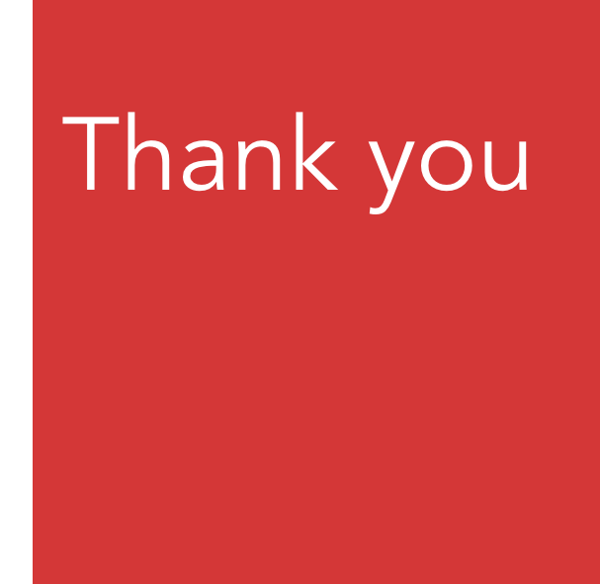
Notes:
Slide 22
Thank you for taking time to be here.
I really hope that you will see the possibilities involved in engaging with a new, young workforce who might think very differently from my generation.
But these are the people who are already the consumers of today, with aspirations to be the leaders of the future, with hopes to shape tomorrow’s economies.
Thank you.
- Ends -

