Slide 1
Global Trends in the Accounting Profession of the Future
George S. Willie, CPA
Member SMP Committee of International Federation of Accountants
June 22, 2019

Slide 2
Agenda
IFAC Global SMP Survey 2018
AICPA – PCPS 2018 Survey: U.S. Top Issues
Will the Profession Survive?
What is the Path Forward?
Hope is Not a Strategy

Slide 3
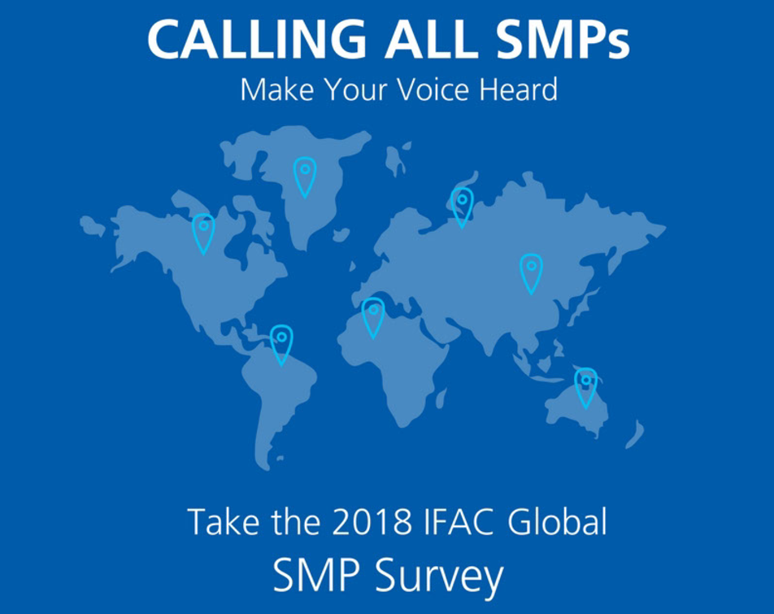
IFAC Global SMP Survey 2018
6,258 Respondents from 150 countries
  24 languages
64% sole practitioner or 2-5 partner and staff
Significant variation between regions and practice size

Slide 4

IFAC Global SMP Survey 2018
Continued
Key Highlights – Advisory & Business Consulting
51% predict a moderate or substantial increase in practice fee revenue in the 12 months for business advisory and consulting services (up from 45% in 2016)
86% provide some advisory or consulting service
  53% corporate advisory
  50% management accounting
  (up from 83% in 2016)

Slide 5
IFAC Global SMP Survey 2018
Continued
Key Highlights – Technology
54% SMPs plan to allocate more than 5% of practice fee revenue to technology investment in next 12 months
Technology developments introduced (or planned to be introduced) in next 12 months
  37% Development of in-house skills and expertise in IT
  32% Adoption and use of cloud options for client’s interface and servicing
  29% Provision of business insights from data analytics
  23% Recruitment of non-accountants (e.g. IT specialists, data scientists)

Slide 6
IFAC Global SMP Survey 2018
Continued
Key Highlights – Technology
38% viewed technology developments as a high or very high challenge (up from 35% in 2016)
However, 26% of SMPs have no immediate plan to tackle the disruption of technology in their business. Is this of concern to the profession?

Slide 7
IFAC Global SMP Survey 2018
Continued
Key Highlights – Talent Management
54% of SMPs have difficulty attracting next generation talent.
These challenges (sum of high & very high) were:
  Lack of candidates with the right mix of skills (66%)
  Competition from larger practices (57%)
  Increase opportunity in other fields (44%)
  Concern about work-life balance and flexibility (41%)
Only 43% of SMPs invested more than 5% of their revenue on training (technical, soft skills, mentoring, etc.)

Slide 8
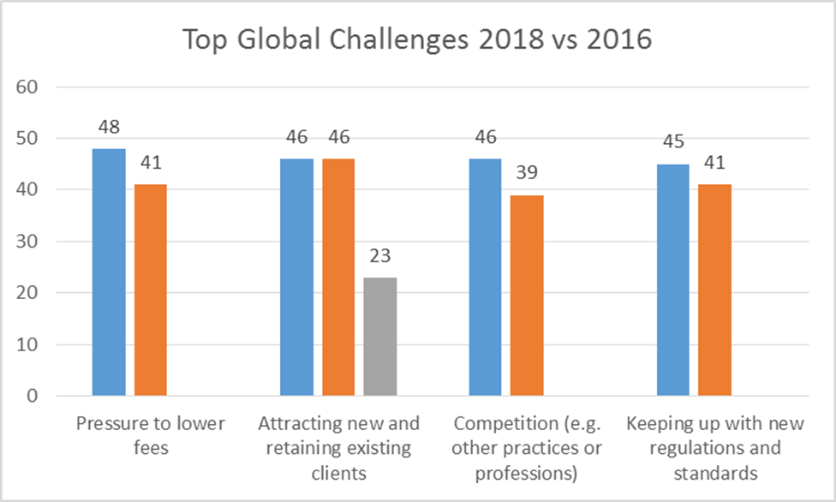
Continued
IFAC Global SMP Survey 2018

Slide 9
AICPA – PCPS 2018 Survey:
U.S. Top Issues
Firms 21+ Professionals | Firms 2 – 5 Professionals
Finding Quality Staff | Finding Quality Staff
Retaining Qualified Staff | Seasonal Work Load
Bringing New Clients | Succession Planning
Managing Work/Life Initiatives | Retaining Qualified Staff
Transitioning to Trusted Advisory | Keeping up with Changes and Complexity of Tax Laws

Slide 10
Will the Profession Survive? Challenges
The Job landscape in 2022 | Top 10 declining roles Data entry clerks Accounting, bookkeeping and payroll clerks Administrative and executive secretaries Assembly and factory workers Client information and customer service workers Business services and administration managers Accountants and auditors Material-recording and stock-keeping clerks General and operations managers Postal service clerks
75 Million
Global
change by
2022
Source: Future Jobs Report 2018. World Economic Forum

Slide 11
Will the Profession Survive? The Future
Continued
The Job landscape in 2022 | Top 10 emerging roles Data analysts and scientists Al and machine learning specialists General and operations managers Software and applications developers and analysts Sales and marketing professionals Big data specialists New technology specialists Organizational development specialists Information technology services User Experience and Human Machine Interaction Designers
133 Million
Global
change by
2022
Source: Future Jobs Report 2018. World Economic Forum

Slide 12
Will the Profession Survive – and How?
Continued
Technological innovations + Changing marketplace demands = | Complex compliance Advisory services SOC services Technology and big data Higher-level analysis | Data entry Compliance tasks Transactional tasks Repetitive, rules -based jobs

Slide 13
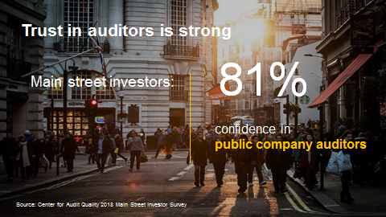
Continued
Will the Profession Survive? The Brand

Slide 14

Continued
Will the Profession Survive?
Technology is Poised to Disrupt Auditing

Slide 15
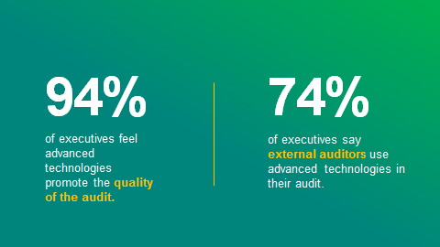
Continued
Will the Profession Survive?
Advanced Technologies Promote Audit Quality
Sources: Forbes Insights/KPMG 2018 Next Generation Audit Report

Slide 16

Continued
Will the Profession Survive?
Key Drivers to Better Audit Quality

Slide 17
What is the Path Forward?
Present
There is a case for transformation:
Missing the opportunity to grow
Complacency
Partner/manager comfort zones
Artificial harmony
Over confidence
Believing that past successes are guarantees for the future
Not recognizing the coming leadership void
Measuring time
Not focusing enough on our people

Slide 18
Hope is Not a Strategy
We must:
Determine who we are
Make it clear that leadership is embracing change
Create a vision for the culture you want to have
Invest in your members’ future
Instill a sense of belonging
Bring firm management on board
Leadership must identify training needs, develop tools and implement transfer of knowledge
Spend more resources and time on learning and development to succeed in the future

