Slide 1

DR L D WHYTE mb.bs.(UWI)
LIFESTYLE TRANSFORMATION CENTRE
906 (LOVE)5683
WWW.LIFESTYLETRANSFORMATIONCENTRE.COM

Slide 2
The Wellness Imperative: don’t Stress Out! Lifestyles for High Stress Jobs”
Dr L Danovan whyte mb.bs 876 906 5683 (LOVE)

Slide 3


Slide 4
DEFINITIONS
WELLNESS…MORE THAN ABSENCE OF DISEASE..A STATE OF PHYSICAL AND EMOTIONAL ABUNDANCE…AND FREE FROM PASSIONS
STRESS… A RESPONSE TO PERCIEVED THREATS..FIGHT FLIGHT FRIGHT MECHANISM= FEAR

Slide 5
ROLE OF STRESS
PREPARATION….TO DEAL WITH CHALLENGES
FIGHT OR FLIGHT RESPONSE
ANCIENT STRESS
MODERN STRESS

Slide 6
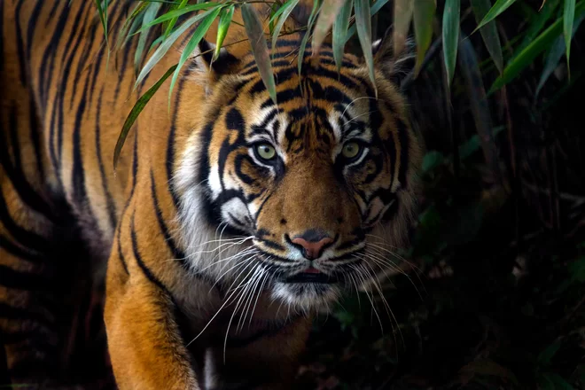
ANCIENT STRESSOR

Slide 7

Modern stressor

Slide 8
EFFECTS OF STRESS
HEART RATE
BLOOD PRESSURE
ANXIETY DEPRESSION
ALL FEAR BASED
ACID TOXICITY
PINCHED NERVES…VISION ….OTHER NERVE DISORDER…ED…PAINS ETC
SECONDARY MYCOTOXICOSIS….ALL SYSTEMS AFFECTED

Slide 9

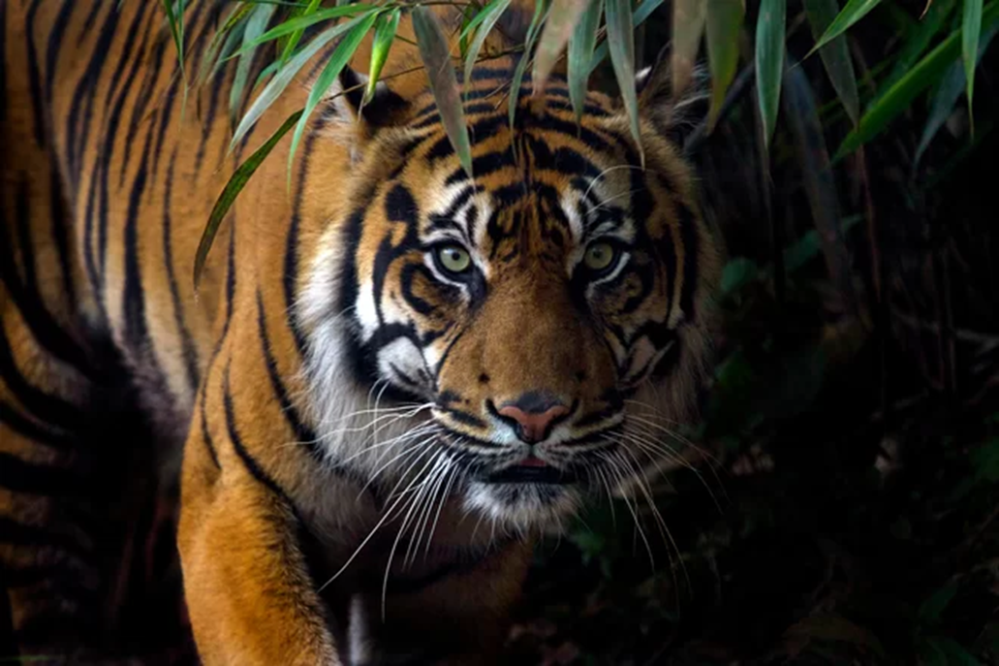

Slide 10
IMPORTANT STUFF……..NEW GODS
TIME
MONEY
JOB
FAMILY
OTHERS…..MYOB
SELF IMAGE

Slide 11
WHAT IS REALLY THAT IMPORTANT?
THIS BECOMES YOUR BURDEN
CARRY IT ON YOUR HEADS…CONSEQUENCES
NEW MASTER….NEW SLAVE
FIRST COMANDMENT…..
IF EVER YOU SHOULD SEE YOUR MASTER…….KILL HIM

Slide 12
PERFECTION
I AM PERFECT AND GETTING BETTER
ONLY GOD IS PERFECT…..MY POINT EXACTLY
KNOW YE NOT THAT YE ARE GODS…..CHILDREN OF THE MOST HIGH??
WITH DOMINION OVER ALL THINGS
POWERFUL CREATIVE

Slide 13
ACCEPTING WHOLENESS AND PERFECTION
REASSURANCE SOUGHT
INVESTIGATIONS
LAB X-RAY
MRI
MEDICAL CONFIRMATION
ALL STRESSORS IN THEIR OWN RIGHT….
ALL OUTSIDE OF THE SELF

Slide 14
CREATING YOUR REALITY
THOUGHTS AND CONCIOUSNESS
WHATEVER YOU CONCEIVE YOU CAN ACHIEVE
WHAT DO YOU BELIEVE??....YOU ARE RIGHT
ORIGIN OF THOUGHTS AND IDEAS
FEAR BASED OR LOVE BASED

Slide 15
FEAR
IGNORANCE
DARKNESS
ABSENCE OF LOVE
PERFECT LOVE CASTETH OUT FEAR
ALL NEGATIVE EMOTIONS

Slide 16


Slide 17
LOVE
KNOWLEDGE
TRUTH
CONSEQUENCES….OF LOVING THE SELF

Slide 18
BELIEF
IS IT SERVING YOUR PURPOSE?
DOES IT PROVIDE YOU WITH PEACE…..JOY….HAPPINESS….WELL BEING
PERFECT SPIRITUAL FOODS

Slide 19
ERROR THINKING
DRUGS MAKE US WELL
WE EAT TO GET ENERGY
GOD IS PUNISHING YOU FOR YOUR SINS

Slide 20
ERRORS IN THINKING
ALLOWING OUTSIDE TO TAKE PRECEDENCE OVER INSIDE
GIVING IMPORTANCE TO EXTERNAL
REFUSING TO LOOK FOR TRUTH IN ALL SITUATIONS
BELIEVING…KNOW AND NOT BELIEVE

Slide 21
FALSE BELIEFS
ERRORS IN THINKING
T HINKING
O UT SIDE
X CEEDS
INS IDE OF OURSELVES
THEREFORE SEARCH FOR MAGIC BULLETS AND MIRACLES

Slide 22
BEHAVIOUR
FACT + BELIEF =RESPONSE/BEHAVIOUR

Slide 23
LOVE
THE ANSWER
STARTS WITH THE SELF
STARTS WITH SELF KNOWLEDGE

Slide 24
WHO AM I???
IMAGE OF THE CREATOR
I AND THE FATHER ARE ONE
ONLY HUMAN ? OR ONE WITH THE ALL POWERFUL CREATIVE FORCE
FORGETTING WHO WE ARE LEADS TO FALSE IDEAS OF SELF….ERRORS

Slide 25
TAKE ACTION
GET PHYSICAL
REST
MEDITATION
BREATHING
SEEK KNOWLEDGE
LET TRUTH BE YOUR GUIDE…..DONT WATCH THE CROWD

Slide 26


Slide 27
THE BEST MEDICINE
L AUGHTER / LOVE
A CCEPTANCE/AWARENESS
U NCONDITIONAL FORGIVENESS
G RATITIUDE
H APPINESS
T RUTH
E NTHUSIASM
R EST

