Slide 1

The C Factor: Optimising China’s role in the Caribbean
Presenter: AUBYN HILL
Ceo, Economic growth council
Venue: Jamaica Pegasus hotel
Date: Friday, June 21, 2019
Time: 2:20 PM

Slide 2
ALL VIEWS AND COMMENTS ARE MINE.
THEY ARE NOT THE VIEWS OF THE GOVERNMENT OF JAMAICA!

Slide 3

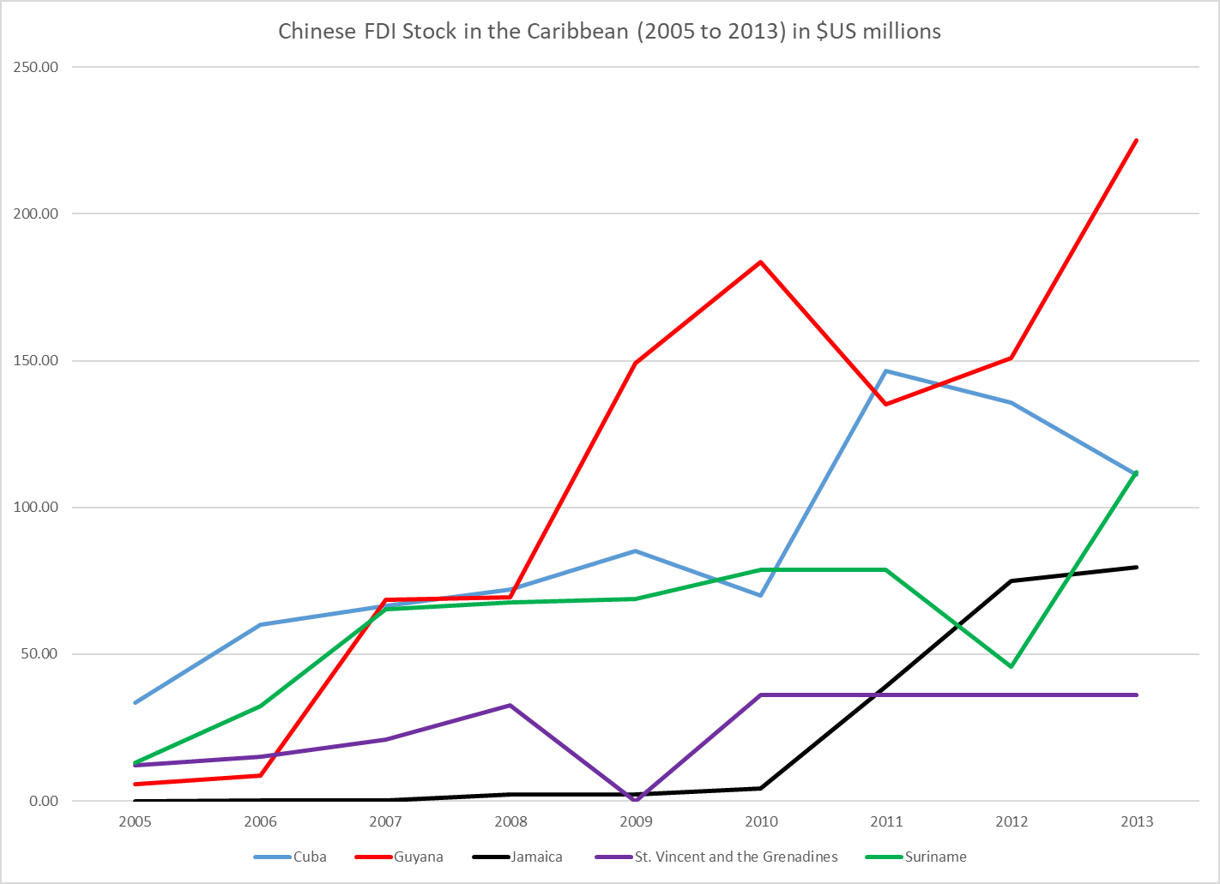
Chinese FDI to the Caribbean
(2005 to 2013) in US$Millions

Slide 4
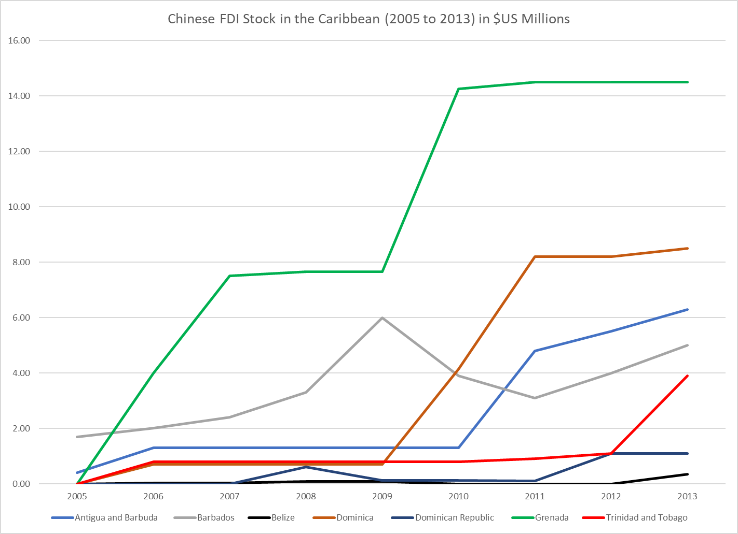
Chinese FDI to the Caribbean (2005 to 2013) in US$Millions

Slide 5
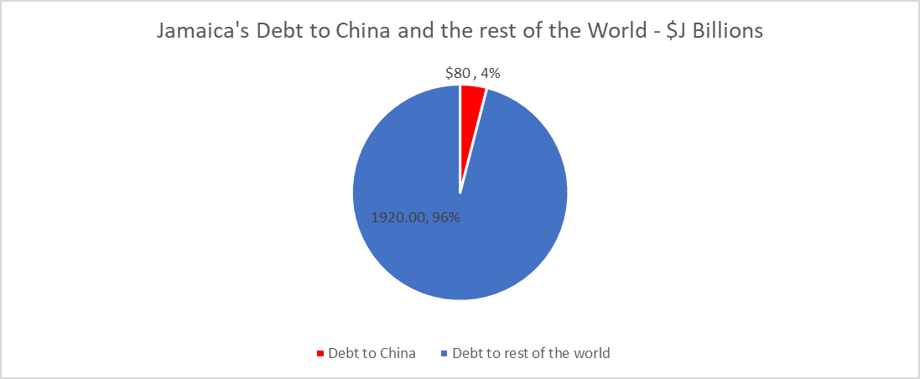
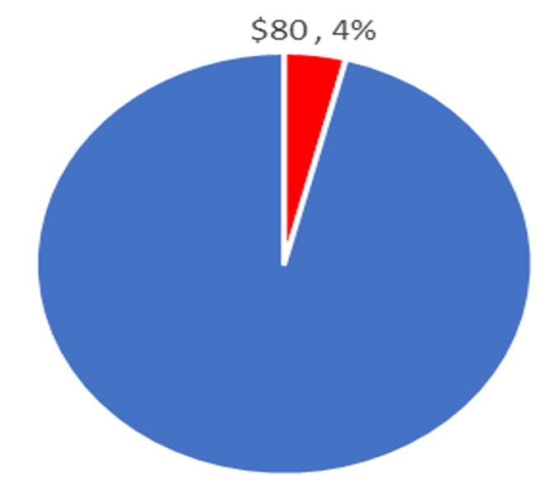
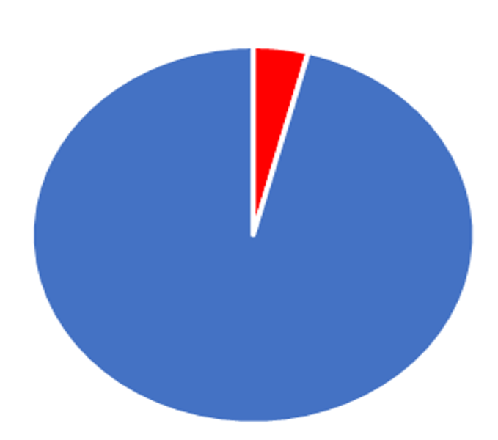
Jamaica’s Debt to China vs Jamaica’s Overall Debt (2019) - $J Billions
J$80/ US$ / 4%
1920.00, 96%
J$1920.00/ 96%

Slide 6
Infrastructure Projects in Jamaica via
Chinese Investment
Project | Value ($US millions) | Year
Trelawny Greenfield Stadium | $30M | 2005
Montego Bay Convention Centre | $45M | 2007
Road Construction | $400M | 2010
Shoreline Reconstruction | $58M | 2010
Jamaica Economic Housing Project | $71M | 2011
Road and Bridge Rehabilitation | $300M | 2013
North-South Toll Road | $457M | 2013
Road network | $327M | 2016
Southern Coastal Highway | $326M | 2017

Slide 7
China Financing in Latin America and the Caribbean (2005 to 2018)
Country | Amount ($US Billions)
Venezuela | $67.2
Brazil | $28.9
Ecuador | $18.4
Argentina | $16.9
Trinidad and Tobago | $2.6
Bolivia | $2.5
Jamaica | $2.1
Mexico | $1.0
Other countries | $1.3
Total | $141.3

Slide 8
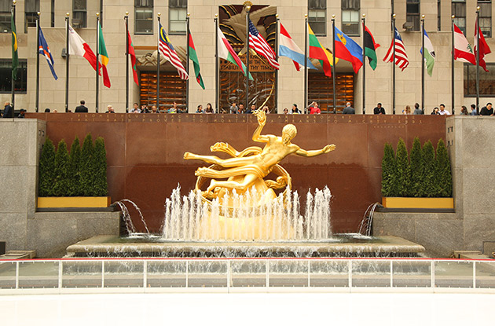



Negotiate Well
Japan - Mitsubishi Estate Company of Tokyo
October 31, 1989
Jamaica
August 2011
Negotiators should look after their own self-interest
Henry Kissinger - We have no permanent friends, only permanent interests

Slide 9
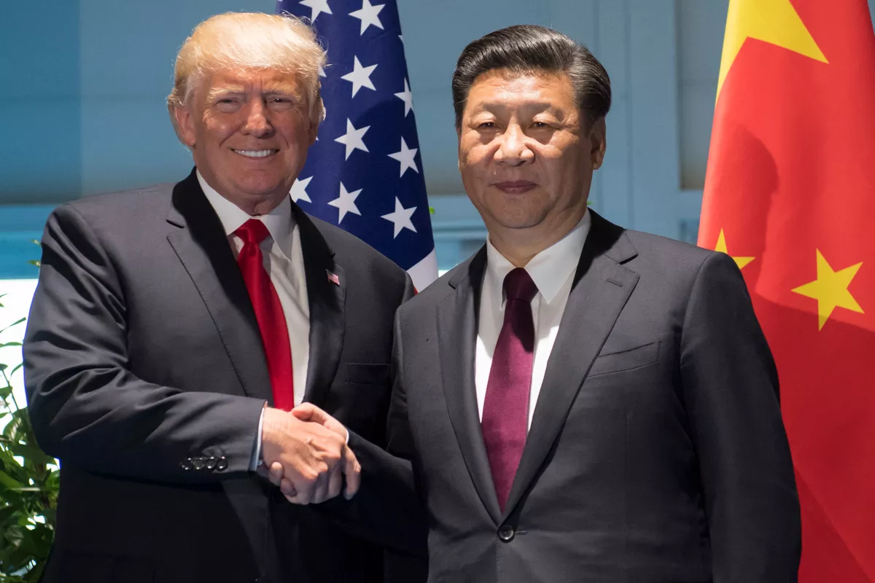
Power Calculus

Slide 10

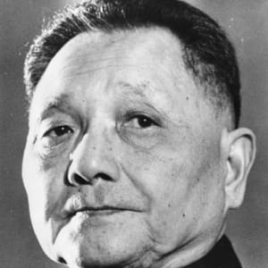
Changing China’s History
Deng Xiaoping
Flag of China

Slide 11
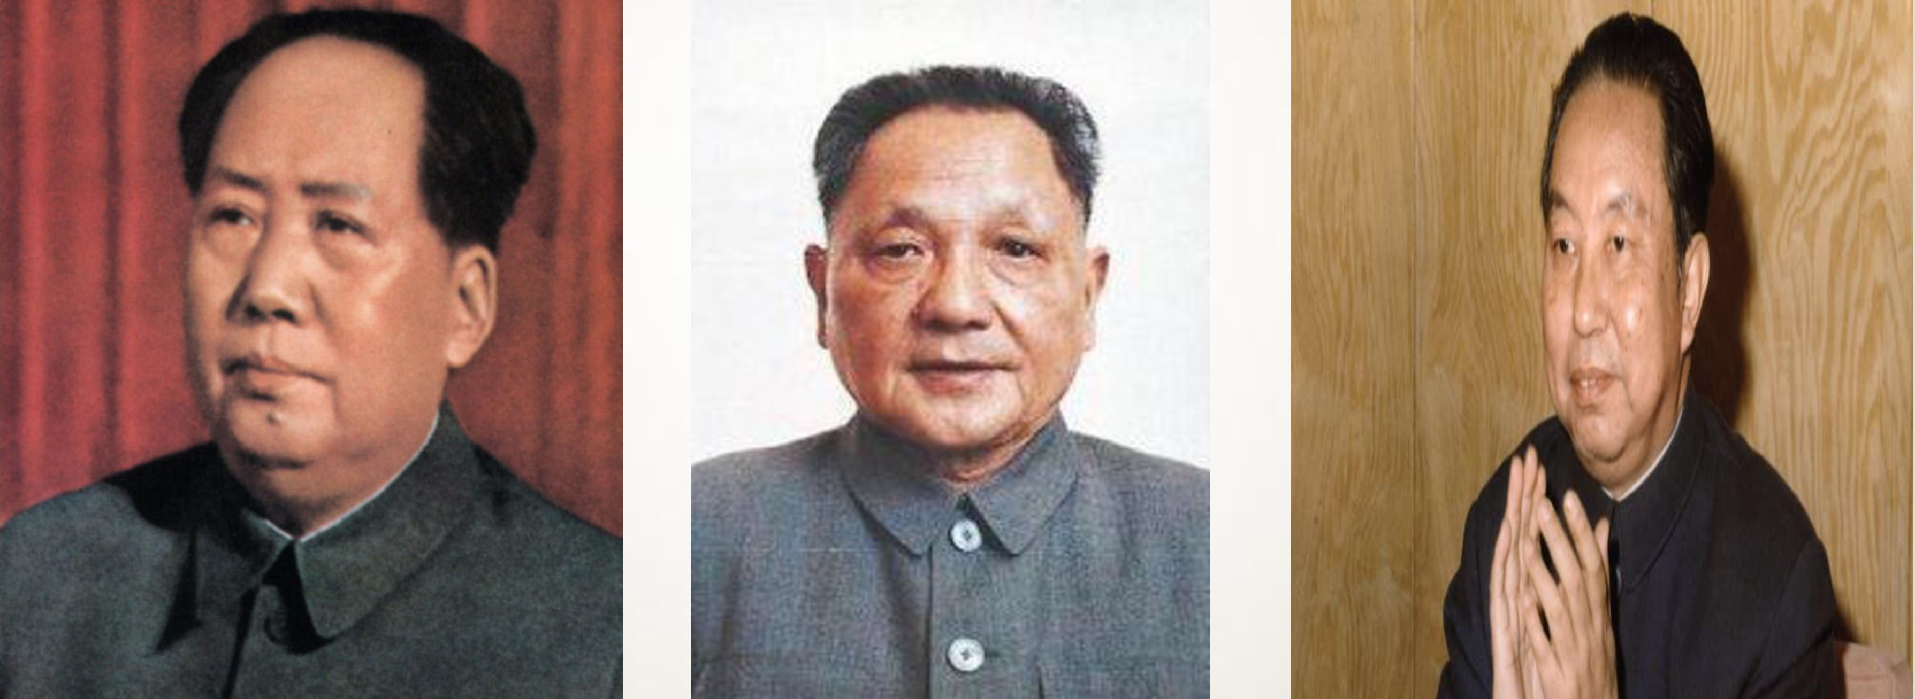
Changing China’s History
Mao Zendong, Deng Xiaoping and Hua Guofeng

Slide 12
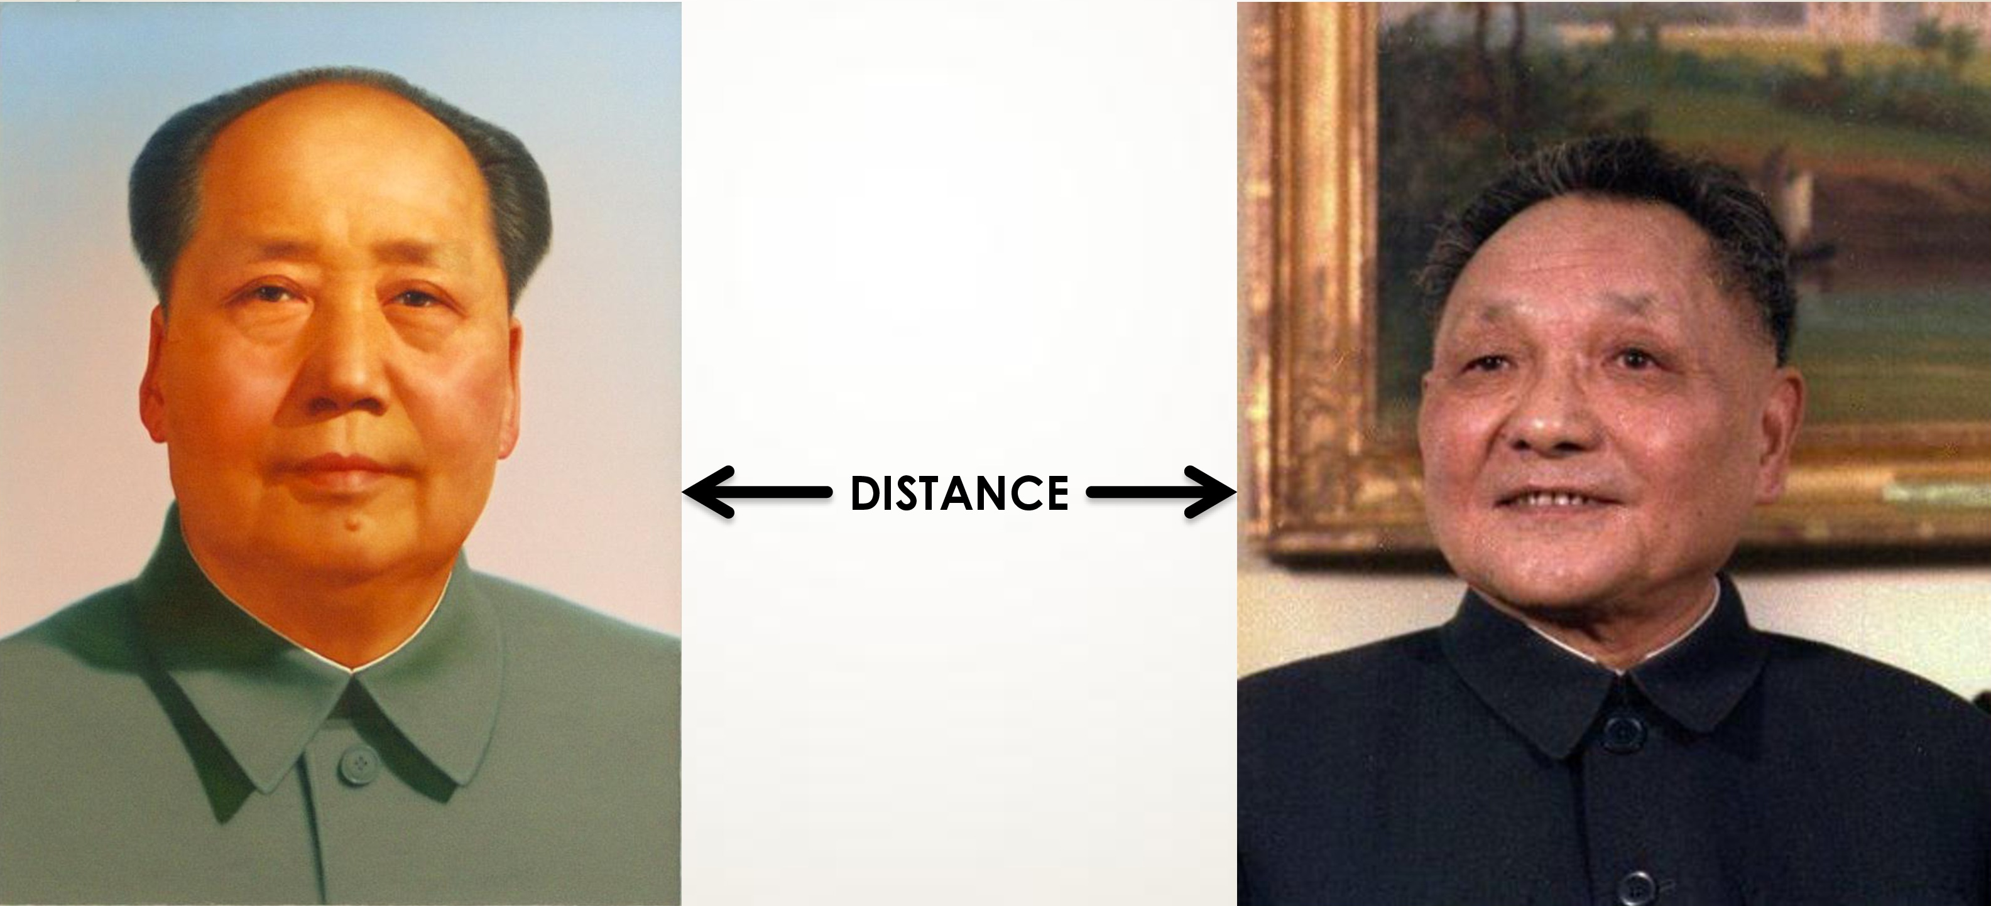
Mao Zendong and Hua Guofeng
Changing China’s History

Slide 13
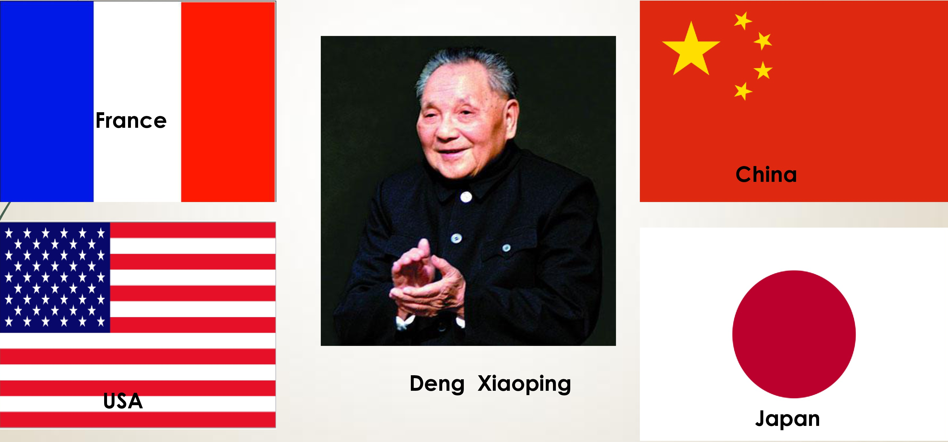
Changing China’s History
Friendship

Slide 14
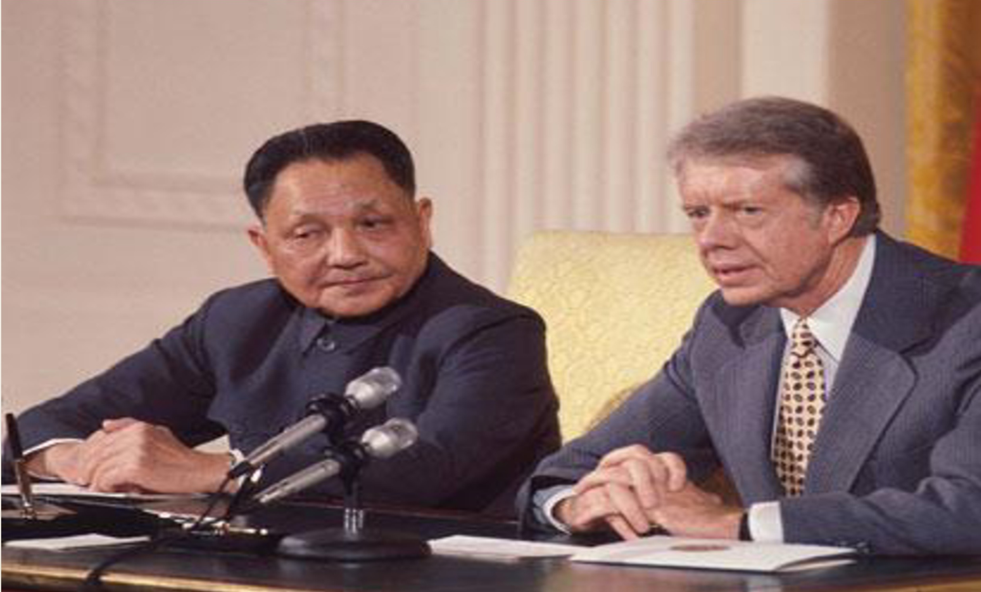
Changing China’s History
Deng Xiaoping and Jimmy Carter February 1979

Slide 15
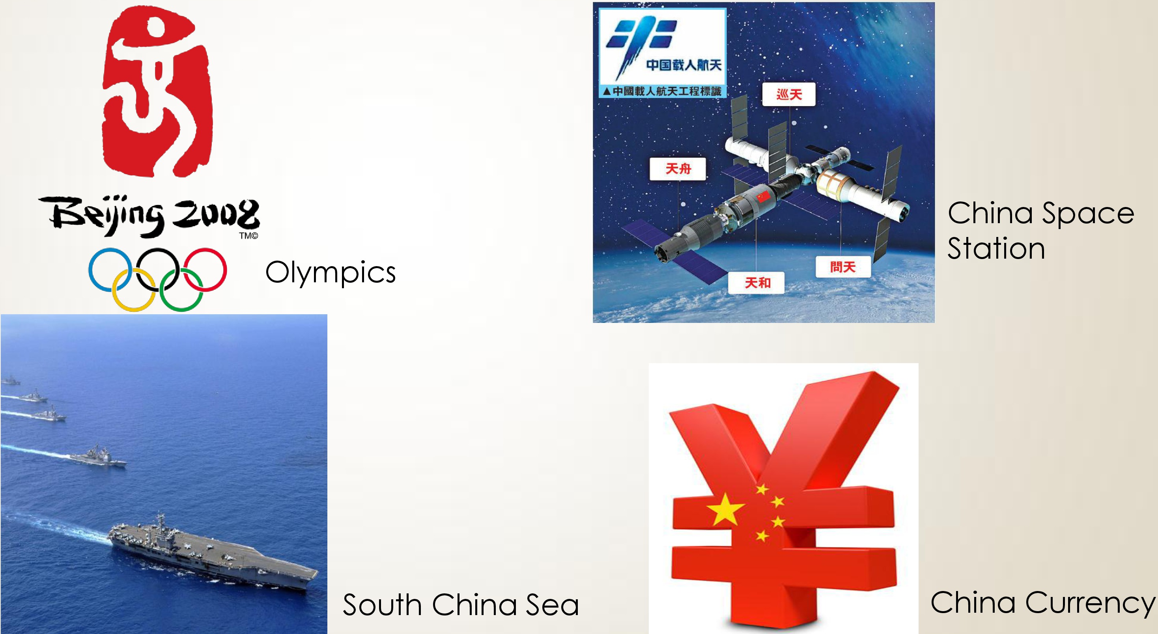
Changing China’s History
China’s Place in the World

Slide 16
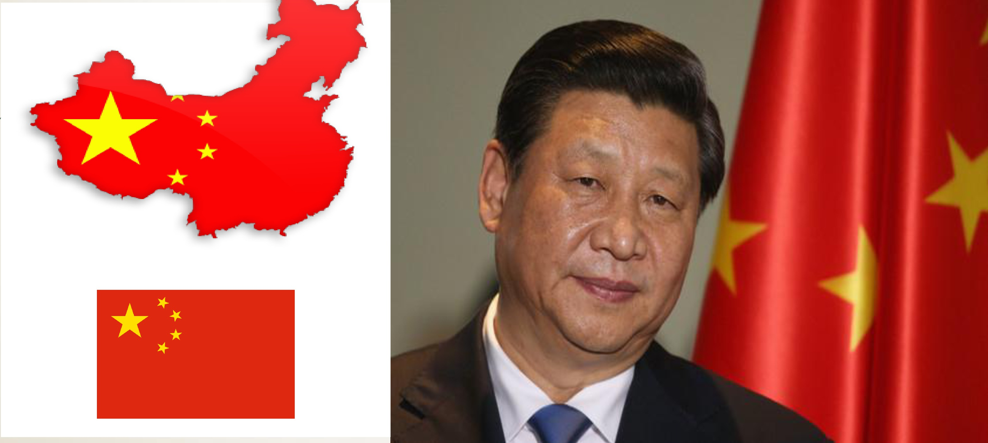
The Power Calculus

Slide 17
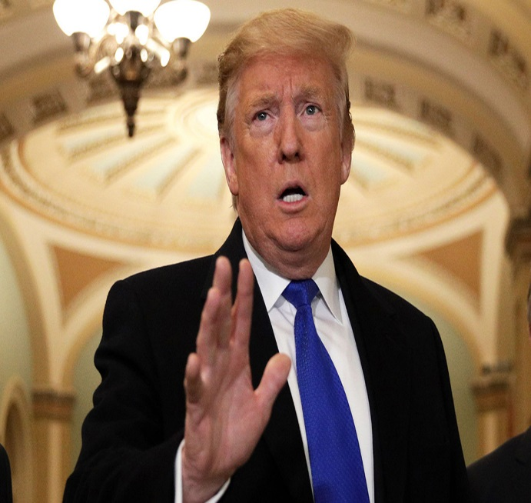
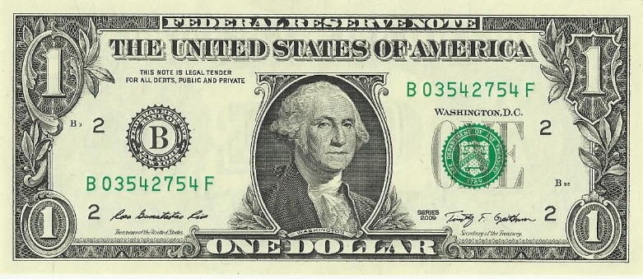
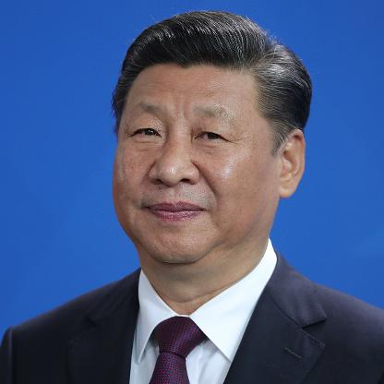
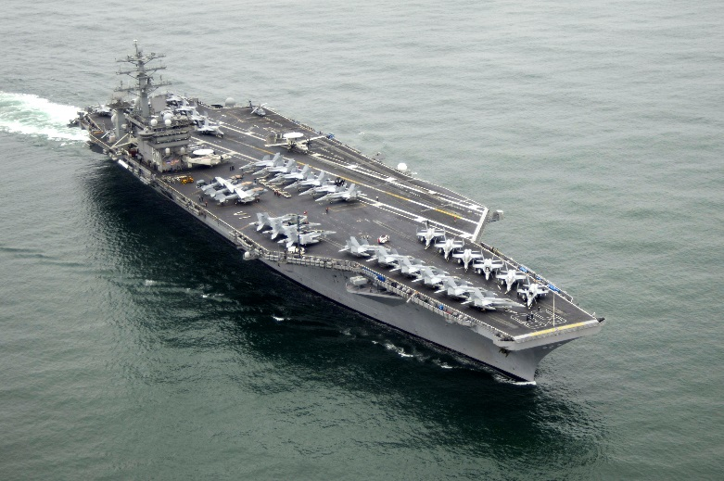


The Power Calculus
Reserve Currency
Super Power
Nimitz + 17 Aircraft Carriers
Robust Democracy
The Governed talks back in abusive terms to the Leader
Trading Power

Slide 18

THANK YOU!
Aubyn Hill CEO
Egcgrow@gmail.com
Aubyn.hill@gmail.com

