Slide 1


ICAC Conference • June 25, 2021
Grace Burnett
CEO, GraceKennedy Financial Group
WE ARE STRONGER TOGETHER. WE CARE.

Slide 2
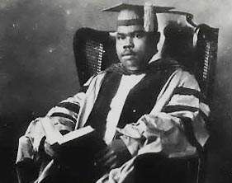
“A people without the knowledge of their past history, origin and culture, is like a tree without roots”
-Marcus Garvey

Slide 3
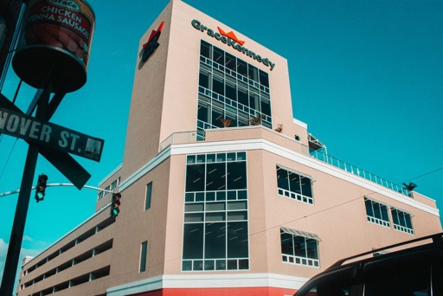
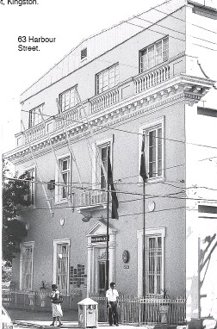
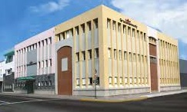
From Humble Beginnings…
2019
1922
1997
Spirit of Jamaica, Inspiring the World

Slide 4
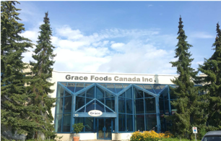
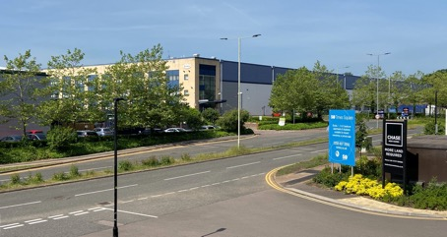
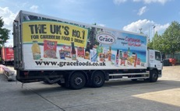
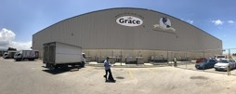
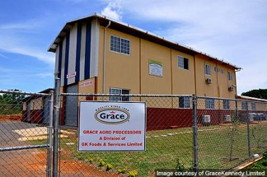
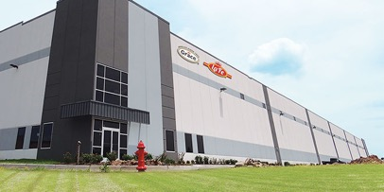
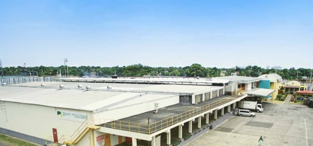
…To a Global Consumer Group
Spirit of Jamaica, Inspiring the World

Slide 5
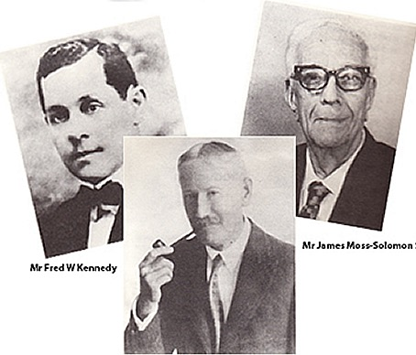

From Jamaica to the World
Inception of Grace, Kennedy & Co Ltd and Early Adventures
1922 - 1950
James Moss-Solomon Sr
Fred W Kennedy
Dr John Grace
Spirit of Jamaica, Inspiring the World

Slide 6

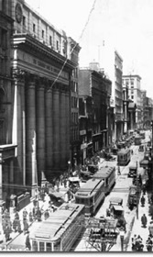
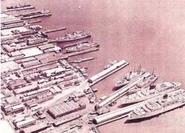
From Jamaica to the World
Building the Business and Expansion Overseas
1950 - 1980
St James Street
Montreal, 1952
The Grace Group’s 6 divisions:
Trading Companies
Insurance and Real Estate
Shipping and Wharf Operations
Manufacturing
Overseas Operations
Financial Operations
Kingston Harbour
Spirit of Jamaica, Inspiring the World

Slide 7
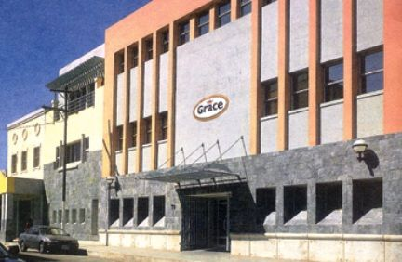
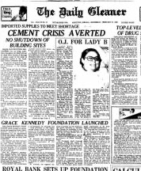
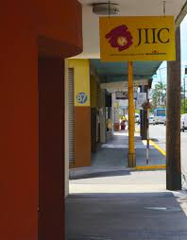
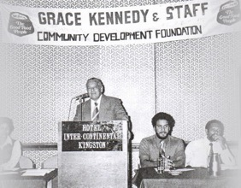
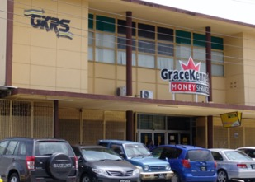
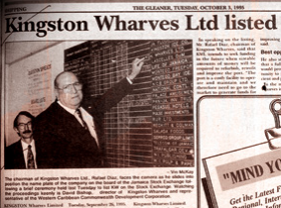
From Jamaica to the World
Continued Global Growth
1980 - 2000
Years of expansion resulted in GK operating offices in (2000):
    Barbados
    Belize
    Bermuda
    Canada
    Guyana
    Jamaica
    Trinidad & Tobago
    Turks and Caicos
    UK
    USA
Spirit of Jamaica, Inspiring the World

Slide 8
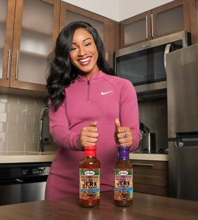


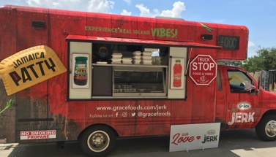
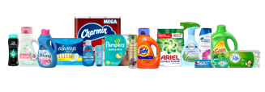
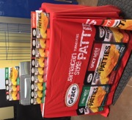


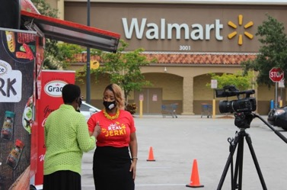
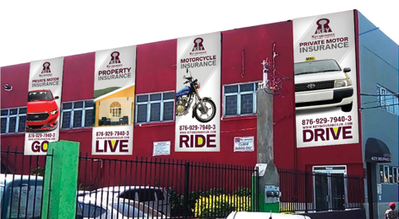


From Jamaica to the World
Strengthening our global presence
2000 onwards
Spirit of Jamaica, Inspiring the World

Slide 9



Some of our major Brands Today
Spirit of Jamaica, Inspiring the World

Slide 10
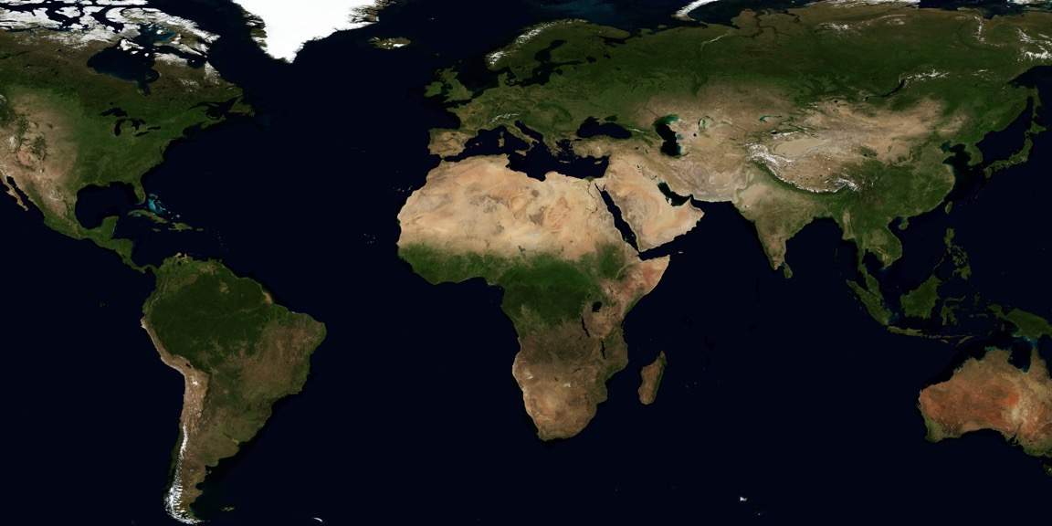

2020 Vision Scorecard
Developed in 1995
1. A high stock market value for our company to benefit our shareholders, and to lower the cost of capital
2. Ethical in our conduct of doing business
3. Responsible members of our community – “Grace we care”
4. Truly international by acting on appropriate opportunities wherever they may arise in the world
5. A dynamic group composed of strong, viable business units
6. A group of business units that gives value to our customers, not added cost
7. A company whose consumers demand our products, our services and our brands
8. Continuously increasing productivity to raise the standard of living of our staff
Spirit of Jamaica, Inspiring the World

Slide 11
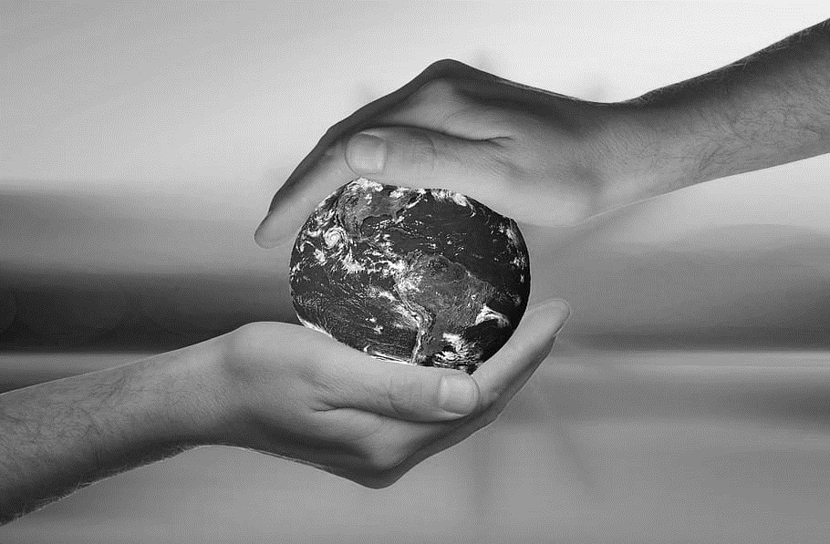
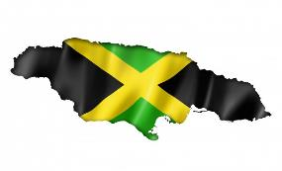
Our Vision and Mission
Vision: To be a Global Consumer Group delivering long term consumer and shareholder value, through brand building and innovative solutions in food and financial services provided by highly skilled and motivated people
Mission: To deliver the taste and experience of Jamaican and other
multi-cultural foods to the world and leading financial services to our region
Spirit of Jamaica, Inspiring the World

Slide 12

Always guided by Our Core Values …
HONESTY
Commitment
In what we say and do
To quality and service
Humility
Integrity
Without pretension or
self-importance
Our word is our bond
Trust
Respect
To inspire and earn
trust and confidence
For staff, peers,
managers and directors
Spirit of Jamaica, Inspiring the World

Slide 13





Global Consumer Group
Leverage
Revenue earned outside Jamaica
Group profit derived
from outside of Jamaica
relationships with multi-nationals & form partnerships to enhance our offerings
60%
50%
Currently with 5 partners
Spirit of Jamaica, Inspiring the World

Slide 14
Global Consumer Group
47%
45%
Leverage
relationships with multi-nationals & form partnerships to enhance our offerings
2020
2020
Revenue earned outside Jamaica
Group profit derived
from outside of Jamaica
[Target of 60%]
[Target of 50%]
Currently with 5 partners
Spirit of Jamaica, Inspiring the World

Slide 15
Revenue by Geography
J$55m
2010
J$111m
2020
Spirit of Jamaica, Inspiring the World

Slide 16




Strategic Drivers
Mission & Vision
Strategy
Focus Areas
Consumer Centricity
Internal Processes
Sustainable Growth & Innovation
Performance Driven Organization
Global Consumer Group
Spirit of Jamaica, Inspiring the World

Slide 17

Spirit of Jamaica, Inspiring the World

Slide 18
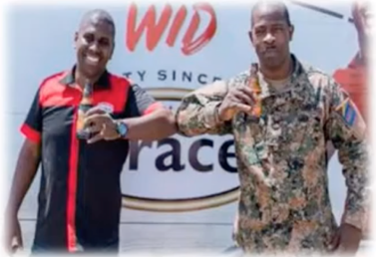
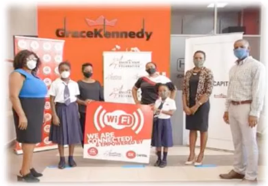
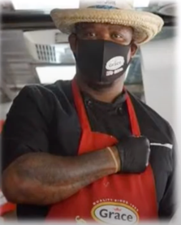
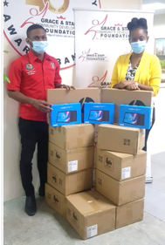
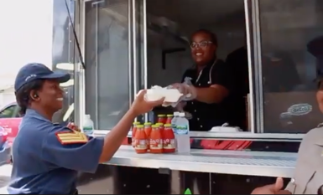
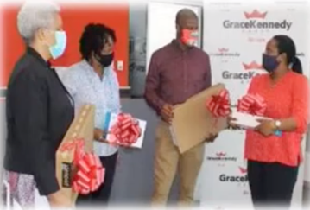
GK Giving Back
#WeCare
GraceKennedy
Jamaica
Spirit of Jamaica, Inspiring the World

Slide 19
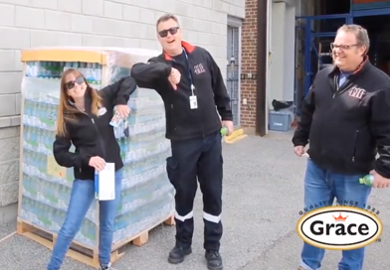
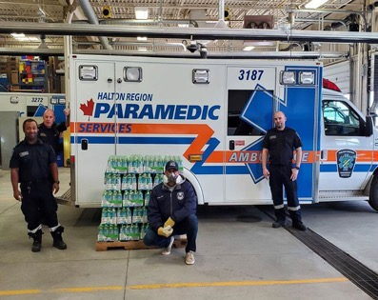
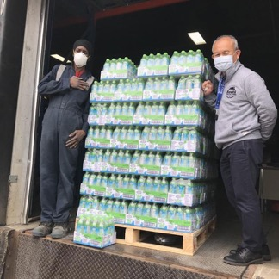
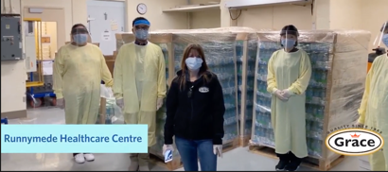
GK Giving Back
Grace Foods Canada
Grace Foods Canada Coconut Water Drop off to first responders in Canada.
Over 1,900 cases of Grace Coconut Water were donated to first responders and front-line health care providers.
Spirit of Jamaica, Inspiring the World

Slide 20
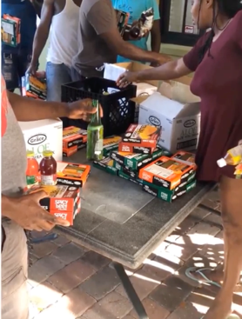
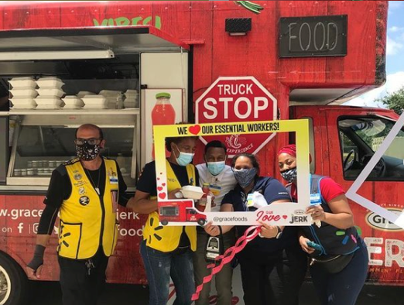
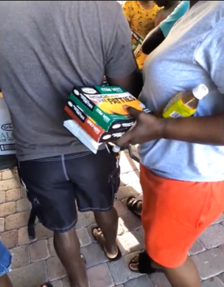
GK Giving Back
GK Foods USA
In the USA, displaced hospitality workers were given meals and products by our team
Spirit of Jamaica, Inspiring the World

Slide 21
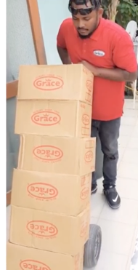
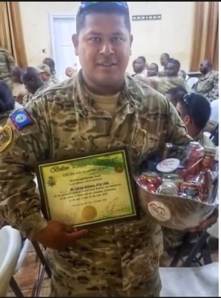
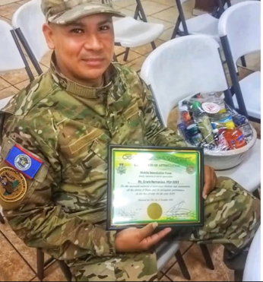
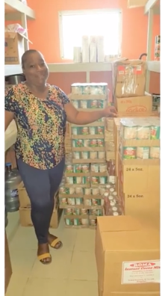
GK Giving Back
GK Belize
We also donated products to the Belize Mental Health Association, Belama Police department and citizens in need of assistance
Spirit of Jamaica, Inspiring the World

Slide 22
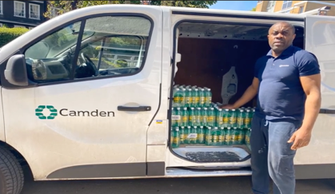
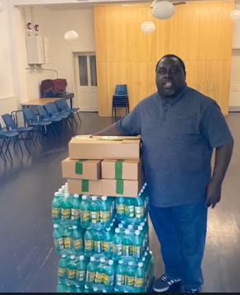
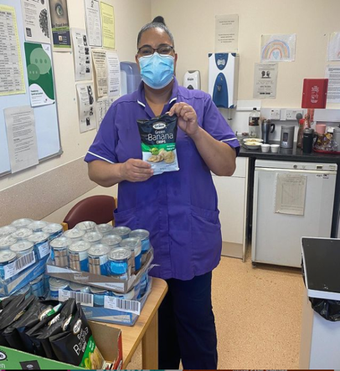
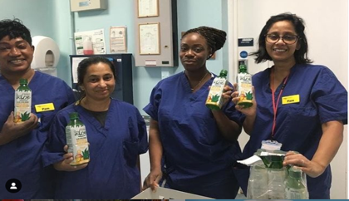
GK Giving Back
Grace Foods UK
We donated products to the Brixton Soup Kitchen and the NHS at Excel
Spirit of Jamaica, Inspiring the World

Slide 23
Diaspora Work
GK is a legacy partner of the Biennial
Jamaica Diaspora Conference
For the past 17 years, provided the opportunity for 2nd & 3rd generation Jamaican university students living in the USA, UK & Canada to better understand their proud Jamaican heritage
Spirit of Jamaica, Inspiring the World

Slide 24

GK100
GraceKennedy celebrates its 100th anniversary in 2022. This is an incredibly important milestone for our Group. We are poised for growth and are excited for the prospects as we embrace the past and look forward to the future.
Spirit of Jamaica, Inspiring the World

Slide 25

GK Accessing Global Markets Strategically
As we solidify our position as a Global Consumer Group, our focus will continue on some of our key initiatives:
Mergers & Acquisitions
Innovation & Grace Brands Growth
Financial Inclusion
Digital Transformation
Develop our Environmental, Social & Corporate Governance (ESG) Framework
We care
Spirit of Jamaica, Inspiring the World

Slide 26

Thank You

