Slide 1
Envisioning the Future … Managing our Reality
38th ICAC Caribbean Conference of Accountants
Helen Brand, chief executive - ACCA
Notes:
Slide 1
Good morning everyone, and first of all can I say thank you so much for inviting me to join you for such a great event today. It is an enormous pleasure to be with you for this, your 38th annual conference.
I know just how big a contribution you make to the accountancy profession, to business, and to society right across the Caribbean, and I am so pleased that we can share this time together today.
I would also like to send warmest greetings to all the friends, colleagues and special guests who are with us, including Perry Christie, the former Prime Minister of the Bahamas; Khalil Alli, the president of ICAC; vice president David Simpson; the presidents of all the national institutes; and to our friends from AICPA, CIPFA and CPA Canada.
I know that the theme of this event is all about envisioning the future. And I would like to spend some time explaining why I am optimistic about the years to come, and why I have so much faith in the ingenuity and talent of the next generation. The new world demands new talents, new skills, fresh thinking, and this opens the door wide to accountants with ambition, dedication and vision.
Certainly, these are difficult times for business. I don’t need to spell out the global effects of the pandemic, and the after-shocks it has had on the world economy. But it is also a landmark point in history, and a good moment to make a career as a professional accountant.
[Click]

Slide 2


Groundbreakers
Rethinking careers: Gen Z and the future of accountancy
Notes:
Slide 2
At ACCA we recently published a report in collaboration with our friends from IFAC called Groundbreakers: Generation Z and the Future of Accountancy, and it paints a picture of a new generation of aspiring finance professionals who are ready and eager to do business differently.
We all know that every generation re-makes the world anew, throwing off old ways and bringing in new ideas, values and attitudes.
The world we know isn’t the same place our grandparents knew. And future generations will look back on this time, their views influenced by their own late 21st Century reality, and wonder at the strange way we did things.
That’s the natural order of life.
In our report, we took a global snapshot of the different way in which the next generation of adults might seek to reshape the world, specifically the world of work and accountancy.
[Click]

Slide 3

9,000 18 – 25 year olds
They demand much more from prospective employers
Less than half believe business leaders have integrity
It really matters to them who they work for
Notes:
Slide 3
It came in the context of a world which half-way through faces a double hit - the global economic, social and health crisis caused by COVID-19, as well as the growing threat of climate catastrophe.
We asked more than 9,000 18-25-year-olds all over the world, including from across the Caribbean region, for their opinions on a whole array of subjects relating to careers and professional life. The responses from Generation Z, as this group have been dubbed, were eye-opening to say the least.
One of the key findings was that Gen Z workers demand much more of their prospective employers than was perhaps the case for older workers. Less than half believe that business leaders have integrity and do what they say. And for this Generation Z, it really matters to them who they work for.
I think that marks a real cultural change. It was a while ago now, but I don’t think that when I first entered the workforce I spent much time second-guessing what my bosses were up to, or what their motivation was. I suspect that most people of my generation were the same.
Generation Z, by contrast, want to feel as though they are working for people and businesses that share their values, and they want to do work that amounts to a lot more than just a pay packet.
They have high expectations for a healthy work–life balance and how employee welfare is managed. Sustainability is a big concern for this generation, but fewer than half of respondents believed businesses are pulling their weight in fighting climate change.
Our report made it quite clear that young workers demand more accountability and transparency. It reveals that their biggest concerns are job security, well-being and mental health, offering a wake-up call to employers, who need to show they care about their staff as people, not just workers.
[Click]

Slide 4
A call out for employers
Gen Z is smart, connected, ambitious – yet realistic
This is an optimistic report, with Gen Z keen to take personal responsibility
Notes:
Slide 4
This research is really valuable for employers, regardless of sector, because meeting this generation’s needs and addressing their concerns will be essential for them to attract the best talent and to thrive.
Gen Z is smart, connected, ambitious yet realistic – but they have concerns about the future and about how business operates. Employers of all sizes have to be aware of this generation’s hopes and ambitions and the value they can bring.
For me, the report was cause for great optimism because the next generation of leaders clearly has a sharply defined sense of what responsible business should look like. They are ready to take personal responsibility to play their part in shaping an economy that serves all people, and also respects the health of the planet.
These are young people who will help create a workforce which is more diverse, more inclusive, and which will make businesses more aware of their broader role in society.
[Click]

Slide 5

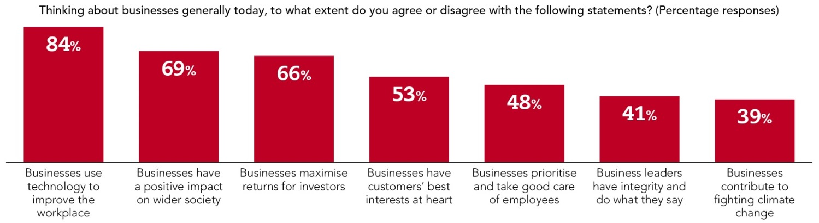
Notes:
Slide 5
They are comfortable with digital technology. It is a part of their lives and part of who they are, in a way that isn’t necessarily true for earlier generations. Young accountants are tech smart, with 80% saying they are comfortable with technology and pick up new tech fast.
They know that it is vital to keep learning, to stay agile, to remain open to new ideas, new ways of doing things, new methods – because the pace of change in our world is only accelerating.
We know that the coming generation of workers will inherit new models of employment. The twin influence of the pandemic and the rise of digital has seen to that.
The worldwide crisis triggered a rapid acceleration of remote working, flexible employment, and more agile operating procedures which have changed forever the nature of work.
[Click]

Slide 6
The new normal?
Many workers are unlikely to return to the old routine of nine-to-five, five days a week, in one location
Now is an opportunity to increase inclusivity
Notes:
Slide 6
Many workers are unlikely to return to the old routine of nine-to-five, five days a week, in one location. The old patterns of working were set by the needs of factory labour in the 19th Century. They make less sense for the modern, super-connected, digitally-enabled professional. We have all got used to working and connecting on a range of digital virtual platforms as a matter of routine, and here we are doing that today.
Many employers are realising that the concept of bringing staff together every day, in the same place, is sometimes not a good use of money and isn’t always especially helpful for productivity.
This sounds unsettling, and it is certainly not what most of us are used to. But I believe that new ways of working offer great opportunities for accountants, and open up new ways for us to fill exciting new roles; to carve out new kinds of careers; to assume positions of greater responsibility and creativity in our organisations; and ultimately to enjoy more satisfying, more rewarding and more fulfilling careers and lives.
There’s an opportunity in all this to increase inclusivity, as more flexible approaches open up the workplace to those who had previously been excluded by the need to attend a specific location at specific hours.
[Click]

Slide 7
The five ‘zones’ of future career opportunity
The Data Navigator is a true business partner. They see extraordinary opportunities from the growth of data and uses emerging analytical tools to drive insights that deliver business outcomes.
The Digital Playmaker is a technology evangelist, who champions technology adoption and data governance within the organisation and sees remarkable possibilities with emerging digital tools in transforming the organisations in which they work.
The Assurance Advocate is essential to the strong stewardship of sustainable organisations for the future in areas such as auditing, risk management, and compliance. They bring new levels of trust and integrity to organisational operations.
The Sustainability Trailblazer is at the heart of performance management in the organisation. They will transform management accounting fit for a multi-capital world and see emerging opportunities with better external disclosures to ever-growing stakeholder groups.
The Business Transformer is the architect of organisational change, driving the strategies of organisations, and supporting sustainable businesses for the future. They may be leading innovative smaller accountancy firms or SMEs, or exploring careers in advisory or business transformation.
Notes:
Slide 7
At ACCA we’ve been monitoring these trends carefully, and responding to changes in our profession with the benefit of our members and future members in mind.
The ACCA Qualification evolves to develop the skills, qualities and aptitudes which the next generation of finance professionals need to thrive. A report we published last year, Future Ready: Accountancy Careers in the 2020s, looks ahead to explore the kind of roles that will be part of the employment landscape for accountants.
These are largely shaped by the growing influence of digital technology and the increasing demand for green finance expertise. We identified five ‘career zones’: the Data Navigator, the Digital Playmaker, the Assurance Advocate, the Sustainability Trailblazer, and the Business Transformer.
It is a time when accelerating disruption means that everyone faces the challenge of re-imagining what their career might look like and what shape it might take.
[Click]

Slide 8

Rethinking careers
This means that there are exciting and varied career opportunities for accountants of all generations ready to embrace the challenges and keep their skills up to date
Notes:
Slide 8
At ACCA we have examined this in a campaign we’ve been running called ‘Rethinking careers’.
The Covid-19 crisis has made all of us rethink our futures. It’s transformed the world of work, shaking up how we run businesses and organisations in ways that mean the role of accountants is wider and more important than ever before. And it’s highlighted how this profession offers a secure and flexible career whatever your age.
Good financial management and business decision-making skills with sustainability and ethics at their heart are more critical than ever. The same applies to digital mastery, dealing with disruption, and the ability to work successfully with people of all generations and backgrounds. This is true whether you’re aiming to be a business leader or start your own business.
It’s this combination of strategic accountancy skills that makes professional accountants more attractive than ever to employers as we move ahead, including for leadership, management, entrepreneurial and strategic roles.
This means that there are exciting and varied career opportunities for accountants of all generations ready to embrace the challenges and keep their skills up to date.
[Click]

Slide 9
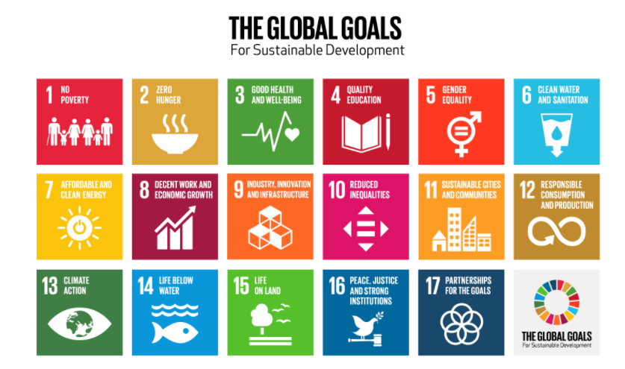
Notes:
Slide 9
I want to say a few words about exactly why accountants are poised to play such an important part in a sustainable future and the protection of the planet.
Professional accountants are in a unique position to make real, impactful change and to stand at the centre of sustainable development – including helping to drive climate action in their organisations.
From making business decisions, to reporting on CO2 emissions, to measuring social impact, the skills, judgement and approach of professional accountants have a vital role in this effort.
Professional accountants are at the heart of decision-making and strategy, playing a critical role in developing credible and resilient businesses that drive long-term value – in ways that are more meaningful than before. They also play a central role in developing, applying, and assuring fast-evolving reporting and auditing standards on value and sustainability.
At ACCA, we’ve made our own organisational commitments to the UN’s Sustainable Development Goals. But our biggest task is ensuring that our members, future members and wider community are equipped with the practical insights, tools, education, professional development opportunities and connections, so that they have the skills and confidence to lead the changes their organisations require to drive positive and sustainable business performance.
In a single generation, sustainability has moved from a fringe issue to one that is top of the list for consumers, investors and society. And we need to make sure that as a profession we are at the heart of the change this is bringing about.
A final word …
The world’s First Industrial Revolution began 250 years ago, and it was powered by steam.
The Second Industrial Revolution began 150 years ago, and it was powered by electricity and oil.
The Third Industrial Revolution began 50 years ago, and it was powered by computers and mass communication.
[Click]

Slide 10

The Fourth Industrial Revolution
We can contribute to work which is rewarding, satisfying and useful - fulfilling our dedication to serve the public good, and leaving a positive legacy for future generations
Notes:
Slide 10
The Fourth Industrial Revolution is happening right now, and it is powered by digital technology, and super-fast connectivity which annihilates borders and makes oceans irrelevant. It means that anyone with a phone or a laptop can carry the world in their hand, and a business in their pocket.
Our future as accountants is to understand that change, respect that change, welcome that change – so that we can play our part as true leaders in our workplaces, equipped with the ideas, skills and ethical integrity which will power a new way of doing business which is sustainable, fair and kind to the planet.
In that way we can contribute to work which is rewarding, satisfying and useful - fulfilling our dedication to serve the public good, and leaving a positive legacy for future generations.
[Click]

Slide 11

Thank you
Notes:
Slide 11
Thank you all so much, and have a great conference.
- ENDS -

