Slide 1


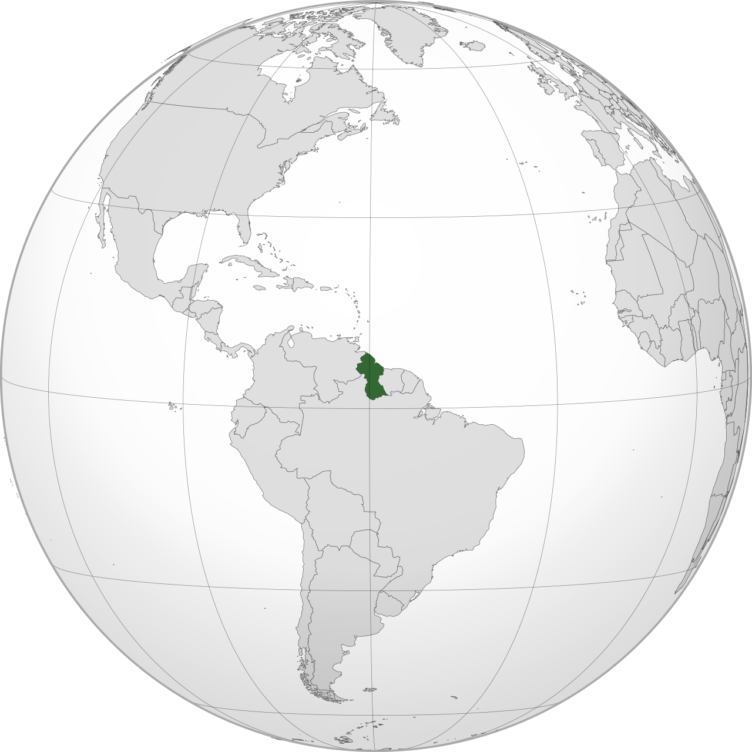

Government of the Co-operative Republic of Guyana
Energy Projects and Development
Martin Jr. Pertab
Gopnauth Bobby Gossai, Jr.
Ministry of Natural Resources
Friday, 24th June, 2021

Slide 2

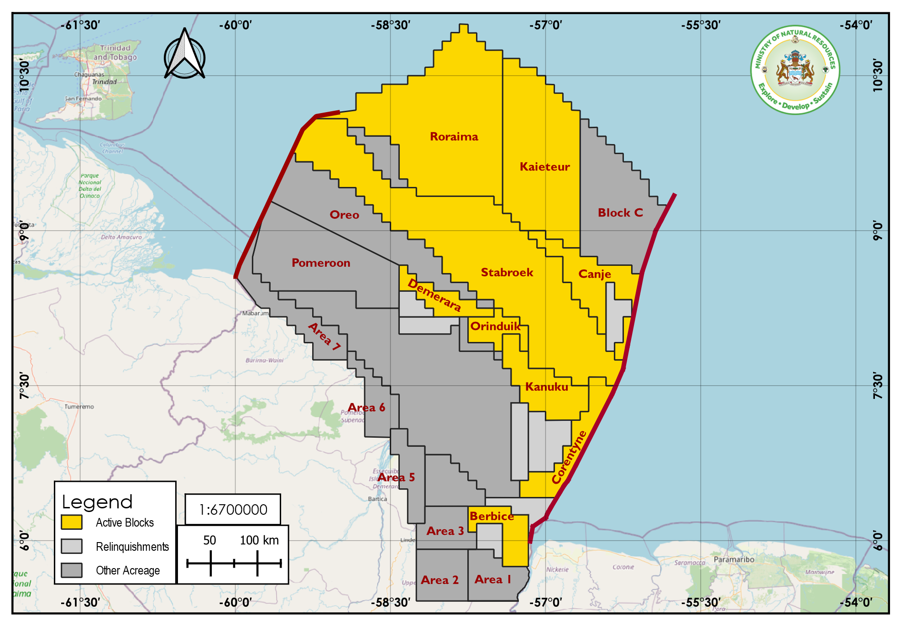
Guyana Oil Blocks
ACREAGE
Total Allocated Acreage:
  ~77, 822 sq. km/
  ~19.2 mil. acres
Total Unallocated Acreage:
  ~82,718 sq. km/
  ~20.4 mil. acres

Slide 3


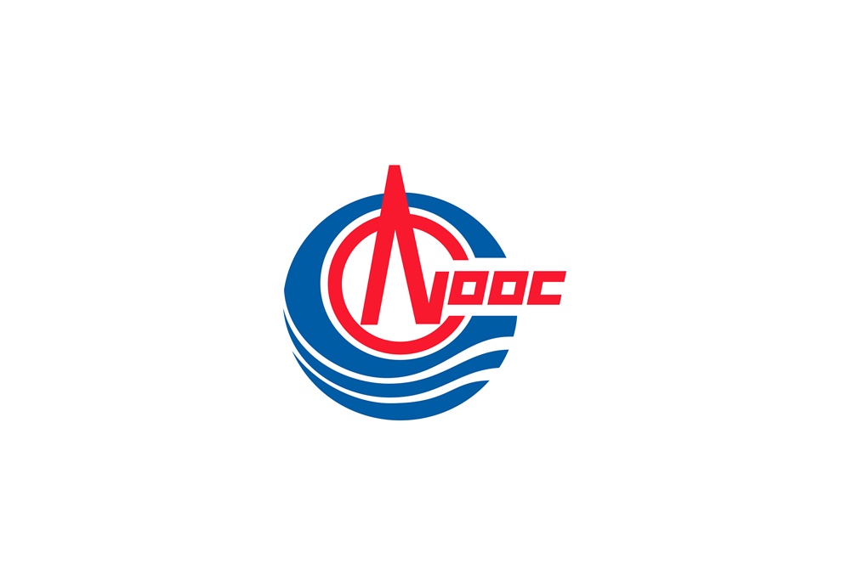
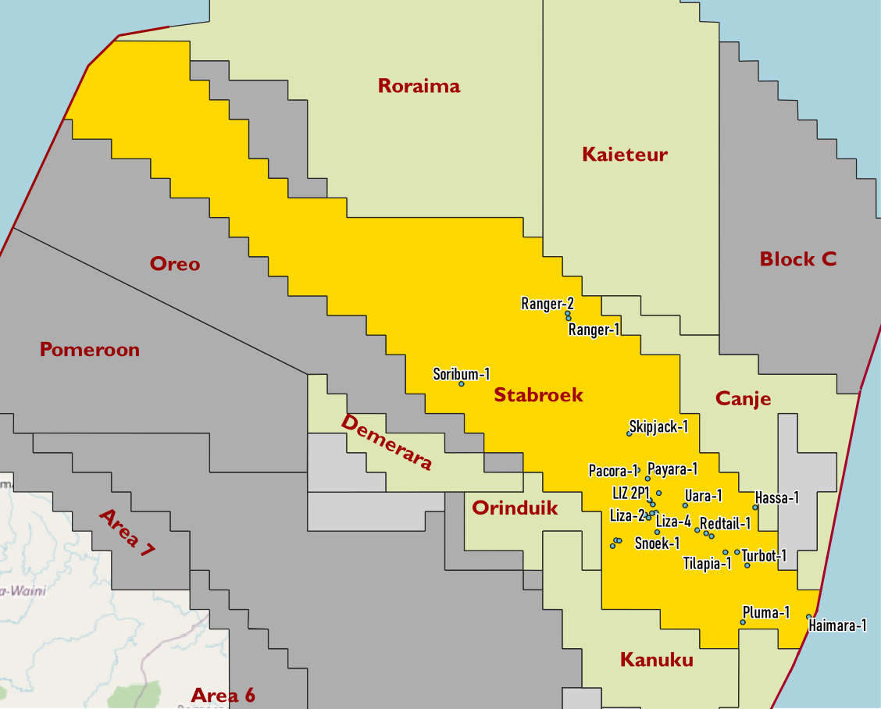
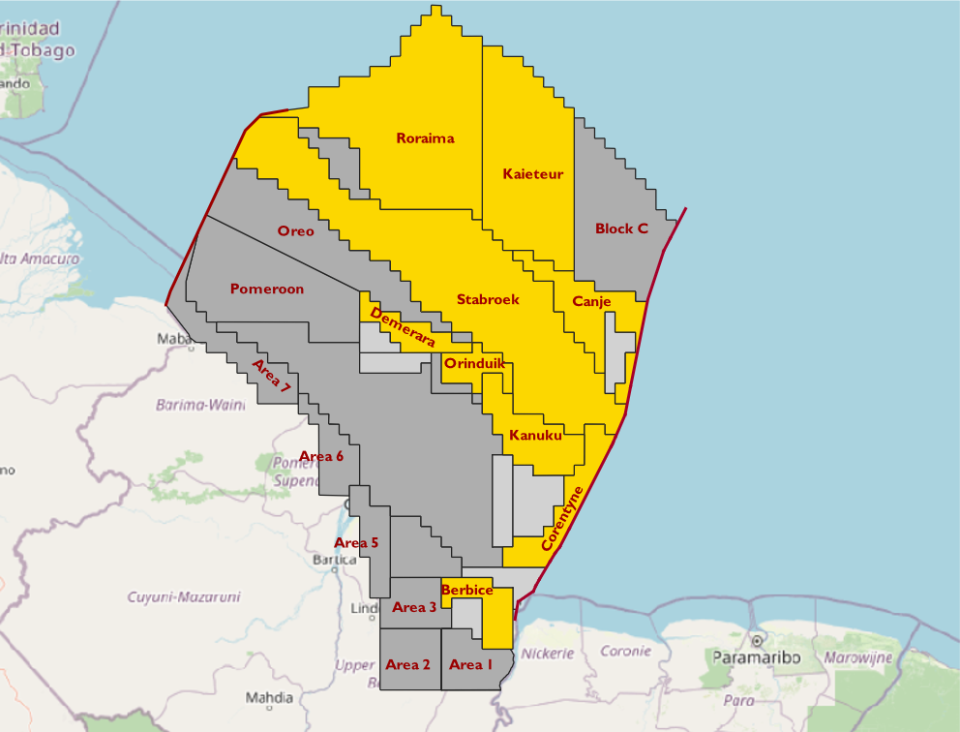
Stabroek Block
SHAREHOLDERS
EEPGL (OP) …………………………………(45%)
Hess Guyana Exploration Ltd. ……………….(30%)
CNOOC Nexen Petroleum Guyana Ltd. ….. (25%)
PETROLEUM AGREEMENTS & AMENDMENTS
Petroleum Agreements
1999 Petroleum Agreement for Stabroek Block | Jun 14, 1999
2016 Petroleum Agreement for Stabroek Block | Oct 07, 2016
Production Licence
Liza Production Licence | Jun 15, 2017
Payara Production Licence | Sep 20, 2020
ACREAGE
Initial Acreage: 60,000 sq. km/ ~14.8 mil acres
3 Prior Relinquishments | Current Acreage ~26,806 sq. km ~6.6 mil. acres
First Oil in December 2019
First Export in 2020

Slide 4
Stabroek Block Development and Outlook - EEPGL
Robust pipeline of future developments
  Four new Guyana discoveries; total resource ~9 Boeb
  Focused exploration on industry-leading basins in Guyana-Suriname and Brazil
Liza Phase 1 achieved nameplate capacity
Liza Phase 2 on schedule for start-up in 2022
  2H21 arrival in Guyanese waters
Payara FID in 2020, start-up in 2024
  Begin topside installation in 1H22
Sixth FPSO producing by 2027
Capturing capital efficiencies through “design one, build many” approach

Slide 5
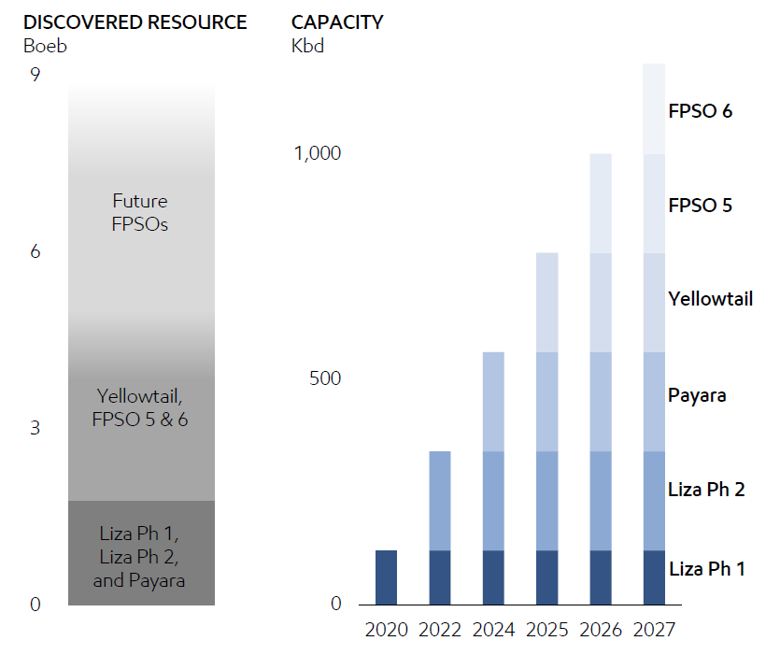
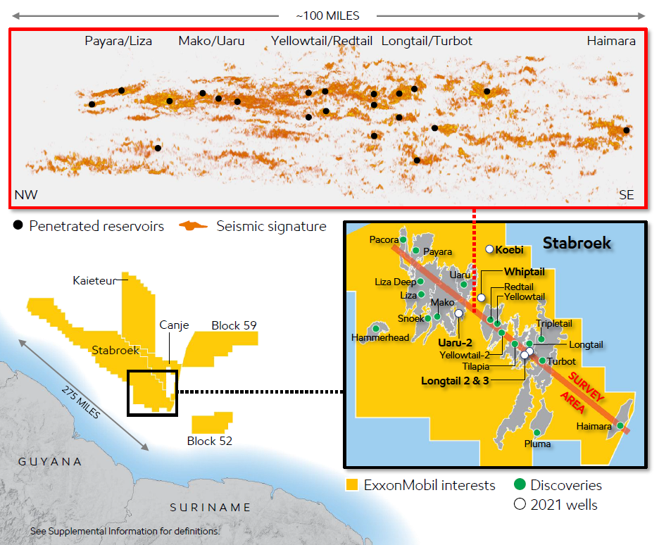
Aggressive Development Schedule
Source: ExxonMobil Investor Day Presentation, March 2021
Notes:
The chart on the left hand side shows the breakdown of our total reserve.
The graph on the righ hand side shows the actual and projected development of the various fields on the level of daily crude oil production. As evident, with the onset of Liza Phase 2, our daily crude oil output would increase to around 300,000 barrel of oil per day while Payara would take us further to roughly 600,000 per day.

Slide 6
Exploration Success Increasing Value of Developments
Stabroek
Size and quality of resource enables:
Highly capital-efficient development
Extended production plateaus through facilities integration
Unmatched flexibility and optionality potential
Significant additional resource potential
New discoveries beneath previously identified resource
Anticipate 10 exploration and appraisal wells in 2021 including Koebi and Whiptail
Largest operated position in Guyana-Suriname Basin
Total basin potential more than 2x discovered resource
Began testing play extensions in 2020-2021
Quality reservoirs and hydrocarbons identified in first wells in Canje, Kaieteur, and Suriname
Notes:
Characteristic of the Stabroek block:
Allows for greater investors return due to highl captial-efficient development, and of course because of the quality and quantity of the crude oil resources that are in the block
By end 2021, we anticipate to add 10 additional exploraiton and appraisal wells
As part of the Guyana-Suriname basin, the total basin potential in twofold more than our proven reserve to data
Testing of the play exension to begin in 2021-2021. In fact, quality reservoirs and hydrocarbons have already being identified in the first wells in Canje, Kaieteur and Suriname

Slide 7
Industry’s Largest Oil-Play Discovered in the Past Decade
Resource
~9Boeb including three additional discoveries in 2020
Exploration
~80% success rate with 18 discoveries
Production
>750Kbd by 2026
GHG intensity
>45%lower than Upstream average in 2025; zero routine flaring by 2030
Cash flow
~$3.5billion of operating cash flow in 2025
Highly resilient
>10% return at <$35/bbl
High return
>20% rate of return
Community support
>2,000 Guyanese supporting developments

Slide 8
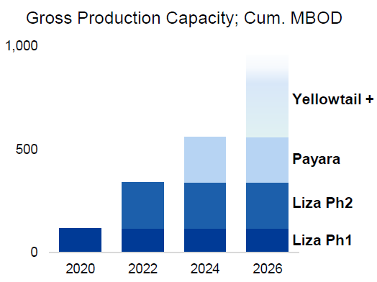
World Class Petroleum Province with Potential for up to 10 FPSOs - HESS
Exceptional reservoir quality and low development costs
Liza Phase 1 ~$35/bbl breakeven oil price
Liza Phase 2 ~$25/bbl breakeven oil price
Payara ~$32/bbl breakeven oil price
Progress Liza Phase 2 and Payara developments
Active Exploration and Appraisal program in 2021
Liza Phase 1 gross development costs reduced from $4.4 billion to $3.5 billion
Liza Phase 2 and Payara developments on track to start up in early 2022 and 2024, respectively.
Source: HESS Credit Suisse Energy Summit, March 2021

Slide 9
Guyana’s Petroleum: Sensitivity Analysis
Oil Price Volatility and Stability
Good position to drive future hydrocarbon production
Consistent exploration success
Adjust its fiscal terms for future contracts to better reflect the de-risking of the country's subsurface.
Competitive Bidding and Auctions for other oil blocks (offshore and onshore)
Major challenge ahead: Maximizing the Economic Benefits for the Country.

Slide 10
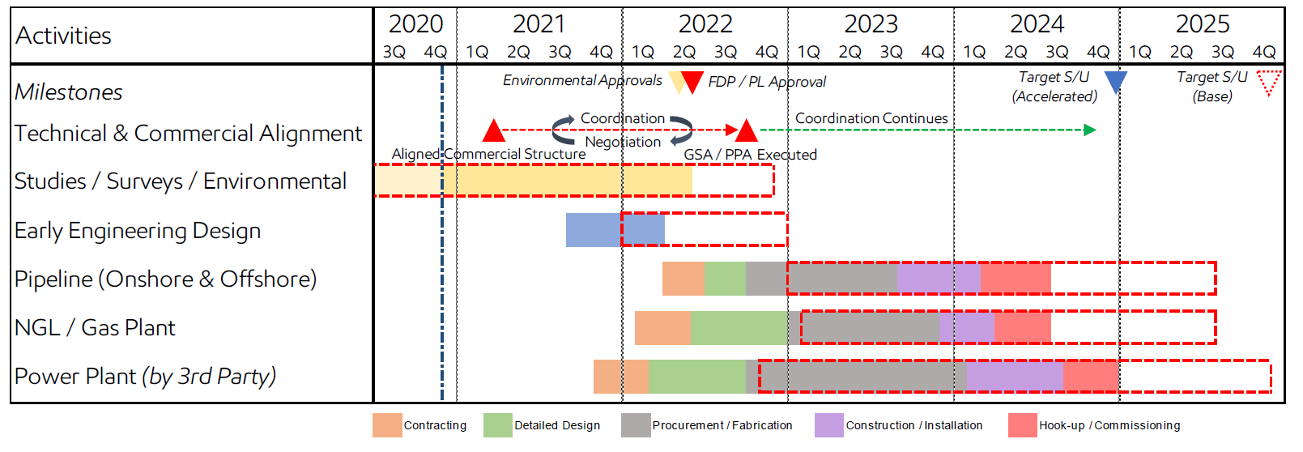
Gas to Energy Project

Slide 11
Thank You For Your Attention!
Questions, Comments, Discussions…

