Slide 1
The Future Fit CFO
Tim Herrod
IFAC Professional Accountants in Business Advisory Group and CPA Canada
25 June 2021
Institute of Chartered Accountants of the Caribbean

Slide 2
“Future-Fit” CFO: Four Major Themes
Value: Strategic versus tactical
Orientation: Future versus past
Role: Enabling business partner versus policy/budget police
Future Skills and Capabilities: Different AND more valuable

Slide 3
Finance Enabling and Sustaining Value Creation
Value
Value framework example. Aligned to customer, business and stakeholder value. What you are, what you’re trying to be and do for your customers, as a business, underpinning strategy, behaviors, capital allocation, etc.
Perceived Value
Enable the Finance function to be a real value enabler for the business:
Create, enable and sustain competitive advantages:
Cost visibility, analysis and reduction; governance and risk: for the business and Finance operation.
Revenue growth and gross margin optimization: what to do and not do, insights, guidance and support for high quality decision making. More strategic.
Perceived value creation: brand and reputation enhancing activities, corporate social responsibility (including DEI) and accountability, rapid acquisition integration + synergy delivery. Most strategic.
Price/Revenue
Margin Growth
Cost/COGS
Source: Adapted from Section4

Slide 4
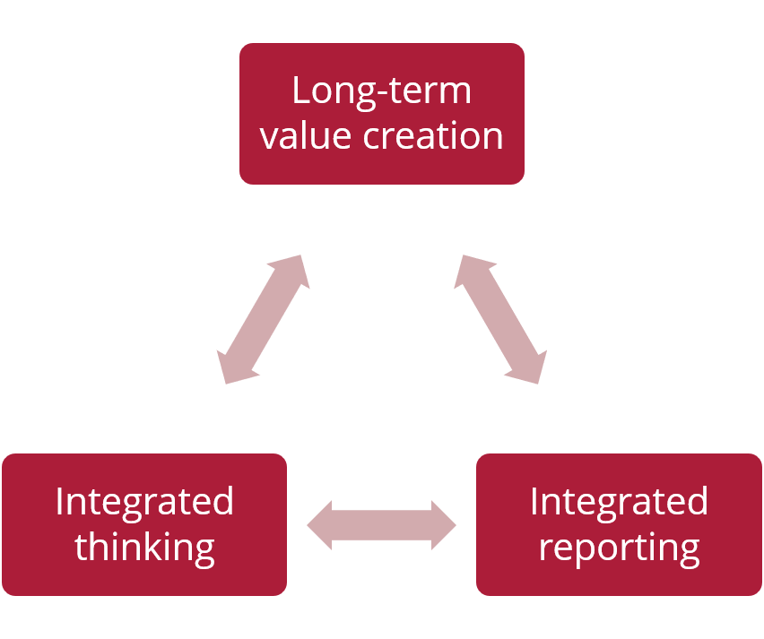
Orientation
Living a ‘Chief Value Officer’ Mindset
Translating purpose into future-oriented quantitative and qualitative decision frameworks for the organization
Rapidly adapting to stakeholder expectations of high- value versus low-value activities for Finance
Modern processes and digital tools for a lean function (accounting for the past), redirecting capacity closer to decisions (future value delivery)
Providing insights on risks and opportunities to long-term value creation, where new models are required, e.g.:
Intangibles like relationships, intellectual capital, innovation capabilities
Sustainability and the SDGs
Enabling integrated thinking and reporting
Managing priorities for value creation and sustainment
Notes:
How business creates value and measures and communicates its impact on society has become an integral part of thinking about business purpose and success through a multi-stakeholder lens. CFOs and the finance community need to take into account a wide range of issues and priorities into decisions. Financials only tell a part of the value creation story. An initiative could have a positive NPV but might not be advisable when considering the impact on other forms of capital and stakeholders.
This change of mindset is epitomized by the chief value officer role - where CFOs and accountants have a mindset and focus on value creation and protection beyond financial performance and shareholder returns. Sustainable finance and the increasing focus business delivering sustainable solutions will mean that financial decisions including lending and investment, will also be increasingly tied to sustainable outcomes and meeting stakeholder needs.
As a CVO, CFOs will be more attuned to how the company is meeting a societal need and responding to key trends, will be focused on all key stakeholder relationships – suppliers, customers, employees as well as investors, and thinking about how to balance value distribution across these groups – e.g., government (taxes); shareholders (dividends) and debtors (interest); incentives for executives (performance-related pay) and wages and benefits to employees; and the organization (retained income for reinvestments and depreciation for reinvestment in machinery and equipment).
No more are we just finance professionals: we must transition to managing priorities and accountability based on a range of information and use integrated thinking and reporting principles to better understand and communicate our value creation and impact across all relevant parts of the business. As chief stewards of business information, we need to bring together financial and non-financial information in our analysis and communication around the business and its performance across different dimensions.

Slide 5
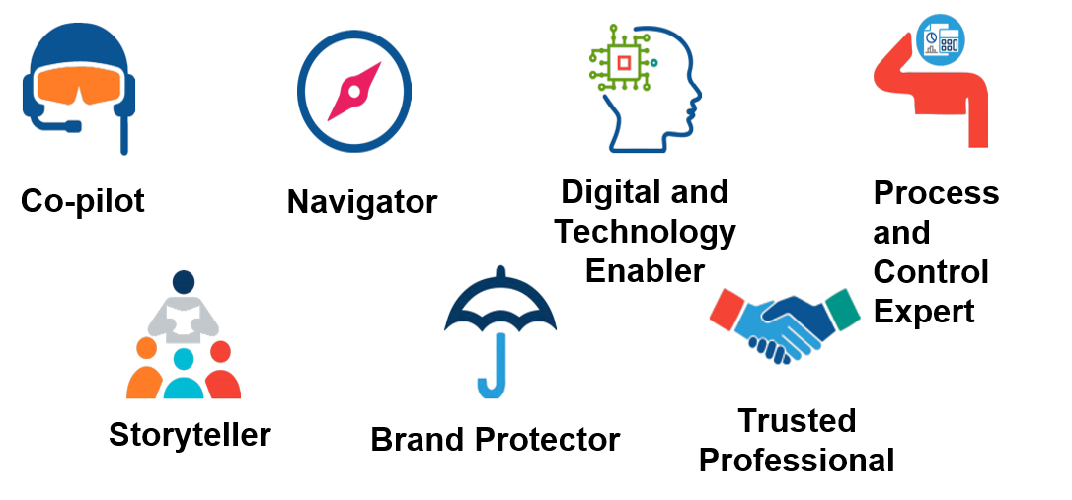
Role
What CFO/Finance Office roles will maximize value?
Notes:
Accountants need to adapt to their changing environment. Eliminating manual-based accounting roles provides the opportunity to shift to broader value-added roles.
IFAC identified seven key roles for finance and accounting professionals to retain relevance and enhance their contribution to strong, sustainable organizations, financial markets, and economies.
Co-pilot – is a strategic leader (e.g. CFO), and a change facilitator, influencing people and decisions. They are actively involved in all significant business decisions and major initiatives to drive change and growth.
Navigator – helps steers an organization toward value creation and sustained profitability by providing decision relevant and actionable insights.
Brand protector - Protects an organization and its reputation through stewardship of tangible and intangible assets and financial and non-financial performance.
Storyteller - enlightens internal and external stakeholders on the organization’s narrative, how it creates value over time, and the opportunities and challenges it faces.
Digital and technology enabler - enables a cognitive and data-driven business that utilizes digitalization, including automation, artificial intelligence and data, in ways that drive decisions and growth.
Process and control expert - ensures efficient and effective end to-end processes and work flows within and across finance and the organization.
Trusted professional - challenges the organization, and themselves, when needed with professional objectivity.

Slide 6
Future Skills
Future Finance Skills and Capabilities, Now
Finance must come to the table with relevant capabilities to enable and support the speed of business in a VUCA world (volatile, uncertain, complex, ambiguous)
Best positioned to define high quality, future-impacting business decision making, while implementing and overseeing new tools and proper data governance
This requires optimal blend of interpersonal, business, technical and technology skills:
Leadership: Vision, ambition, purpose, inspiration, empowerment, encouragement, self-awareness
Business: Commercial/competitive awareness and acumen, strategic context and value-chain thinking
Partnering: Communication, collaboration, trust and relationship building, story-telling, negotiation, influencing without authority
Analysis: Problem-solving, best practices/benchmarking, business process improvement, decision-making
Technical: Planning and forecasting, risk, performance and value management, advanced analytics and modeling and statistics
Technology: End-to-end enabling digital and data literacy
Notes:
We know from recruiters that there are chronic shortages of accounting and finance professionals with right blend of technical, business and interpersonal skills for finance leadership and business partner roles
Digitalization is making skills shortages more acute
Demand for higher level cognitive skills and skills for collaboration and relationship building that enable a broader business partnership role in value creation
Entrepreneurial / business and stakeholder focus key
The key talent and skills that companies are seeking to support effective business partnering and digital business
Partnering: communication, story-telling, influence, relationships
Technology: digital and data literacy in all professional roles – we need to be able to talk the language of IT
Analysis: problem-solving, thinking out-of-the-box, decision-making
Technical: planning and forecasting, business analysis, risk, performance and value management
Business: commercial awareness and acumen, adaptability, strategic thinking
Leadership: Self-awareness, determination, change management
Skills required by employers are evolving rapidly. Recruitment is increasingly focused on desired behaviors rather than skills alone, with a premium on those who work effectively with uncertainty and ambiguity, and across functions.
How we learn and develop also needs to change in the CV-19 era
Technology-driven learning
Focus on leadership & interpersonal skills in a remote working environment
Identifying critical skills: digital, social & emotional, skills that support adaptability & change
Reinventing skills to emerge stronger by changing what we do & how it is delivered

