Slide 1

Discipline Misconduct and Enforcement – Part I
Adrianna McDonnell
ACCA
21/09/2018

Slide 2
Overview – aim of both sessions
Underlying principles of the modern regulatory and disciplinary landscape
Public interest v member interest where and how that falls when dealing with disciplinary and regulatory matters
Misconduct
How these guiding principles translate in practice pre Tribunal and at Tribunal; some ‘dos’ and ‘don’ts’

Slide 3
Recap - The Common Framework
Screening
Investigation
Hearing (examples: Disciplinary, Health, Interim Orders, Admissions and Licensing, Case Management meetings)
Appeal

Slide 4
Recap - Grounds for Disciplinary Action – General
Misconduct
Breach of the rules
Breach of principles or codes
Criminal conduct
Incompetence
Health
Insolvency
Conduct in public office

Slide 5
Fairness, Due Process, Article 6 and SM06 requirements
Art 6(1) of the ECHR as applied to public authorities by Human Rights Act 1998, provides that:
‘in determination of his civil rights and obligations…everyone is entitled to a fair and public hearing within a reasonable time by an independent [my emphasis] and impartial tribunal…..’

Slide 6

Independence and
Impartiality

Slide 7
Independent Tribunal
ECtHR has summarised its requirements as follows:
In determining whether a body can be considered “independent” notably of the executive and of the parties to the case – regard must be had to the, inter alia, to the manner of appointment of its members and duration of their term of office, the existence of guarantees against outside pressure and the question of whether the body presents an appearance of independence…..
Phoska v Poland [2012] ECHR 4

Slide 8
Independent Tribunal
The right to an independent tribunal is unqualified. It is not to be subordinated to the public interest in the detection and suppression of crime.
Montgomery v HM Advocate and Another [2003] 1 AC 641
.

Slide 9
Factors for independent Tribunal
  Inclusion among the members of the tribunal of persons from outside the profession
  Lay member majority (or independent Chairman to have casting vote)
  Appointment of tribunal members from outside the profession or regulator
  Security of tenure- reasonable period
  Outside training and appraisal

Slide 10
Impartial Tribunal – conflicts/bias
Impartiality is different to independence
Lord Browne Wilkinson in the House of Lords in the case of R v Bow Street Metropolitan Stipendiary Magistrates ex parte Pinochet Ugarte No 2 [2000] 1 AC 119:
The fundamental principle is that a man may not be a judge in his own cause. This principle, as developed by the courts, has two very similar but not identical implications. First it may be applied literally: if a judge is in fact a party to the litigation or has a financial or proprietary interest in its outcome then he is indeed sitting as a judge in his own cause. In that case, the mere fact that he is a party to the action or has a financial or proprietary interest in its outcome is sufficient to cause his automatic disqualification.

Slide 11
Impartial Tribunal – conflicts/bias continued
Lord Browne Wilkinson in the House of Lords in the case of R v Bow Street Metropolitan Stipendiary Magistrates ex parte Pinochet Ugarte No 2 [2000] 1 AC 119:
The second application of the principle is where a judge is not a party to the suit and does not have a financial interest in its outcome, but in some other way his conduct or behaviour may give rise to a suspicion that he is not impartial, for example because of his friendship with a party. This second type of case is not strictly speaking an application of the principle that a man must not be judge in his own cause, since the judge will not normally be himself benefiting, but providing a benefit for another by failing to be impartial.

Slide 12
Impartiality and conflict
The 2nd Lord Browne-Wilkinson principle:
Prior knowledge of the member
Knowledge of a witness
Lenient and/or hostile questioning
Body language
Prior involvement in the issue
Prior involvement in separate proceedings
Representative interest
Informal contacts
Biased questioning/ remarks during the Hearing
Falling asleep!

Slide 13
Fair minded and informed observer
Bias in a tribunal member is to be judged by the views of the fair minded and informed observer
The appearance of bias is as important as actual bias
Porter v McGill [2001] UKHL 67

Slide 14
Steps to avoid conflict/bias
All members of the tribunal should examine the papers as soon as they are received
If any concerns: recuse or disqualify themselves
Or bring the matter to the attention of the parties for submissions
Systems in place that record whether panel member has sat on the case previously
Systems that ask for formal declaration within specified time
Names of panel members publicised
Conflict and impartiality training provided in advance of first sitting

Slide 15
Further rights of the member
Right to understand the case against him
Right to be present
Right to be represented (but not to be provided with representation)
Right to cross examine
Right to call witnesses
Right to appeal

Slide 16
Knowing the case against him – Allegations
The first right of the respondent in a properly regulated tribunal is to be informed of the allegations (charges) against him – natural justice requires this.
Article 6(a) of the ECHR, which provides the defendant before the tribunal of a public authority with a right:
….. to be informed promptly, in a language which he understands and in detail, of the nature and cause of the accusation against him. ECtHR have accepted this applies to disciplinary proceedings notwithstanding the provision is confined to criminal proceedings.

Slide 17
Allegations and evidence
Evidence must also be supplied to the member, this is normally done once the allegations are perfected but certainly by the time a hearing is scheduled and in advance of the hearing.
Evidence must relate to the allegations only, and you must avoid prejudicial material. To do so could cause an adjournment or at worst cause the case to collapse.

Slide 18
Adequacy of the particulars of the allegations
The member must understand the allegations and the case against him so as to prepare his defence and answers to the case
An allegation must contain:
A statement of the offence that:
(i) describes the offence in ordinary language and identifies any legislation/regulations that creates it
(ii) Outline in summary form the factual particulars of the offence and to make clear what rule or provision this has breached and the resultant and/or cumulative outcome e.g. misconduct

Slide 19
Allegations
Liable to disciplinary action by virtue of Bye Law
by virtue of facts 1, 2 & 3 you have breached this rule/code
As a result of any or all of these breaches you are guilty of misconduct

Slide 20
Documentation and evidence
All relevant paperwork to support the allegation must be disclosed to the member
On-going duty of disclosure; including disclosure of any matters that undermine your case
Witness statements
Certificate of convictions
Attendance notes by the investigators, though independent documentation is preferable

Slide 21

Misconduct

Slide 22
Misconduct – underlying principles
No standard definition, but it is wide in its remit.
‘Epithet misconduct’- broad formula that leaves it to the tribunal to decide the ambit in any particular case.
This is as opposed to individual offences of a narrowly defined scope.
This has the advantage of being able to reflect current market and/or societal standards.

Slide 23
Misconduct
ACCA refers to discredit but not limited to this.
Courts have provided guidance, and these are the principles referred to by decision makers either at first instance or in the higher courts in the UK (and in other jurisdictions).

Slide 24
Misconduct- approach
‘It has been said that ‘misconduct’ is a word of general effect, involving some act or omission which falls short of what would be proper in the circumstances.
The standard of propriety may often be found by reference to the rules and regulations ordinarily required…. by the particular profession.
Lord Clyde in Roylance v GMC [1999] Lloyds Rep 139
Importantly the public interest criteria plays a key consideration when looking at all the circumstances.

Slide 25
Professional work only?
‘Lord Clyde went to say:
Professional conduct extends further than [clinical conduct]. So it is not simply misconduct in carrying out medical work which may qualify as professional misconduct…… professional misconduct may arise where the conduct is quite removed from the practice of medicine, but is of a sufficiently immoral or outrageous or disgraceful character.

Slide 26
Single Incident and Course of Conduct
….as a matter of law one error could be capable of constituting misconduct, though whether in fact this constitutes misconduct such as to render a person unfit to remain on the register must depend on the precise evidence taken as a whole and the Committee’s view of that evidence.
Lord Justice Scrutton: R v Statutory Committee of the Pharmaceutical Society of Great Britain (1986)

Slide 27
Misconduct and Single Incident
‘In Calhaem R v GMC [2007] EWHC 2606 Jackson J:
Mere negligence does not constitute misconduct
A single negligent act or omission is less likely to cross the threshold of misconduct than multiple acts or omissions
Single incident unless very serious unlikely to amount to misconduct

Slide 28
Single Incident/s and Inadvertence
A serious single act could amount to misconduct
A series of minor errors/omissions may cumulatively amount to misconduct
These types of cases may be more suited to ‘competency’ issues –unless rules provide that lack of competence could amount to misconduct
A genuine mistake may not amount to misconduct but if the consequences are serious that would not be the case

Slide 29
Misconduct- member’s responsibility
Caution against blaming junior members
The more senior the greater the responsibility
More so if your rules and regulations say you are responsible - it still falls to the more senior member
Client gave me permission – not a defence
May amount to mitigation

Slide 30
Discipline Misconduct and Enforcement – Part II
Adrianna McDonnell
ACCA
21/09/2018

Slide 31
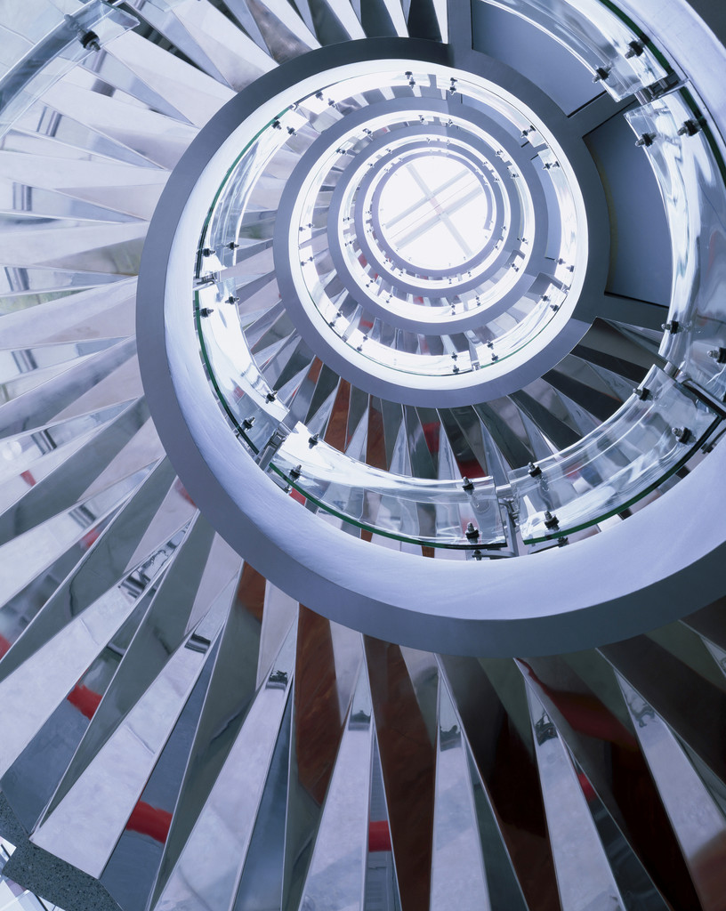
The Tribunal

Slide 32
Composition of a Tribunal
Uneven number
Lay majority
Legal Advisor
Confidentiality of the retiring room
Voting should not be disclosed
A tribunal should not be drawn into giving dissenting reasons (except where the rules allow)
Confidentiality of the retiring room
Open recruitment process
Arms length appraisal process

Slide 33
The Legal Advisor
Suitably qualified
Independent of the panel
Does not take part in the decision making
Retire or not to retire with the panel?
Panel are arbiter of facts; legal advisors deal with matters of law
Advice must always be on the record
Ensures fairness in the proceedings

Slide 34
The panel – decision making
The Courts have said:
That a disciplinary tribunal should play a more proactive role than a judge in a criminal trial in making sure that the case is properly presented and that the relevant evidence is placed before it. This is particular so with an unrepresented member.
Important caveats:
In particular, not to speculate and/or enter into the domain of the advocate, not to cross examine.

Slide 35
Decision making of the tribunal
Burden of proof- civil standard - balance of probabilities
Sequential approach: facts = a breach = misconduct → sanction, costs and any other interim points of law
Avoid ‘fishing expeditions’
Hear from all the parties first - before questions
Not inquisitorial- questions for clarification
Must not stand in the shoes of the advocate for either party
Avoid all appearance of bias
Ensure all legal advice is on the record

Slide 36
Procedures of the Tribunal – Equality of Arms
Introductions and explanations
Allegations read to the member
Member admits or not
If admissions made – declarations found proved on the admissions
Opening argument by the presenting officer
Examination in chief of prosecuting witnesses
Cross examination of prosecuting witnesses

Slide 37
Procedures in Tribunal
Examination in chief of members witnesses
Cross examination of members witnesses
Questions for clarification by the panel
Closing arguments prosecution
Closing argument member
Panel retire
Panel announce findings on allegations (facts and misconduct)

Slide 38
Procedures in Tribunals
Arguments in mitigation by the member
(in some instances prosecution may make submissions on sanction)
Any questions for clarification
Costs
NB - respondent/member must always have the last word….
NB - judge craft of the panel/Chairman

Slide 39
Notice and proceeding in absence
A member is entitled to fair notice
A member has, in general, a right to be present at his trial, and a right to be legally represented.
Those rights can be waived, separately, or together, wholly or in part
The tribunal has discretion to decide whether to proceed in the absence of the member
Two stage process, whether notice has taken place and fair to proceed – must not be a rubber stamping exercise.

Slide 40
Service & Exercising discretion to proceed in absence
R v Hayward approved by the privy Council in Tait v Royal College of Veterinary Surgeons [2003] UKPC 34:
In exercising that discretion, fairness to the defence is of prime importance but fairness to prosecution must be taken into account
Regard must be had to all the circumstances in the case, the case sets out 10 different considerations.
Voluntarily absent

Slide 41
Adjournments
Difficult balancing act, the standing and reputation of the member in the ‘palm’ of the panel’s hands. It should not be a mechanical exercise of merely looking at the delays and reasons.
The guiding principle is one of justice to both parties. But neither the member nor his representative should be permitted to frustrate the objective of a speedy trial without substantial [my emphasis] grounds.
R v Hereford Magistrates Court [1997] 2 WLR

Slide 42
Adjournment medical grounds
Brabazon-Drenning v United Kingdom Central Council for Nursing, Midwifery and Health Visiting (2000) LTL 4/1/2001
The Divisional Court (Rose LJ, Elias J);
…. save in very exceptional circumstances where the public interest pointed strongly to the contrary, it was wrong for a committee which had the livelihood and reputation of an individual in the palm of its hand to go on with a hearing when it had unchallenged medical evidence before it that an individual was simply not fit to withstand the rigours of the disciplinary process. In this case there was both a breach of natural justice and of Art.6 European Convention on Human Rights.
However, there must be clear medical evidence produced
If the panel is in doubt about medical reasons, they must say so

Slide 43
Adjournments
Examples of doubtful grounds:
Holidays
Lack of availability generally- not for the respondent to dictate the date
Preferred legal representation not available
Need more time to prepare – fact sensitive

Slide 44
Sanction and
Costs

Slide 45
Sanction
Sanction is not about punishment!
Courts have held time and again.
A principal purpose of the panel’s jurisdiction in relation to sanctions is the preservation and maintenance of public confidence in the profession rather than retributive justice.
Fatnani &Another v GMC [2007] EWCA

Slide 46
Sanction
Set out in the rules
Important to have accompanying guidelines and policies
Tariff system v bottom up approach- the latter is generally regarded as the most progressive and in line with overarching principles
Duty is on the member to put forward his mitigation – he who asserts.
Fines are a sanction so ability to pay is not determinative, rather it should reflect the gravity of the misconduct and can be combined with another sanction

Slide 47
Costs
Costs are not part of the sanction framework
An order for costs may compromise of:
Reasonable legal expenses
Reasonable legal expenses of party’s witnesses
The cost of the investigation including fees and expenses of any expert witnesses
The costs of the tribunal

Slide 48
Costs
Schedule of costs must be provided by those who are claiming the costs
In defending the costs the member may challenge the reasonableness, and importantly where he asserts financial hardship, the duty is on him to provide the evidence and to ensure it is readily available
Use of pro –formas, guidance and/or Case Management forms are useful for assessing costs

Slide 49
Costs- special position of a regulator
Ordinarily costs follow the event, however in disciplinary proceedings a different approach applies:
Paul Baxendale-Walker v Law Society [2007] EWCA Civ 233
The Court of Appeal held that in regulatory proceedings, costs should not automatically follow the event. The regulator should not be treated as an ordinary party to civil proceedings. Except where a complaint is improperly brought, the Court should consider that the regulator is acting in the public interest for the maintenance of proper professional standards.
Unless it was “shambles from start to finish”
See Gorlov v Institute of Chartered Accountants [2001] EWHC Admin. 220

Slide 50
Costs special position of a regulator
The courts have consistently upheld this principle, see:
Murtagh v Solicitors Regulatory Authority [2013] EWHC 2024 (Admin)
Solicitors Regulatory Authority v Libby [2017] EWHC 973

Slide 51
Reasons and Publicity

Slide 52
Reasons
There is no general duty to give reasons, however:
Lord Clyde in Stefan v GMC:
.. that what were once seen as exceptions to the rule may now becoming the norm.
Importantly, having regard to Art 6 and SM06, member is entitled to a ‘reasoned judgment’.
The discussion tends be around the adequacy of reasons

Slide 53
Adequacy/Sufficiency of reasons
Reasons will be generally be sufficient if they demonstrate to the parties why the won or lost and to explain to any appellate jurisdiction what facts they found proved
They need not be at all lengthy and where credibility was in issue it would usually not be necessary to do more than indicate that the evidence of a particular witnesses was accepted
When evidence had been given on particular matters and especially where the appellant had been cross-examined about them, it might be unnecessary for the panel to do more than indicate its conclusions if it was apparent from the transcript why the particular decision had been reached.

Slide 54
Public Hearing / Publicity
‘publicity is the very soul justice’
Nowadays default position is that hearings are in public, and full publicity follows.
It is now considered that the public interest is served by open justice, and that only very significant public interest criteria can defeat publicity.
Health reasons or danger to any of the parties or market destabilisation might be significant public interest criteria to stop publicity, but nowadays it is very rare.

Slide 55
Delays
In disciplinary matters courts have given wide remit on delay
Every regulator has faced the ‘delay dilemma’
Develop realistic but challenging KPIs
Attack the backlog
Look at recognised business methodology Lean 6 etc
Get it right first time
Tracking alert – Red, Amber, Green (RAG systems)
Delineated case differentiation- one size does not fit all.

Slide 56
And finally
In the seminal case of Bolton v Law Society [1994] 1 WLR 512 CA
Sir Thomas Bingham MR
A profession’s most valuable asset is its collective reputation and the confidence which that inspires…. the reputation of the profession is more important than the fortunes of any individual membership. Membership of a profession brings many benefits, but that is part of the price.

Slide 57
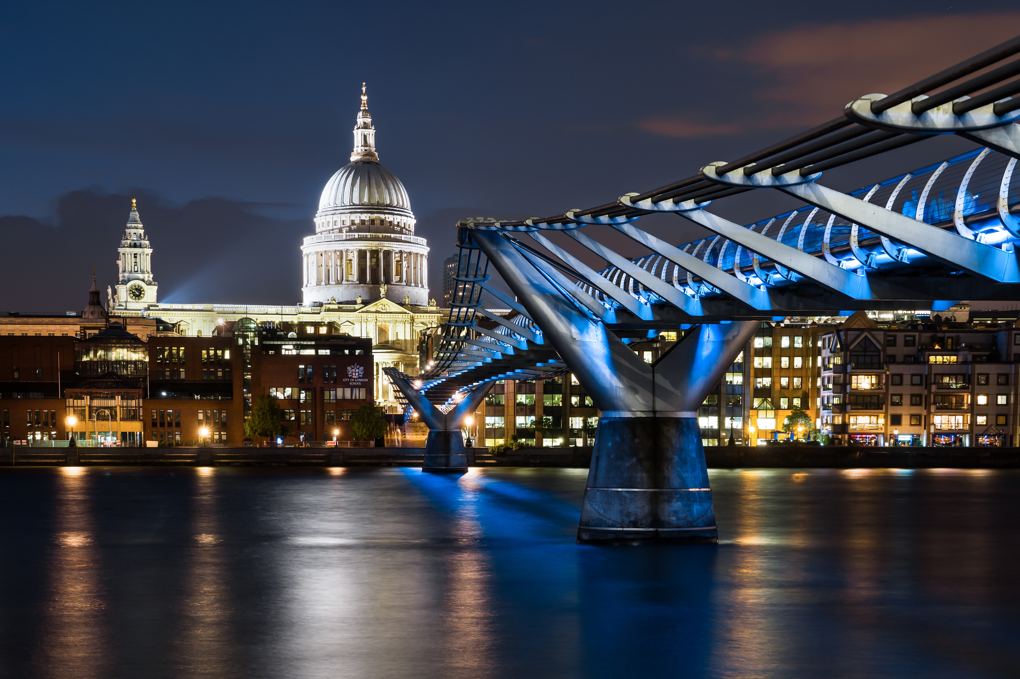
https://www.accaglobal.com/uk/en/member/standards/committees.html
ACCA’s guidance on Hearings, service, sanctions, publicity

Slide 58
Thank you
Questions

